Slide 1
Introduction to
Common Operational Datasets
(CODs)
Presenter: Kristina MacKinnon
Facilitator: Marion Orchison
Office for the Coordination of Humanitarian Affairs
August 2020

Slide 2
Topics
What is a COD and Core COD
The value of P-codes
What are Country Specific CODs
COD Partners
Where can CODs be found

Slide 3
WHY ARE CODs IMPORTANT?
Notes:
CODs are more than a dataset. They …
1. Provide coherence between all partners working on humanitarian preparedness and response
2. Facilitate the exchange and harmonization of data and information
3. Facilitate informed decision-making both before and after the crisis
4. Reduce duplication of work on baseline data by partner organizations
= Allow for a common operational picture of the crisis

Slide 4
IASC definition of CODs (2010)
Predictable, core sets of data needed to support operations and decision-making for all actors in a humanitarian response
Identified and maintained prior to an emergency as part of data preparedness
Made available by OCHA (or pre-agreed in-country alternate) within 48 hours of a given humanitarian emergency
Meet minimum criteria for format and attribute information in accordance with national standards
OCHA … will facilitate the distribution of the “best” available common operational and fundamental datasets
IASC Guidance on CODs, 2010

Slide 5
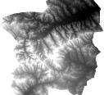
COD guidance (2016)
Pop Male Fem
3800 1900 1900
3600 1800 1800
3200 1600 1600
2800 1400 1400
2600 1300 1300
2400 1200 1200
2200 1100 1100
Pop Male Fem
3800 1900 1900
3600 1800 1800
3200 1600 1600
2800 1400 1400
2600 1300 1300
2400 1200 1200
2200 1100 1100
Admin boundaries
Population figures
Caseload figures
Populated places
Transport
Hydrology
Elevation
IASC Guidance on CODs, 2016
Notes:
The seven old COD FOD Data themes. Core CODs are the only datasets without ‘X’

Slide 6
COD guidance (2016)
Pop Male Fem
3800 1900 1900
3600 1800 1800
3200 1600 1600
2800 1400 1400
2600 1300 1300
2400 1200 1200
2200 1100 1100
Pop Male Fem
3800 1900 1900
3600 1800 1800
3200 1600 1600
2800 1400 1400
2600 1300 1300
2400 1200 1200
2200 1100 1100
Admin boundaries
Population figures
Caseload figures
Populated places
Transport
Hydrology
Elevation
Health Facilities
Schools
Power lines
Earthquake epicenter
Core CODs
IDP/Refugee Camps
Storm path
Dams
Country Specific CODs
IMWG Guidance on CODs, 2016
Notes:
Rational for change
more data consistently available online (SRTM- elevation, OSM, etc)
Resources required to manage all CODs was high and Core CODs are true CODs/required by all
Partners at global level agreed, data should be made available via IMWG and via HDX
Core CODs, needed in their entirety in all operations and high-risk countries
Admin boundaries
SADD population
Country-specific CODs
Depending on a country’s risks, capacity or event
Caseload figure
are by definition not a ‘preparedness dataset’ and have since been defined through their own guidance under the IMWG

Slide 7
Core CODs
Pop Male Fem
3800 1900 1900
3600 1800 1800
3200 1600 1600
2800 1400 1400
2600 1300 1300
2400 1200 1200
2200 1100 1100
Pop Male Fem
3800 1900 1900
3600 1800 1800
3200 1600 1600
2800 1400 1400
2600 1300 1300
2400 1200 1200
2200 1100 1100
Admin boundaries
Population figures
Caseload figures
Notes:
OCHA provides global oversight of two core Common Operational Datasets - administrative boundaries and sex- and age-disaggregated population data - and is responsible for making them available through a public platform or service. OCHA will ensure these data are maintained for countries that are risk-prone or have ongoing humanitarian operations.

Slide 8
Core CODs in initial response
Pop Male Fem
3800 1900 1900
3600 1800 1800
3200 1600 1600
2800 1400 1400
2600 1300 1300
2400 1200 1200
2200 1100 1100
Event
Humanitarian Profile
(Affected Population)
(Humanitarian Caseload)
People
in Need
People
Targeted
Admin boundaries
Population figures
Pop Male Fem
3800 1900 1900
3600 1800 1800
3200 1600 1600
2800 1400 1400
2600 1300 1300
2400 1200 1200
2200 1100 1100
Admin boundaries
Population figures
Notes:
Core CODs should be made available during preparedness as they are so critical at the beginning of an emergency for the calculation of initial affected population.

Slide 9
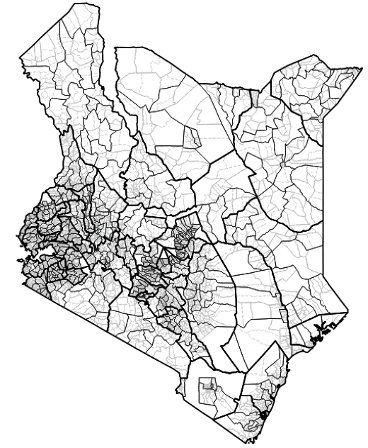
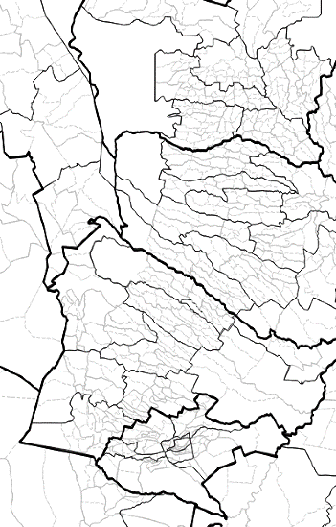
Administrative Boundaries COD-AB
Notes:
Here’s what four levels of admin boundary in Kenya look like
The COD-AB is the workhorse of the CODs,
a spatial dataset that can:
inform a common operational picture
provide a base layer for maps
provide a dataset for spatial analysis (e.g., when linked to the COD-PS allows estimates of affected people in a storm path or near an earthquake epicenter, or assessment locations)
2. a dataset that can provide a framework in all phases of the Humanitarian Program Cycle (HPC)
data collection (e.g., 3W monitoring data)
analysis (e.g., secondary data analysis)
for assessment locations in collection tool (e.g., Kobo Collect)
for humanitarian systems (e.g., Humanitarian Response, Humanitarian ID, Response, Planning and Monitoring)

Slide 10
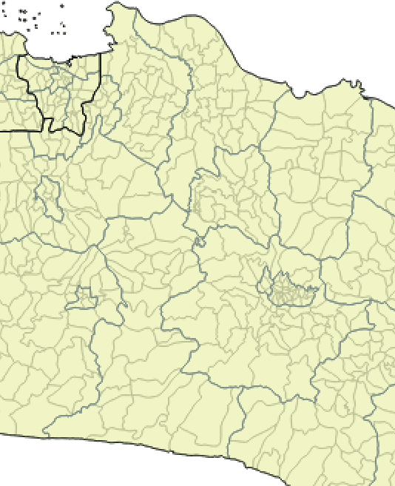
Propinsi
(Province)
A1
Rural
Urban
Indonesia
Kabupaten /
Regency (District)
Kota
(City)
A2
Kecamatan
(Sub-District)
A3
Rural
Urban
Nagari / Desa
(Village)
Kelurahan
(Ward)
A4
Jorong, Korong, Kampung
Rukun
Warga
A5
Rukun
Tunaga
A6
Kepala Keluarga (household)
A7
Notes:
Administrative structures Here’s what the structure in Indonesia looks like
Admin levels can be complicated, it helps to understand them
Quite a common model, with different divisions depending on whether the area is rural or urban

Slide 11
COD-AB attributes
Notes:
Why? Because they’re more than just a dataset
They are a data standard and a taxonomy
OCHA’s use of admin boundaries to coordinate data is as old as OCHA, literally
These are the admin boundaries from Kosovo, created in early 1999 months after DHA was reorganized into OCHA
The column on the left was the origin the term ‘Pcode’ that is still widely used today to describe admin boundaries
Pcodes / admin boundaries let us connect data between agencies, themes and time periods and relate them to a physical location
They’re also a means of aggregating data from individual water points, schools and communities up to bigger units we can work with more easily, like provinces and countries
Everything on earth falls within one or more administrative boundaries
And that’s why they’re so important

Slide 12
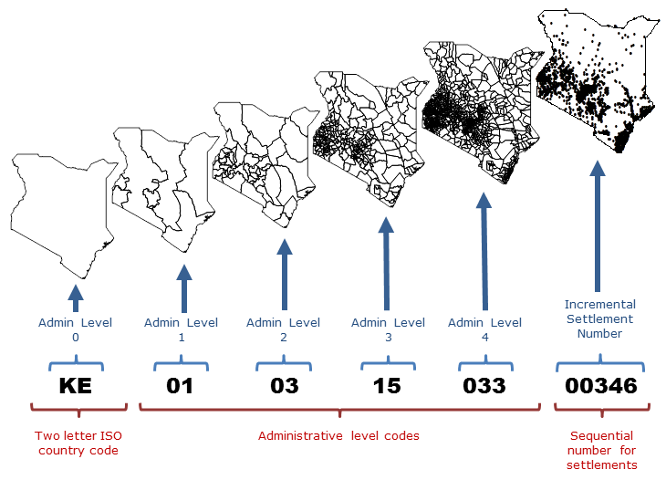
P-codes
P code guidance
P-codes for Populated places do not need
to contain the hierarchy of admin levels
Notes:
If good quality Pcodes and CODs are provides partners are more likely to include them in their data making the data easier to do analysis and visualize
Pcodes are used in most population statistics, humanitarian profiles, HR.info, 3W, monitoring templates, maps, and other HPC activities.
12

Slide 13
Core CODs
Pop Male Fem
3800 1900 1900
3600 1800 1800
3200 1600 1600
2800 1400 1400
2600 1300 1300
2400 1200 1200
2200 1100 1100
Admin
boundaries
Population figures
Notes:
Let’s take a closer look at the other Core CODs – COD- PS.
Perhaps not as exciting to look at, these are often huge tables (especially if done properly and they are SADD)
This is arguably the most important population set as it is the basis for the response initially and will likely be referenced throughout the emergency

Slide 14
Population Statistics (COD-PS)
Notes:
COD-Population Statistics
Purpose of COD-PS: https://humanitarian.atlassian.net/wiki/spaces/imtoolbox/pages/174031031/Population+Statistics+COD+COD-PS
COD-PS standards: https://humanitarian.atlassian.net/wiki/spaces/imtoolbox/pages/219644081/COD-PS+Standards+and+Process

Slide 15
COD-PS
Notes:
Note the P-code and names and data is sex and age disaggregated

Slide 16
COD guidance (2016)
Pop Male Fem
3800 1900 1900
3600 1800 1800
3200 1600 1600
2800 1400 1400
2600 1300 1300
2400 1200 1200
2200 1100 1100
Pop Male Fem
3800 1900 1900
3600 1800 1800
3200 1600 1600
2800 1400 1400
2600 1300 1300
2400 1200 1200
2200 1100 1100
Admin boundaries
Population figures
Caseload figures
Populated places
Transport
Hydrology
Elevation
Health Facilities
Schools
Power lines
Earthquake epicenter
Core CODs
IDP/Refugee Camps
Storm path
Dams
Country Specific CODs
IMWG Guidance on CODs, 2016
Notes:
Country-specific CODs
Depending on risks, capacity

Slide 17
Country Specific cod (COD-cs)
Think in terms of categories, be realistic
POPULATION
ENVIRONMENT.
INFRASTRUCTURE
EVENT
RESPONSE
Populated places
Vulnerable groups
Disease profile
Socioeconomic profiles
MD Poverty Index
Refugees / IDP camps
.
Hydrology
Elevation
Water basins
.
Transportation
Education Facilities
Medical Facilities
Hydro lines
Dams
Bridges
Storm path
Flood area
Surge
Earthquake MMI
Road access
Checkpoints
Health zones
ATM locations
Market locations
Grid
Other INFRASTRUCTURE DATASETS: Land use/cover (geology), Building/housing type, Telecommunication locations (e.g., towers), Oil Refineries (if relevant), Sports center (potential shelters/evacuation centers), Energy (power, gas, Waste collection sites, Water treatment site, Clean water access points, Markets)
Notes:
COD-CS (Country specific COD information) https://humanitarian.atlassian.net/wiki/spaces/imtoolbox/pages/54886480/Country-Specific+COD

Slide 18
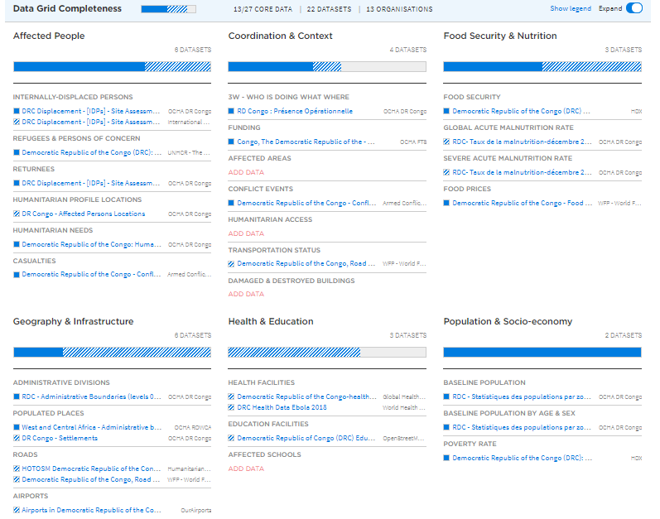
COD-cs and hdx grid

Slide 19
COD-cs Event category
Sudden onset
Cyclone/ Hurricane | Flood | Earthquake
Strom path | Flood extent over time | Earthquake MMI
Strom surg | Water basin | Damage
Wind speeds
EVENT
Complex emergency
Famine, Draught | Conflict
Livestock disease situation | Livestock conditions/drought (number of animal deaths)
Water points/sources availability for domestic use | Number of children associated with armed forces / groups
Cultivated land / crop condition | Roadblocks / checkpoints
Normalized Difference Vegetation Index (NDVI) | IDP /Refugee locations
Food Commodity prices |  | Medical Outbreak
Average rainfall in the country |  | Outbreak locations
Famine Early Warning Systems Network |  | Health zones (boundaries)
Notes:
Complex emergency: https://humanitarian.atlassian.net/wiki/spaces/imtoolbox/pages/242483237/Complex+Emergencies
Natural Disasters: https://humanitarian.atlassian.net/wiki/spaces/imtoolbox/pages/242090029/Natural+Disaster+CODs

Slide 20
What makes ‘good quality’ operational datasets (CODs)
Notes:
So what’s our definition of good quality data?

Slide 21
Spatial data
Attribute data
Metadata
Notes:
This is how admin boundaries are represented in data form
They have three basic elements
Spatial data, which enclose the geographic area of the admin boundary
Attribute data, which at a minimum include a unique code (pcode) and a name
Metadata, which describes

Slide 22
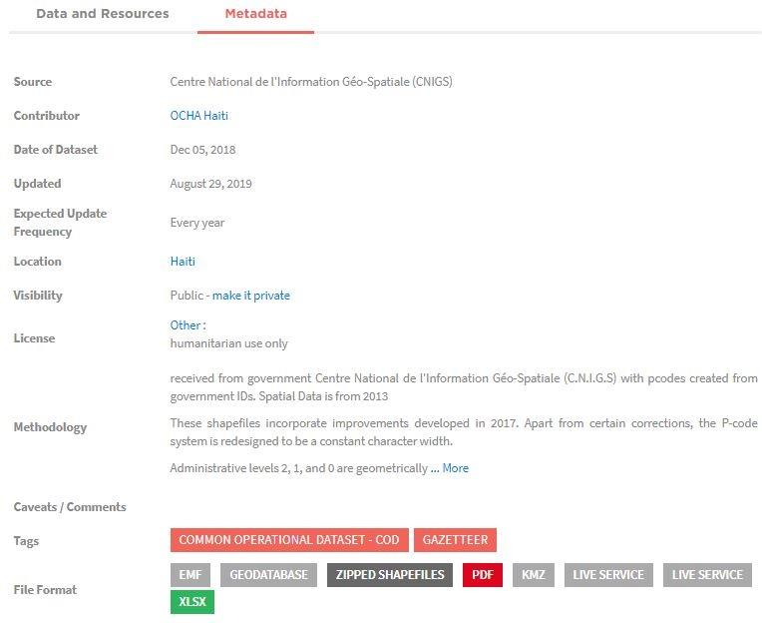
Metadata
Title
File name
Source
Contributor
Description
Date
Update Freq
Rights
Methodology
Caveats
Notes:
Guidance on metadata from OCHA IM toolbox: https://humanitarian.atlassian.net/wiki/spaces/imtoolbox/pages/228884547/Metadata
HDX metadata guidance: https://data.humdata.org/faq (see question - How do I add a dataset?)
COD-AB standard: https://humanitarian.atlassian.net/wiki/spaces/imtoolbox/pages/219971654/COD-AB+Standards+and+Process
COD-PS standard: https://humanitarian.atlassian.net/wiki/spaces/imtoolbox/pages/219644081/COD-PS+Standards+and+Process

Slide 23
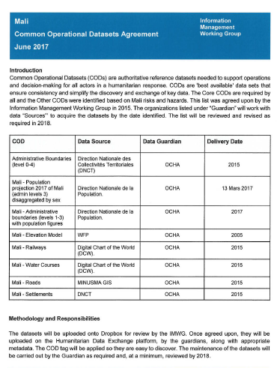
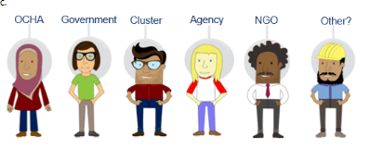
How to Get CODs
IMWG / IM Network
DATA AGREEMENT
HDX
Notes:
There is a great deal of information and many tools on the OCHA IM Toolbox that can help you with technical and process side of CODs. It’s a great resource but the 3 key words/steps are: IMWG, Data Agreement, HDX
IMWG – identify and contact key data partners in your area. Include the CODs in the agenda (it’s a great way to break ice and bring people together, every organization needs data). Be sure to plan COD meetings/agenda point a few times a year to ensure understanding of data landscape. These are the partners most likely to have data or have relationships with the data sources, they are using data in different ways and may have different opinions or may make improvements that everyone can benefit from. Most importantly it is the IMWG that decides what datasets are CODs (https://humanitarian.atlassian.net/wiki/spaces/imtoolbox/pages/213254193/COD+Planning)
DATA AGREEMENT - This document although very simple in appearance – is quiet powerful. It identifies the dataset themes that are considered CODs and who is responsible for them. It is what is behind this document that is very valuable which should include discussions about criteria to trigger an update (new version), the definition of terminology, processing requirements (e.g. ITOS), etc. (OCHA IM Toolbox: https://humanitarian.atlassian.net/wiki/spaces/imtoolbox/pages/185761833/Data+Agreements+and+Sharing)
HDX – this is the platform to share CODs and this is the place where most are first introduced to the COD for a country. This is where metadata comes into the limelight and a CODs metadata becomes as critical as the dataset itself. This should be accurate, informative and clear. Particular attention to methodology, date, caveats.

Slide 24
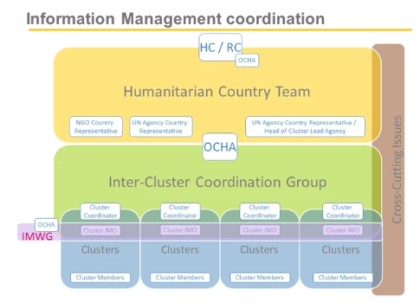
COD PARTNERSHIPS
Information Management Working Group (IMWG)
LEVELS
Global (Strategic)
Regional (Preparedness)
Country (Operational)
Notes:
Key partners for CODs are:
The most important is an Information Management Network (IM Network) - which is a country-level, inter-agency working group under the Humanitarian Country Team (HCT) that coordinates and harmonizes the information management activities of all humanitarian partners, including
efforts to develop and maintain core and Country-specific Common Operational Datasets.
The Global Information Management Working Group (IMWG) that is responsible for
maintaining guidance on Common Operational Datasets. They can also be consulted if there are issues with data flow or access to datasets as they can perhaps provide support or datasets.
For Core CODs – ITOS who provides services to improve quality and standardization and deploys the COD-AB services is an invaluable partner (https://humanitarian.atlassian.net/wiki/spaces/imtoolbox/pages/183959622/ITOS+and+COD+services). UNFPA is provides support to the identification and possible development of the COD-PS and should be part of all levels of IMWGs if possible. Discussions are underway to have ITOS process the COD-PS in a similar manner to COD-PS in the hopes to improve the quality of this core dataset.
During a response – for our country offices (and can beneficial to regional as well) are partners such as UNOSAT, Mapaction, and hot to name a few consistent ones. Each providing different services that can support CODs
Examples:
UNOSAT - provides analyses data in the form of shp such as flood planes, destruction (burnt villages, earthquake damage) and these would be considered ‘event CODs’
MapAction – when deployed at sudden son set they become basically a data centralization point for all operational data, datasets on their drives should be reviewed by the IMWG for potential CODs that can save everyone time and put us on the same page. Bonus Mapaction has the most beautiful file and folder naming convention that it is a delight to work with
HOT – this volunteer group works on very detailed data that takes many hours, they can respond quickly and cover a lot. Think of the Nepal earthquake and building damage. Even better their data is open and free! WFP has an agreement with OSM and they push data (transport and access data) to OSM for us all to to use… this then gets pushed to HDX… Remember HOT/OSM when requesting sat images as they could perhaps use them to do work we do not have time for but would be super helpful

Slide 25
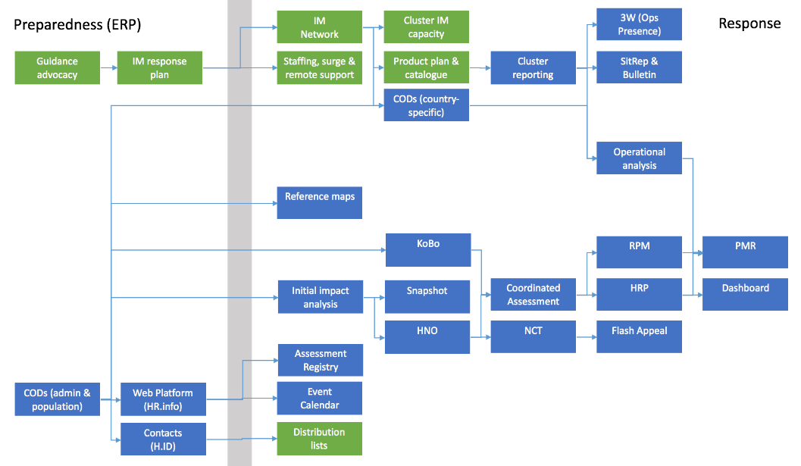
CODs in Preparedness & Response
Notes:
Coming up-to-date
This is simplified mapping of major IM process and products straddling preparedness and response
Feed into most of the products and services at the centre of the HPC
Baseline dataset to help, with population data, initial impact analysis
Data standard to support intra- and inter-cluster data coordination
Taxonomy feeding HR.info, H.ID, Kobo, NCT and others

Slide 26
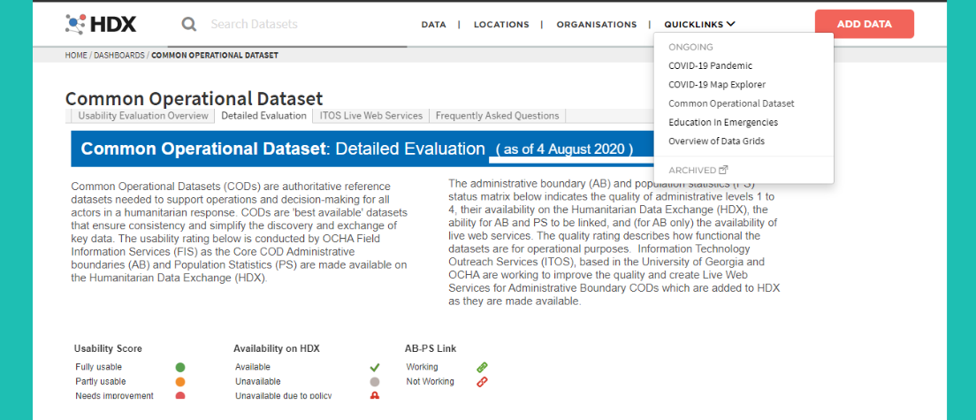
WHERE DO I FIND THEM?
Humanitarian Data Exchange (HDX)

Slide 27
WHERE DO I FIND THEM?
https://cod.unocha.org/
Core COD Dashboard
Notes:
https://cod.unocha.org/

Slide 28
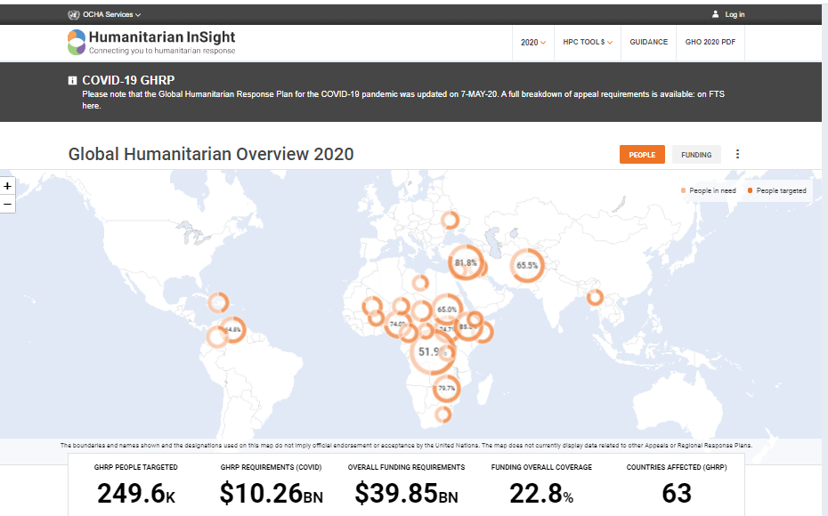
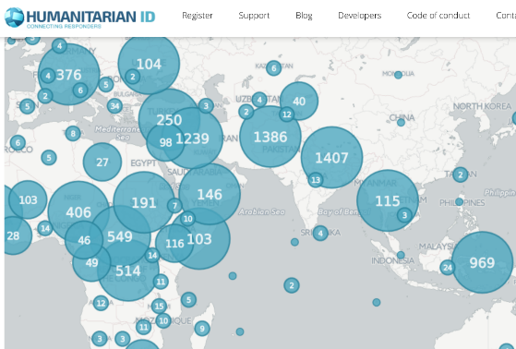
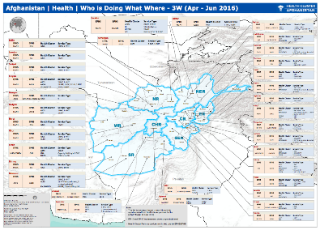
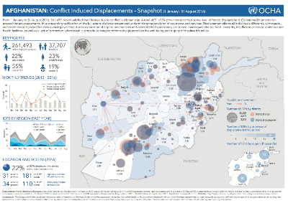
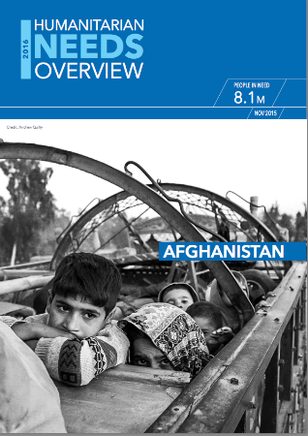
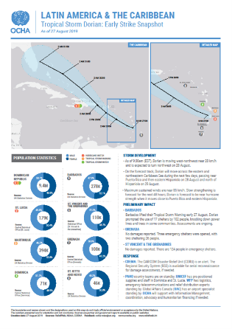
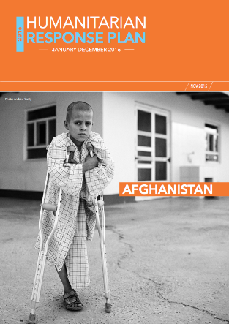
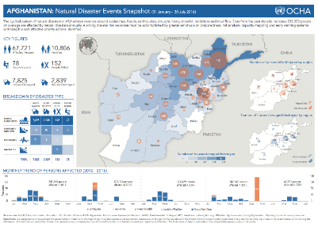
Notes:
Used throughout the programme cycle.
- Admin boundaries are one of only two IM ‘MPAs’ under preparedness

Slide 29
WHERE TO FIND MORE INFORMATION ON CODs
OCHA Information Management Toolbox
Notes:
OCHA IM Toolbox – COD Chapter: https://humanitarian.atlassian.net/wiki/spaces/imtoolbox/pages/474447949/Common+Operational+Datasets+CODs

Slide 30
Summary
CODs are required in in all humanitarian responses and are more than a dataset
P-codes are a unique ID that are used in almost all data collection, processing, and analysis in humanitarian response
The partnerships and coordination that take place as a result of CODs is as valuable as the datasets themselves
CODs should be shared on HDX
Notes:
‘All admin boundaries are wrong, but some are useful’
Operational admin boundaries are a political more than a technical challenge
Prepare nationally, respond locally
Balance commitment with resource
Paraphrased from George Box
1) Our job is not to provide perfect data on administrative boundaries. Our job is to provide a data standard to support humanitarian action.
Sometimes compromises in data veracity are necessary for operational practicality. It may sometimes be better for all humanitarian actors to be wrong together, than for only some to be right.
Let’s not lose sight of why we manage these data
2) Primarily a political challenge
Cleaning a dataset can be done by anyone with moderate GIS and database skills
It can be time-consuming but is not difficult
The bottlenecks come in:
a) dealing with government and partners
- Building relations
- Obtaining data and the rights to use them
- Validating among the three agencies
- Validating with local government
- Linking to attribute data
- Endorsement
- Adoption by all partners
- Training partners to use them properly
Adding technical capacity is easy.
Addresses non-technical issues requires relationship building, negotiation and considerable time
3) Accept that country offices manage high-resolution CODs, e.g. village boundaries, as a preparedness measure. It’s not necessary to chase perfection, but rather be prepared in a local emergency to validate the data that’s needed
4) Admin boundaries get exponentially more expensive in resources as we increase resolution. In looking at clients, let’s be careful we don’t over-commit ourselves to deliver a service that we can’t maintain
For example, committing to serve A5 for every country in the world.
Or updating the geo-taxonomy every week
There are bottlenecks that can slow down the process, especially in-country
And there are disadvantages to frequent versioning, since datasets become out-of-sync every time the dataset changes

Slide 31
Questions or Comments
?

