Slide 1
COD
Common Operational Datasets

Slide 2
Origin and purpose of CODs
Admin boundaries 101
The definition of ‘good quality’ data
International boundaries

Slide 3
Origin and purpose of CODs
Notes:
So what are they?

Slide 4
IASC definition of CODs
Predictable, core sets of data needed to support operations and decision-making for all actors in a humanitarian response
Identified and maintained prior to an emergency as part of data preparedness
Made available by OCHA (or pre-agreed in-country alternate) within 48 hours of a given humanitarian emergency
Meet minimum criteria for format and attribute information in accordance with national standards
OCHA … will facilitate the distribution of the “best” available common operational and fundamental datasets
IASC Guidance on CODs, 2010
Notes:
Intended for use in a response operation
Preparedness: because
needed in first few days,
and impossible to build from scratch in that time
One of only 2 MPAs under ERP
Preparedness, but, made available in 48. Why?
Talk about later, but essentially
Recognizes that perfect CODs are near impossible
So update often necessary for specific geographic area affected in a new emergency
Minimum criteria
Will discuss those criteria later
National standards
Will also talk about more,
Almost all operations have us in support role to government, so
Important to respect national standards
COs and ROs are responsible for CODs!

Slide 5
The seven CODs
Pop Male Fem
3800 1900 1900
3600 1800 1800
3200 1600 1600
2800 1400 1400
2600 1300 1300
2400 1200 1200
2200 1100 1100
Pop Male Fem
3800 1900 1900
3600 1800 1800
3200 1600 1600
2800 1400 1400
2600 1300 1300
2400 1200 1200
2200 1100 1100
Admin boundaries
Population figures
Populated places
Caseload figures
Transport
Hydrology
Elevation
IASC Guidance on CODs, 2010
Notes:
Seven designed in 2010 guidance
We won’t talk about all of them today

Slide 6
Some CODs have globally consistent data
Pop Male Fem
3800 1900 1900
3600 1800 1800
3200 1600 1600
2800 1400 1400
2600 1300 1300
2400 1200 1200
2200 1100 1100
Pop Male Fem
3800 1900 1900
3600 1800 1800
3200 1600 1600
2800 1400 1400
2600 1300 1300
2400 1200 1200
2200 1100 1100
Admin boundaries
Population figures
Populated places
Caseload figures
Transport
Hydrology
Elevation
IASC Guidance on CODs, 2010
Notes:
Used to be hard to find
Often sourced from gov
Now we go to global datasets like SRTM (elevation) and OSM

Slide 7
Caseloads not a preparedness dataset
Pop Male Fem
3800 1900 1900
3600 1800 1800
3200 1600 1600
2800 1400 1400
2600 1300 1300
2400 1200 1200
2200 1100 1100
Pop Male Fem
3800 1900 1900
3600 1800 1800
3200 1600 1600
2800 1400 1400
2600 1300 1300
2400 1200 1200
2200 1100 1100
Admin boundaries
Population figures
Populated places
Caseload figures
Transport
Hydrology
Elevation
IASC Guidance on CODs, 2010
Notes:
Caseload figure are by definition not a ‘preparedness dataset’ and have since been defined through their own guidance under the IMWG

Slide 8
We’ll come back to populated places…
Pop Male Fem
3800 1900 1900
3600 1800 1800
3200 1600 1600
2800 1400 1400
2600 1300 1300
2400 1200 1200
2200 1100 1100
Pop Male Fem
3800 1900 1900
3600 1800 1800
3200 1600 1600
2800 1400 1400
2600 1300 1300
2400 1200 1200
2200 1100 1100
Admin boundaries
Population figures
Populated places
Caseload figures
Transport
Hydrology
Elevation
IASC Guidance on CODs, 2010
Notes:
Populated places are both a baseline dataset and a taxonomy, but we won’t discuss today
Why not? Basically you’ll see how complicated even basic admin boundaries are to maintain. Doing so for individual towns and villages on a national scale is, for our purposes, impossible
Or, to be less dramatic, has such a poor return-on-investment that we should be very, very careful before making any commitment – even at a country level – to maintain accurate populated place data

Slide 9
Two ‘Core CODs’ under revised guidance
Pop Male Fem
3800 1900 1900
3600 1800 1800
3200 1600 1600
2800 1400 1400
2600 1300 1300
2400 1200 1200
2200 1100 1100
Pop Male Fem
3800 1900 1900
3600 1800 1800
3200 1600 1600
2800 1400 1400
2600 1300 1300
2400 1200 1200
2200 1100 1100
Admin boundaries
Population figures
Populated places
Caseload figures
Transport
Hydrology
Elevation
IASC Guidance on CODs, 2010
Notes:
So COD guidance is out-of-date
IMWG is currently revising the guidance
New policy document is near-final
One of main changes is to redefine CODs:
Core CODs, needed in their entirety in all operations and high-risk countries
Admin boundaries
SADD population
Country-specific CODs
Depending on risks, capacity

Slide 10
Admin boundaries: one COD to rule them all
Pop Male Fem
3800 1900 1900
3600 1800 1800
3200 1600 1600
2800 1400 1400
2600 1300 1300
2400 1200 1200
2200 1100 1100
Pop Male Fem
3800 1900 1900
3600 1800 1800
3200 1600 1600
2800 1400 1400
2600 1300 1300
2400 1200 1200
2200 1100 1100
Admin boundaries
Populated places
Population figures
Caseload figures
Transport
Hydrology
Elevation
IASC Guidance on CODs, 2010
Notes:
Today we’ll focus on one core COD in particular: admin boundaries

Slide 11
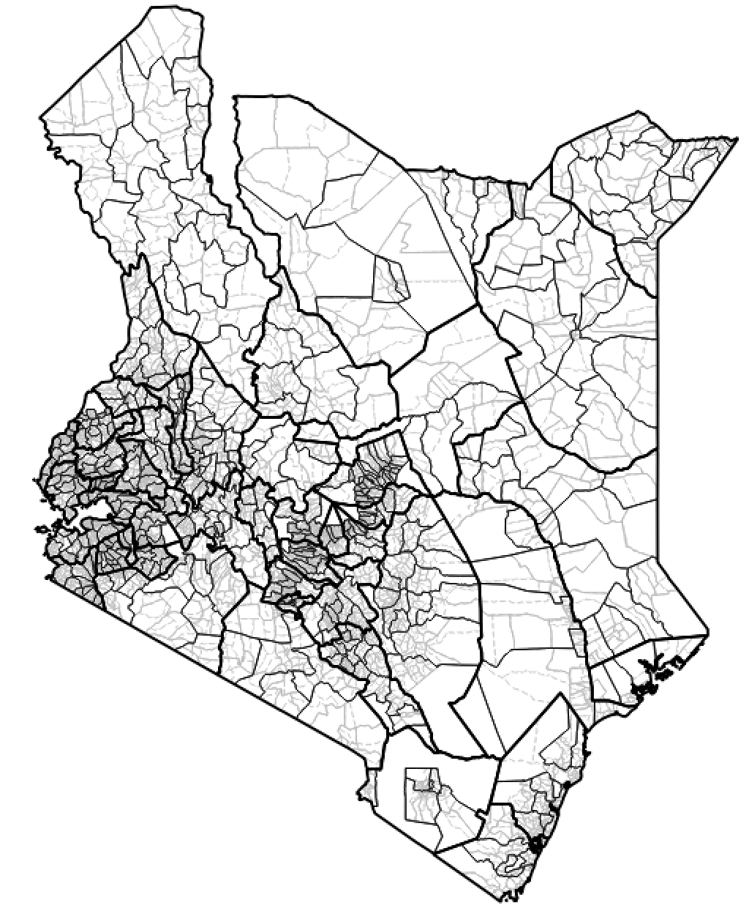
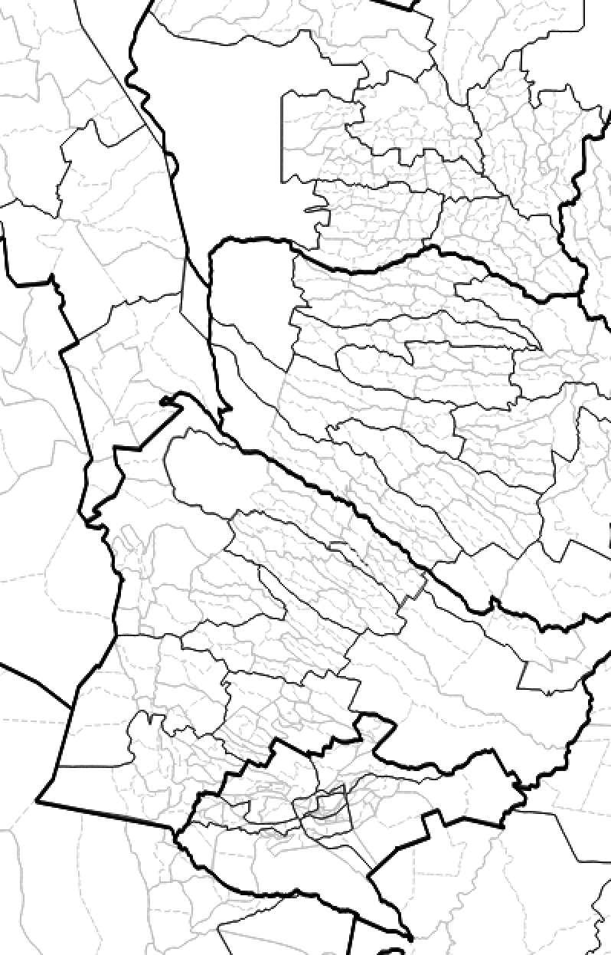
Notes:
Here’s what four levels of admin boundary in Kenya look like

Slide 12
Admin Boundaries (Kosovo, 1999)
Notes:
Why?
Because they’re more than just a dataset
They are a data standard and a taxonomy
OCHA’s use of admin boundaries to coordinate data is as old as OCHA, literally
These are the admin boundaries from Kosovo, created in early 1999 months after DHA was reorganized into OCHA
The column on the left was the origin the term ‘Pcode’ that is still widely used today to describe admin boundaries
Pcodes / admin boundaries let us connect data between agencies, themes and time periods and relate them to a physical location
They’re also a means of aggregating data from individual water points, schools and communities up to bigger units we can work with more easily, like provinces and countries
Everything on earth falls within one or more administrative boundaries
And that’s why they’re so important

Slide 13
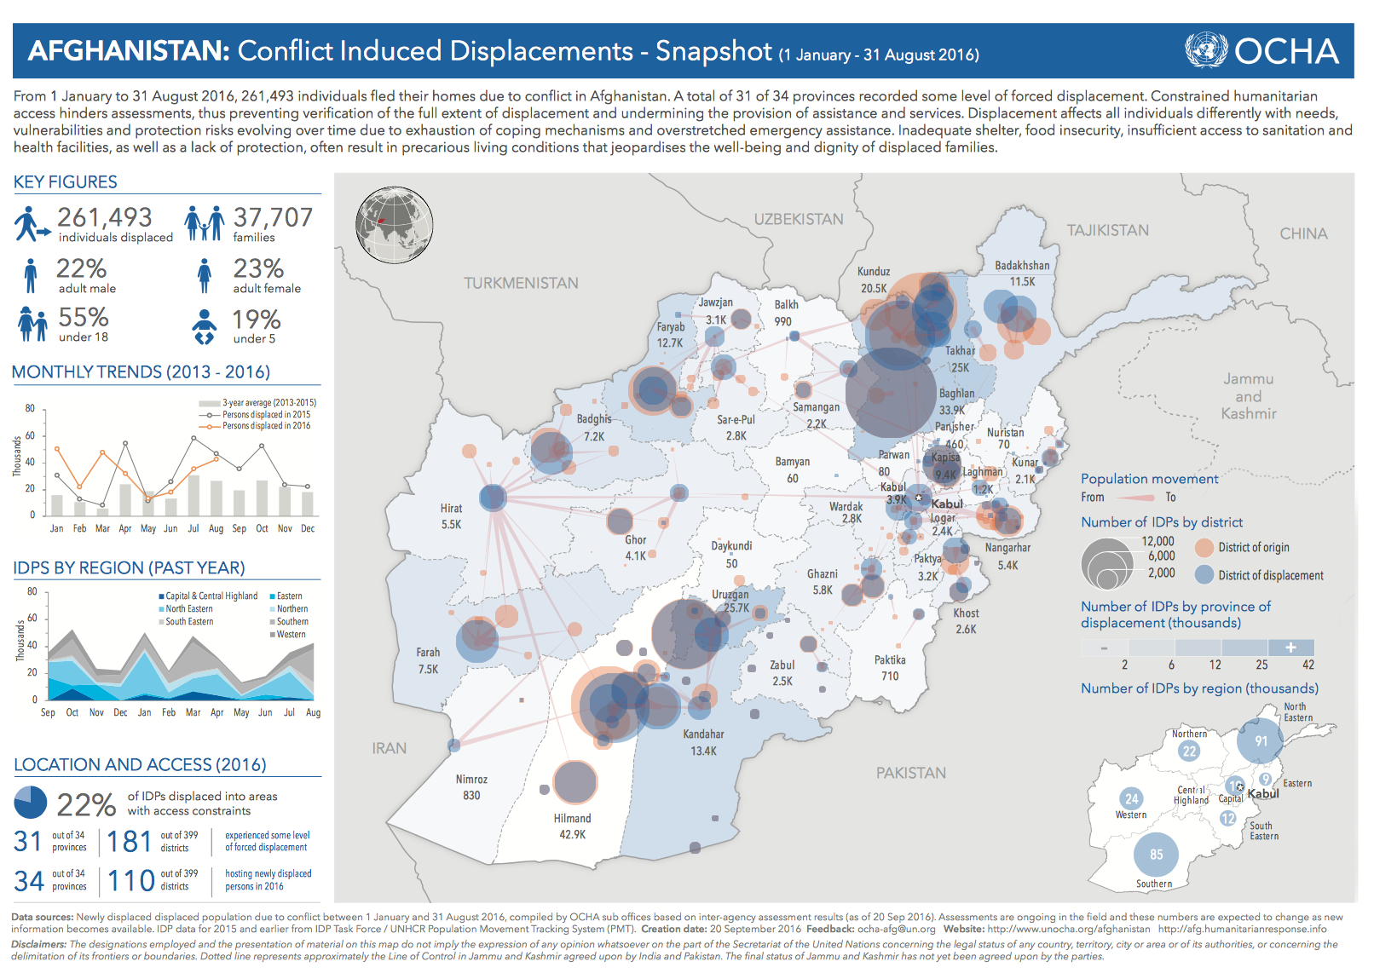
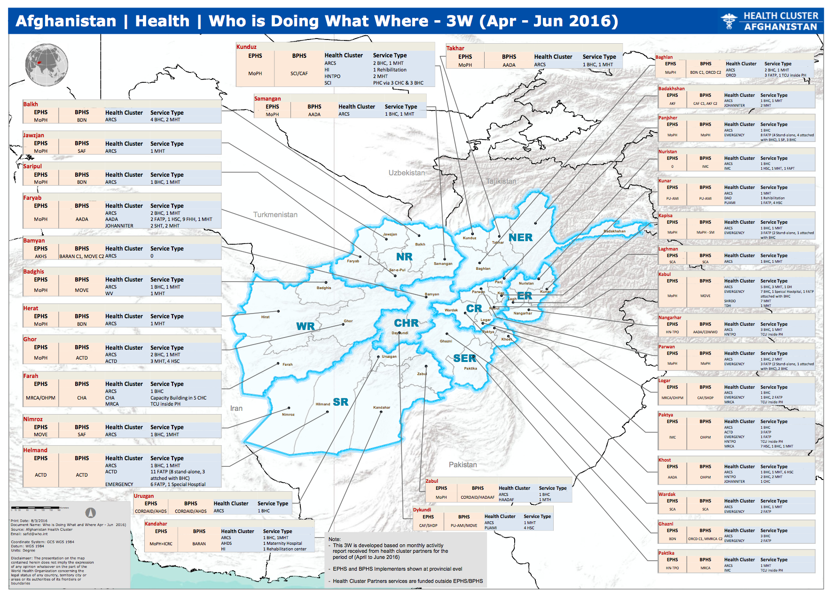
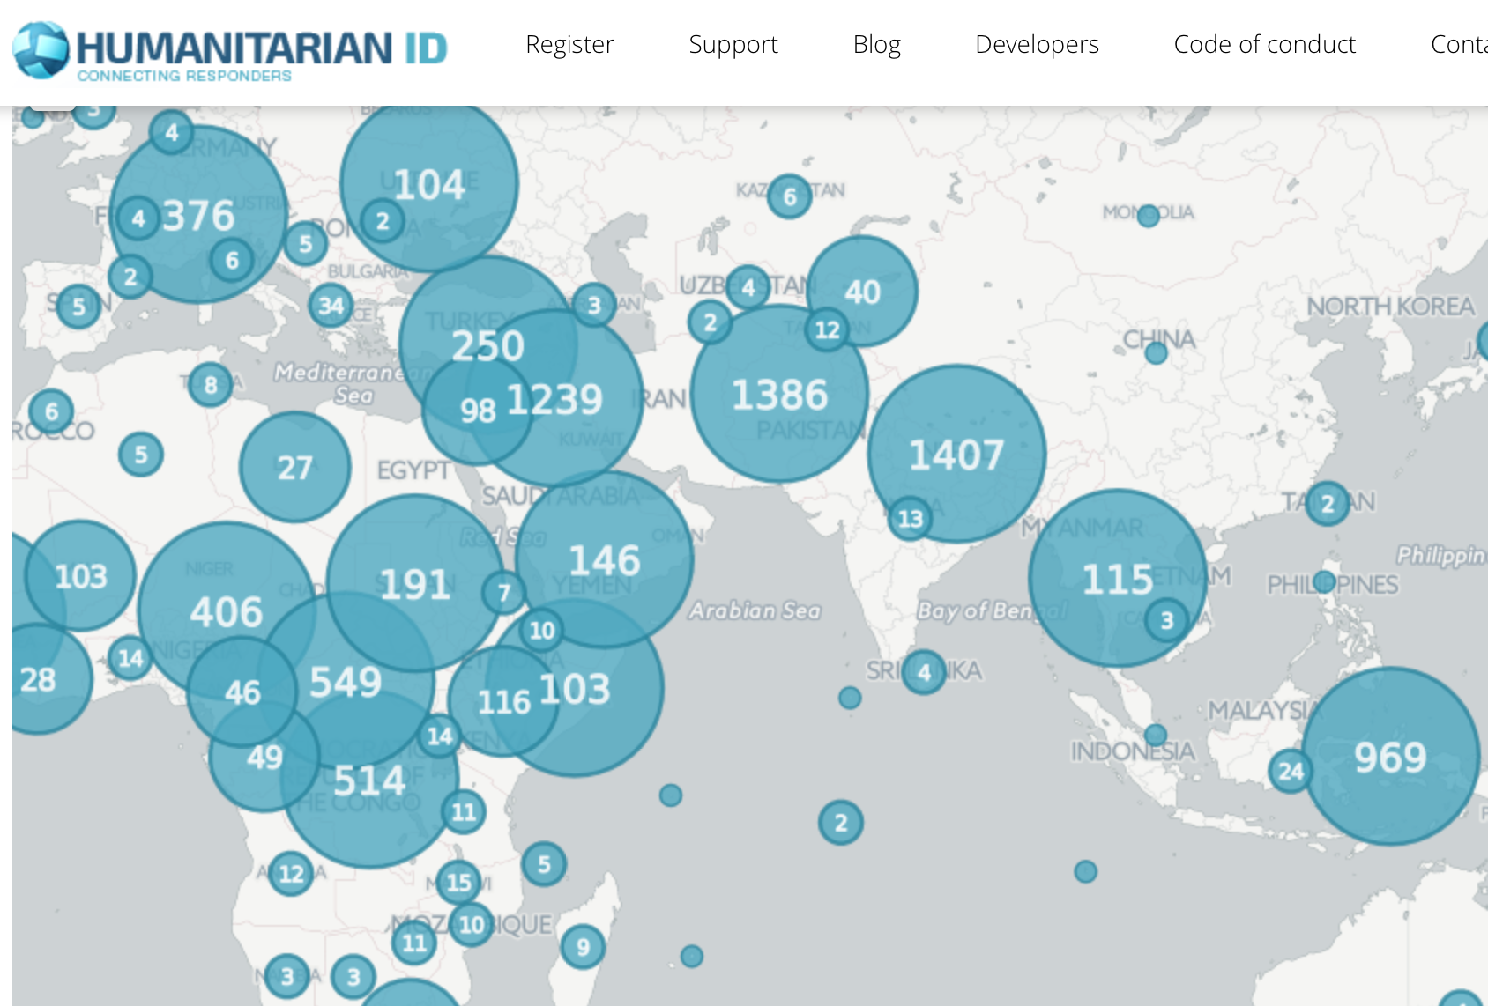
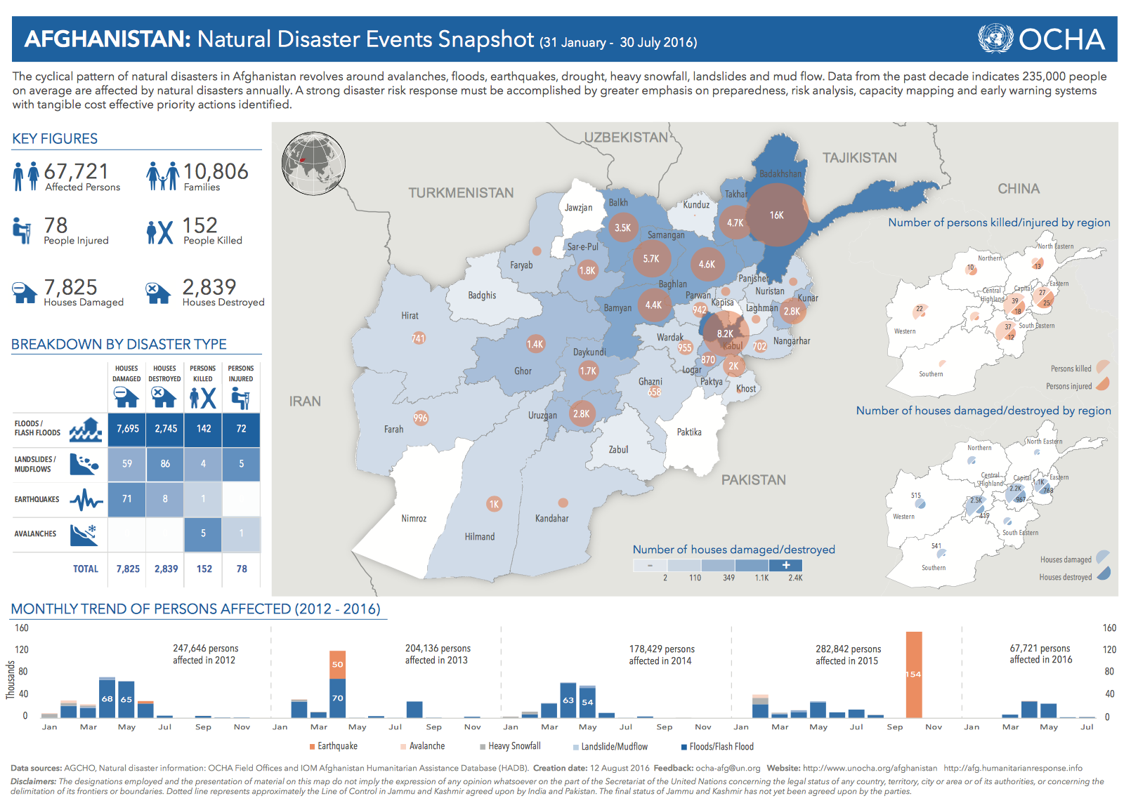
Notes:
Used throughout the programme cycle.
- Admin boundaries are one of only two IM ‘MPAs’ under preparedness

Slide 14
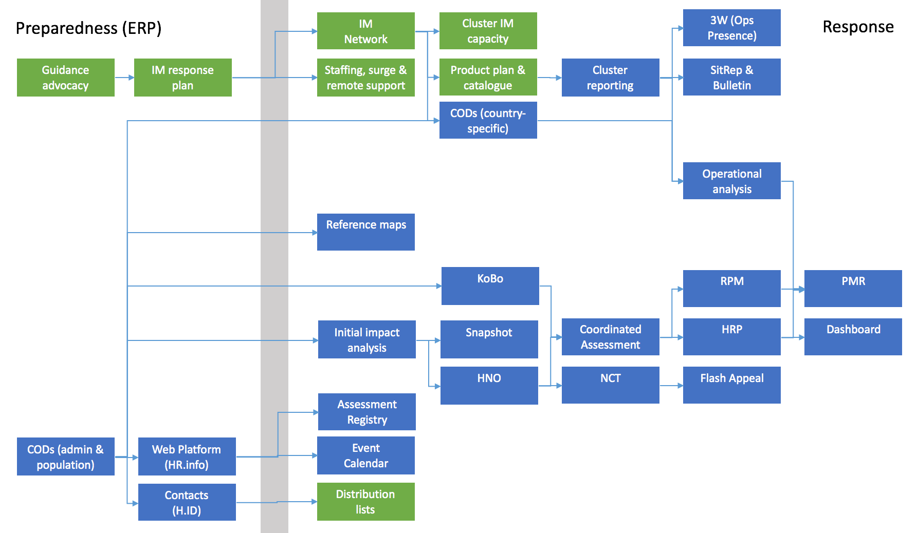
CODs in Preparedness & Response
Notes:
Coming up-to-date
This is simplified mapping of major IM process and products straddling preparedness and response
CODs one of only two MPAs
Feed into most of the products and services at the centre of the HPC
Baseline dataset to help, with population data, initial impact analysis
Data standard to support intra- and inter-cluster data coordination
Taxonomy feeding HR.info, H.ID, Kobo, NCT and others

Slide 15
Admin Boundaries 101
Notes:
So what are they?

Slide 16
Admin Boundaries: terminology
Admin level | RO Korea | USA | UK | Switzerland
Admin 0 | Country | Country | Country | Country
Admin 1 | Province | State | Region | District
Admin 2 | County | County | County | Commune
Admin 3 | Town | Town | District
Admin 4 | Village |  | Parish
Admin 5 | Hamlet
Notes:
Every country has admin boundaries.
Some are quite simple, like Switzerland
Others more complex:
Korea has five different types of A1 (province, metropolitan city, Seoul)
USA has tribal entities, a federal district as well as incorporated and trust territories
All operate on basis of ‘nesting’. Lower level admin boundaries should always fit completely within a higher one

Slide 17
Propinsi
(Province)
A1
Rural
Urban
Indonesia
Kabupaten /
Regency (District)
Kota
(City)
A2
Kecamatan
(Sub-District)
A3
Rural
Urban
Nagari / Desa
(Village)
Kelurahan
(Ward)
A4
Jorong, Korong, Kampung
Rukun
Warga
A5
Rukun
Tunaga
A6
Kepala Keluarga (household)
A7
Notes:
Here’s what the structure in Indonesia looks like
Quite a common model, with different divisions depending on whether the area is rural or urban

Slide 18
Admin Boundaries: where do they come from?
Legal Status
Spatial Data
Attribute Data
e.g. Ministry of Local Government (MoLG) in Bangladesh
e.g. Badan Informasi Geospasial (BIG) in Indonesia
e.g. National Bureau of Statistics in South Sudan
Notes:
Often three different sources
The three are rarely aligned. There is a time lag between boundaries being legal established, codes and names of the new entities being formalised, and spatial data being updated. In some cases the systems may be a year or more out of synch. Why?
Lack of capacity in national governments
Lack of coordination between agencies
Inevitable time lag
Disputes between central & local government
Similar discrepansices happen at local level, where regional authorities are out of sync with national suthorities as well as each other

Slide 19
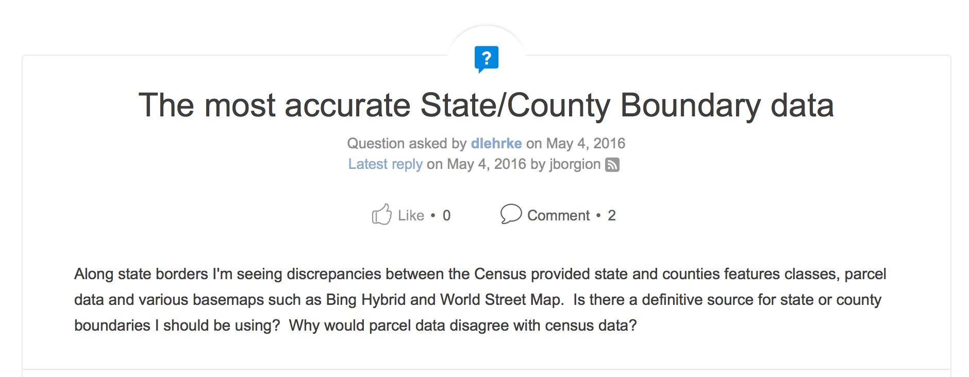
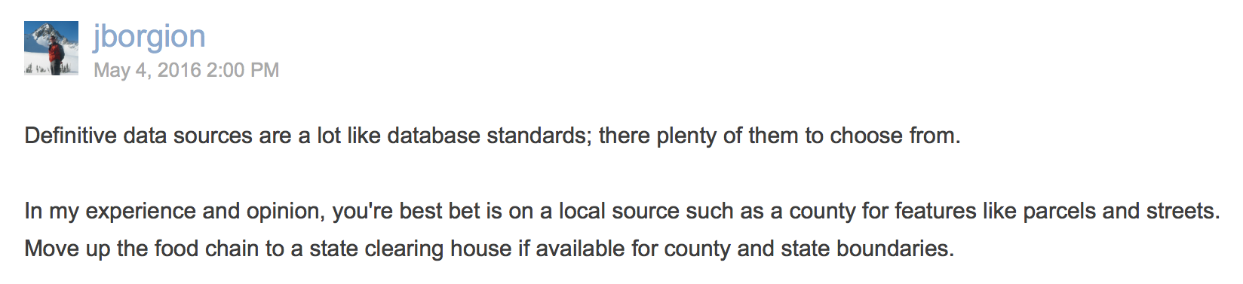
Notes:
Even the most highly-developed countries face these problems, including the US
But especially so in most of the countries we work in

Slide 20
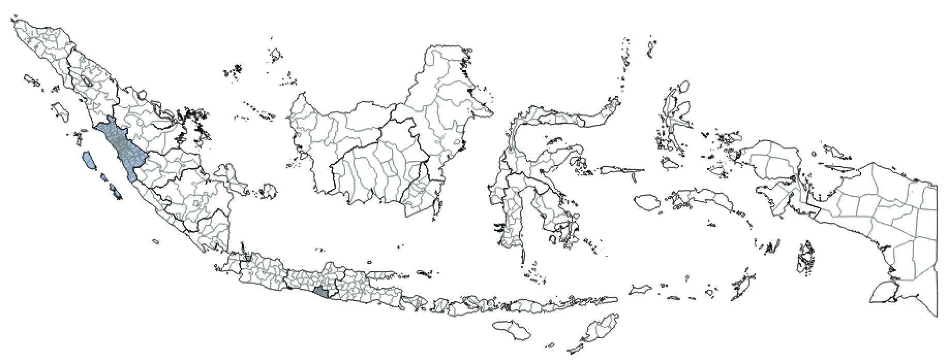
Admin boundaries: dynamic data
Admin level | 2005 | 2015 | Change
A1 - Propinsi | 33 | 34 | +1
A2 - Kabupaten | 440 | 502 | +62
A3 - Kecamatan | 5,269 | 6,543 | +1,274
A4 - Desa | 71,551 | 75,244 | +3,693
Notes:
What compounds the problem of multiple agencies sharing responsibility is the frequency of changes
Admin boundaries are regularly shifting
The lower down the admin ladder you go, the more frequently they change
This shows changes in Indonesia over 10 years
Net increases at each admin level
And this certainly underestimates the changes, because it only shows the net change
Many more changes of boundaries between two divisions, changes in name, changes in code
The problem? Data gets out of date almost immediately.
Indonesia data collected in 2010 will not perfectly match boundaries from 2009 or 2011

Slide 21
Prepare nationally, respond locally
Notes:
So trying to keep up-to-date is enormously challenging and very expensive in terms of time and resources
And truth is, trying to stay up-to-date across an entire country is unecessary
Our preparedness is done mostly at a national level, preparing for events that could happen anywhere in a country
But when those events happen, the response is often geographically localised
The red boxes are the affected areas of two earthquakes in Indonesia
So often, the model followed in a preparedness country is twofold
Obtain and clean the data to a ‘best available’ standard
Build relationships with the data sources and understand the actors who can validate the data in an emergency
After an event, in accordance with the IASC guidance, use those first 48 hours to update and validate the data for the affected area
Even then, we accept that we may not get perfect data, and that may not be necessary
It can be more useful to have data that are slightly wrong, that everyone is using, than wait for a perfect dataset that’s only used by a few

Slide 22
50 responsibilities of an OCHA Information Management Officer (IMO)
Situation Report
Periodic Monitoring Report (PMR)
Who does What Where (3W)
Advocacy on Cluster IM capacity
Training
Contact Management (H.ID)
Social Media Monitoring
Data processing
Humanitarian Bulletin
Product Catalogue
Financial Reporting
Data exchange
Operational web platform (HR.info)
Data Repository (HDX)
Situational Awareness
Humanitarian Dashboard
Reporting Cycle
Operational Baseline Data (CODs)
Comms with communities
Document Repository
KoBo Emergency Toolkit
Severity Estimation
Humanitarian Snapshot
Reference Mapping
IM Network
UAVs and other tech
Event Calendar
Contingency Planning
Needs Assessment
Humanitarian Needs Overview
Operational Mapping
Physical Space for Information
Community of Practice
Humanitarian Access
Risk Monitoring (ERP)
Needs Analysis
Key
Needs Comparison Tool (NCT)
Online Mapping
Cluster IM Support
Unit management
MailChimp
Risk Analysis (INFORM)
Gap Analysis
PRODUCT
COORDINATION
Humanitarian Response Plan (HRP)
Dynamic Online Charts
Digital Humanitarian Network
Admin and staffing
Humanitarian Kiosk
Response Monitoring
International Charter (Imagery)
SERVICE
ANALYSIS
Responsibilities derived from inter-agency and internal policy and guidance documents. Compiled by the Field Information Services section (FIS).

Slide 23
What makes ‘good quality’ operational administrative boundaries
Notes:
So that’s why admin boundaries are rarely perfect – even in countries like the UK, US or Japan that have well resourced, well coordinated technical bodies
So what’s our definition of good quality data?

Slide 24
Spatial data
Attribute data
Metadata
Notes:
This is how admin boundaries are represented in data form
They have three basic elements
Spatial data, which enclose the geographic area of the admin boundry
Attribute data, which at a minimum include a unique code (pcode) and a name
Metadata, which describes
The pcode is there in case there are duplicate boundary names.
In the USA for example there are 31 Washington Counties, 26 Jefferson counties and 24 Franklin counties
The pcode is a way to tell each of them apart

Slide 25
Data Source is known
Encoding is in UTF-8 or higher
Projection is defined, correct and consistent
Admin layers are closed polygons
Data extent is correct
Admin layers are numbered/named consistently
File names follow the OCHA Naming Convention
Metadata is included
There are no missing polygons
Multipart geometry check
Topology of each layer is clean
Admin layers are nested by geometry
Admin layers are nested by attribution
Notes:
These are the elements of the ITOS data cleaning process
Some very simple to check and fix – few seconds
Others can take quite a bit of time to clearn
But others can take a lot of time because they need to be referred back to the field
And this is really the biggest bottleneck

Slide 26
Spatial data cleaning
Village
Village
Notes:
Biggest bottleneck is where errors or inconsistencies have to be referred back to the field
Solution is usually to clean the lowest admin level, then recreate the upper levels by aggregation
But, any errors in the lowest layer gets copied over to the higher levels

Slide 27
Name and p-code fields exist for each layer
Only essential fields are included
Admin0 Name uses UN Short Name
Field names are clear
Field names used consistently across all Admin layers
Reference name field exists if necessary
Reference name field attributed correctly
Attribute names in Proper Case, not ALL CAPS
P-code uses a National system code
P-codes are fully constructed
Name and p-code fields of higher levels are included
Alternate language fields analyzed
P-codes are unique
P-code attribution is consistent
Admin Names checked for uniqueness
P-code attribution is consistent across all layers
Admin Name attribution is consistent across all layers

Slide 28
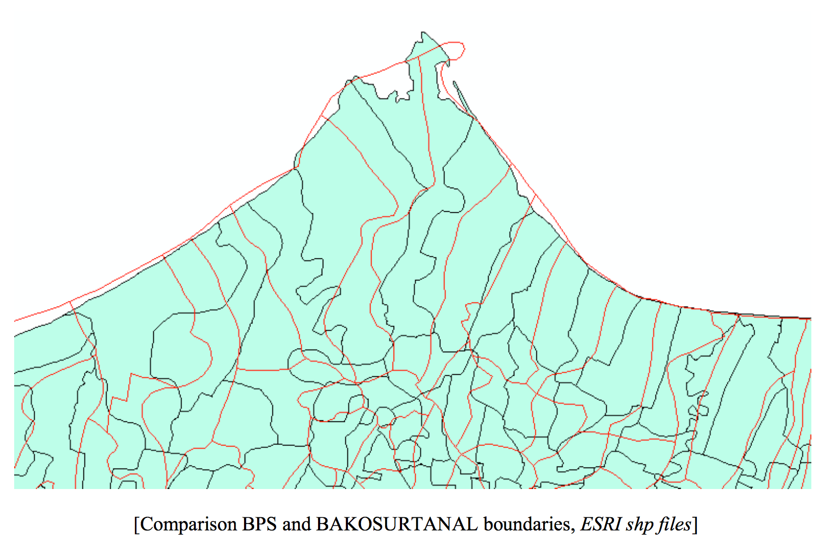
Indonesia: matching spatial and attribute data geographically without matching pcodes

Slide 29
Title
File name
Source
Contributor
Date
Coverage
Rights
Description / methodology
Subject
Notes:
Third element is the metadata
Guidance called for Dublin Core: 15 fields
But not very appropriate for spatial data
Once COD/FOD registry established developed a simplified metadata standard
With migration to HDX, settled on the above
Simple, but room for interpretation
Title: can vary

Slide 30
Country Office Admin Boundaries, IPOR9
PASS (22)
USEABLE (5)
FAIL (1)
Afghanistan
CAR
Chad
Colombia
Cote d'Ivoire
Eritrea
Ethiopia
Haiti
Iraq
Lebanon
Libya
Mali
Myanmar
Niger
Nigeria
oPt
Fiji
Pakistan
Philippines
South Sudan
Syria
Yemen
Burundi
Jordan
Somalia
Sudan
Turkey
DRC
Notes:
- Not all ITOS countries, e.g. Afghanistan

Slide 31
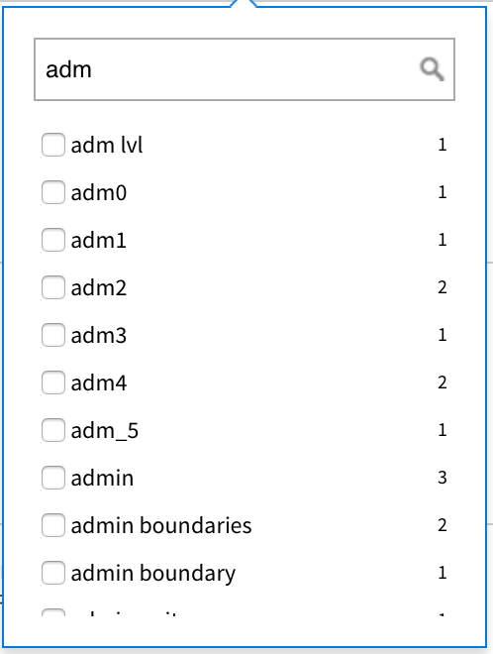
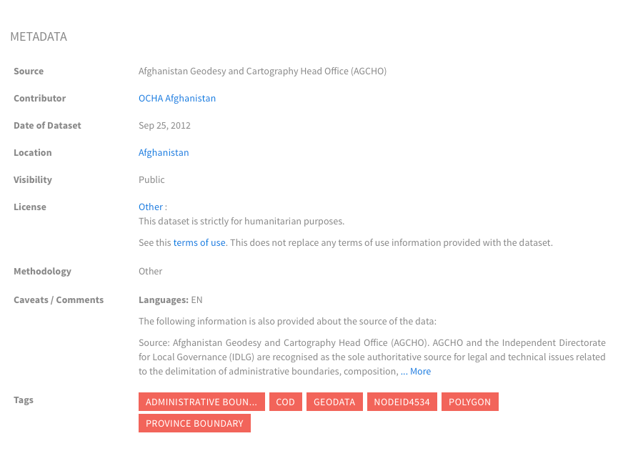
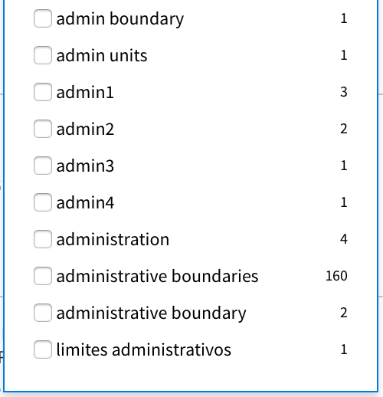
Shapefile
Title
100%
Name
72%
Source
100%
Contributor
100%
Date
97%
Coverage
100%
Rights
100%
Description
72%
Subject
100%
Notes:
Title – could be better standardised, but clear in all cases
Name – a third don’t follow format, including country name+admin1
Source – acronyms should be spelled out. Sometimes HDX metadata contradicts .shp metadata
Contributor –
Date – one missing (Turkey), but not always clear what date means: Origin? Sourced? Cleaned? Endorsed? Switch to range?
Coverage – also inherent to shapefile
Rights – mostly humanitarian use only. Some link to usage guidance
Description - ’methodology’ field doesn’t really fit with CODs, so most are ‘other’. Should provide clearer guidance on what we’re expecting. Afghanistan great example
Subject – Tags not always consistent
Conclusions & Recommendations
Most datasets have all the required metadata, however
Standardisation could be improved (e.g. file name, tags)
- Improve metadata in HDX:
- Add more information on HDX where required
- Copy metadata from SHP to HDX (need to confirm with IMO that this is acceptable, may be for political reasons it is not in HDX)
- Improve metadata in SHP (so maintained when file downloaded)
- Improve compliance
- Review/revise guidance about COD AB metadata on HDX (start with this) and place on HDX
- Include IMWG endorsement date
- Provide steps to add metadata in shp/gdb (example example)
- Hold online metadata clinics with IMOs to review guidance and technical steps in GIS (then ask them to update their CODs by specific date)
- Create standard term in HDX for “Administrative Boundaries”
- Create tool tips on HDX metadata entry page so providers understand information that should be provided for each element
- Add new types of methodology on HDX that apply to operational data (e.g. compiled, endorsed, processed, gps, etc)

Slide 32
International Boundaries
Notes:
So far we’ve talked about country operational datasets
What happens when we want to map the data regionally or globally?

Slide 33
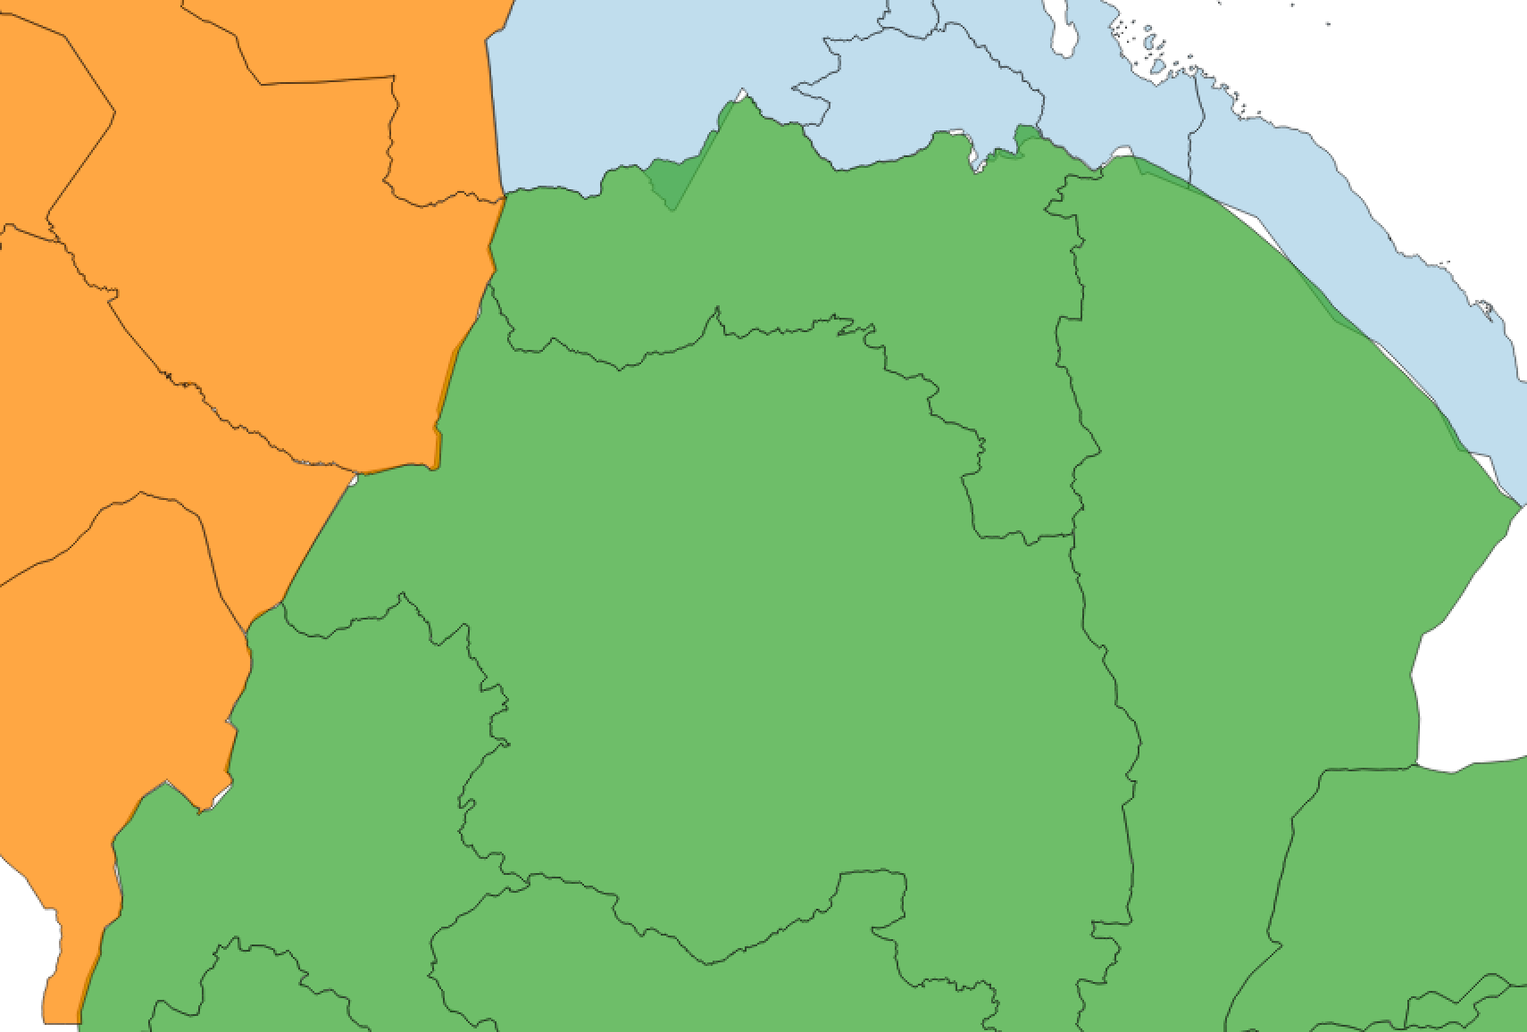
Notes:
They often don’t match up. Why?
Often uncontroversial
Inaccurate survey
Different resolutions
Different methods (digitise old maps – GPS – imagery)
Sometimes more complicated
Different interpretations of historical boundary definitions
Sudan / Egypt border described based on landmarks and directions
Shifting natural features, e.g. rivers
Can often be cleaned relatively easily
Can track geographic features or other datasets to ground-truth

Slide 34
Notes:
But sometimes the issue is more complex
Like border dispute between ETH and ERI
Dates to Eritrea’s war of independence in 1990s
Independent boundary commission decided on the border, but Ethiopia never accepted
Maps in Ethiopia, including OCHA’s, use the pre-EEBC border while Eritrea uses mostly the post-EEBC (except where they lost territory)
UNCS provides guidance on a handful these borders, mainly around the India, China, Pakistan borders
But there are many, many more disputes

Slide 35
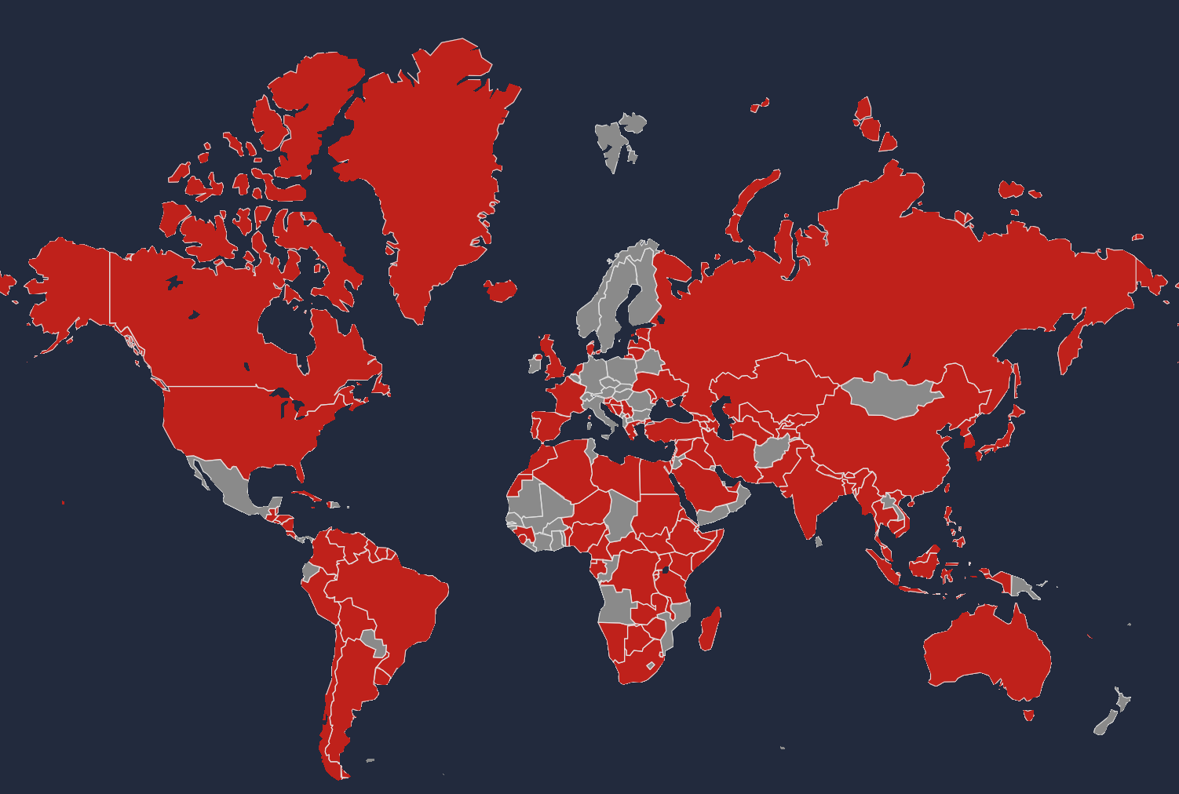
Countries with boundary disputes
Notes:
Almost every country has a dispite with one or more if its neighours, including USA, UK and Korea
Many have led to conflict. Since OCHA was created (1998), involving Serbia, Kosovo, Armenia, Azerbaijan, Ethiopia, Somalia, Eritrea, Djibouti, Cambodia, Thailand, India, Pakistan, China, Israel, Lebanon, Timor Leste, Indonesia, Bangladesh, Sudan, South Sudan, Russia, Georgia and Ukraine

Slide 36
Notes:
- And this is why UNCS refuses to share the data for their country dataset
We can use it to create products, but you won’t find it on HDX
Instead, HDX has a US government equivalent dataset, which does not match our own
Similar dataset, including sub-national, maintained by WFP/FAO – GAUL, but also not public
So issues facing us to produce a seamless border dataset:
What’s our base layer. UNCS? Then can’t share
GAUL? Also can’t share

Slide 37
Operational ‘best available’ COD
International ‘gourmet’ COD
Common taxonomy
Notes:
Paraphrased from George Box

Slide 38
GAUL Admin 2
COD Admin 2
Notes:
- There are other existing global datasets, but OCHA CODs are generally more likely to be current (e.g. GAUL will usually use in-country CODs)

Slide 39
Countries by level of service

Slide 40
Countries by level of service
Tier 1, OCHA Country Offices
Tier 2, countries under ERP
Tier 3, other countries of concern
Tier 4, all other countries
30
20?
10?
130
CO
RO
HQ
??
Boundaries by admin level
Admin 0 (UNCS)
Admin 1 (GAUL)
Admin 2 (GAUL)
200+
39,000+
80,000+

Slide 41
Summary
‘All admin boundaries are wrong, but some are useful’
Operational admin boundaries are a political more than a technical challenge
Prepare nationally, respond locally
Balance commitment with resources
Notes:
Paraphrased from George Box
1) Our job is not to provide perfect data on administrative boundaries. Our job is to provide a data standard to support humanitarian action.
Sometimes compromises in data veracity are necessary for operational practicality. It may sometimes be better for all humanitarian actors to be wrong together, than for only some to be right.
Let’s not lose sight of why we manage these data
2) Primarily a political challenge
Cleaning a dataset can be done by anyone with moderate GIS and database skills
It can be time-consuming but is not difficult
The bottlenecks come in:
a) dealing with government and partners
- Building relations
- Obtaining data and the rights to use them
- Validating among the three agencies
- Validating with local government
- Linking to attribute data
- Endorsement
- Adoption by all partners
- Training partners to use them properly
Adding technical capacity is easy.
Addresses non-technical issues requires relationship building, negotiation and considerable time
3) Accept that country offices manage high-resolution CODs, e.g. village boundaries, as a preparedness measure. It’s not necessary to chase perfection, but rather be prepared in a local emergency to validate the data that’s needed
4) Admin boundaries get exponentially more expensive in resources as we increase resolution. In looking at clients, let’s be careful we don’t over-commit ourselves to deliver a service that we can’t maintain
For example, committing to serve A5 for every country in the world.
Or updating the geo-taxonomy every week
There are bottlenecks that can slow down the process, especially in-country
And there are disadvantages to frequent versioning, since datasets become out-of-sync every time the dataset changes

