Slide 1
OCHA Yemen
INFORMATION MANAGEMENT & ASSESSMENTS UNIT (IMAU)

Slide 2
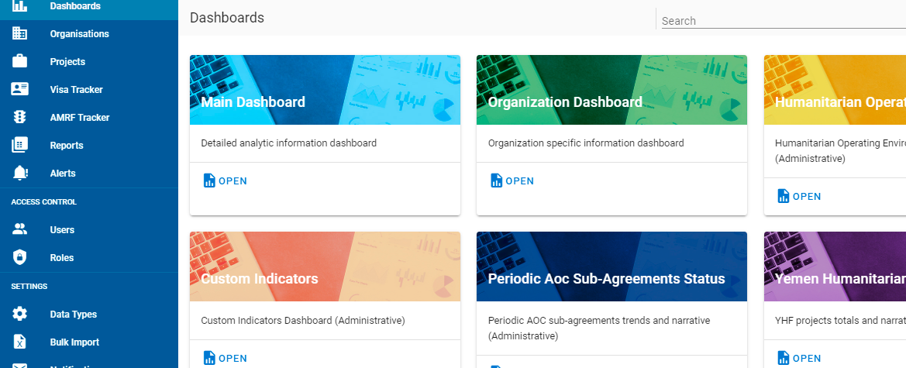
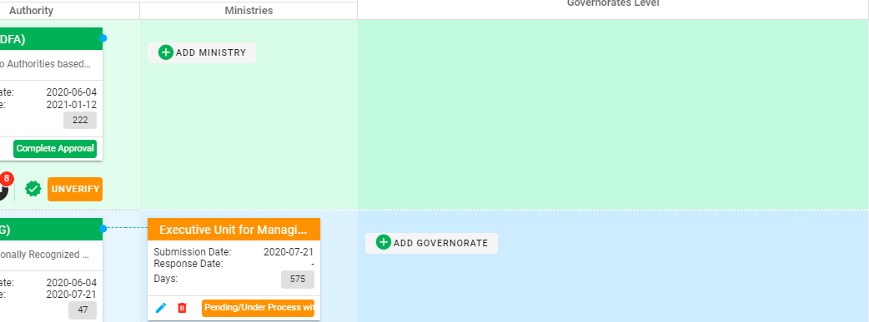
UNOCHA Sub-Agreements/AMRF Trackers
Technical Overview
https://trackers.ochayemen.org

Slide 3
Sub-Agreements Tracker
OCHA Sub-Agreements Information Tracking System, is an interactive web solution for managing and tracking project-profiles and sub-agreements submitted by implementing humanitarian partners to the corresponding authorities and track the progress of their approval. The system allows OCHA to oversee and administrate the various parts of the system and provide the necessary communication and support when needed. The system is also equipped with reporting and data analysis tools.

Slide 4
Platform Features
Projects Profiles
Sub-Agreements
Notifications
Reports
Analytic Dashboards
AMRF (Access Monitoring & Reporting Framework) Tracker
Access Control & Administrative Tasks

Slide 5
Project Profiles
General data about the project to be implemented, such as schedule, target beneficiaries, target areas, budget, sectors and donors.
No-Cost Extension adjustment details can also be added in Project Profiles.

Slide 6
Sub-Agreements
Are the entities by which we submit and follow up approval requests to related authorities.
Project Profile can have one or two Sub-Agreements, one for each government authority type (e.g., IRG or DFA)
Additional Sub-Agreement can be added for No-Cost Extension.
Sub-Agreements are automatically created when creating Project Profile based on selected target authorities. They can also be created manually by users.

Slide 7
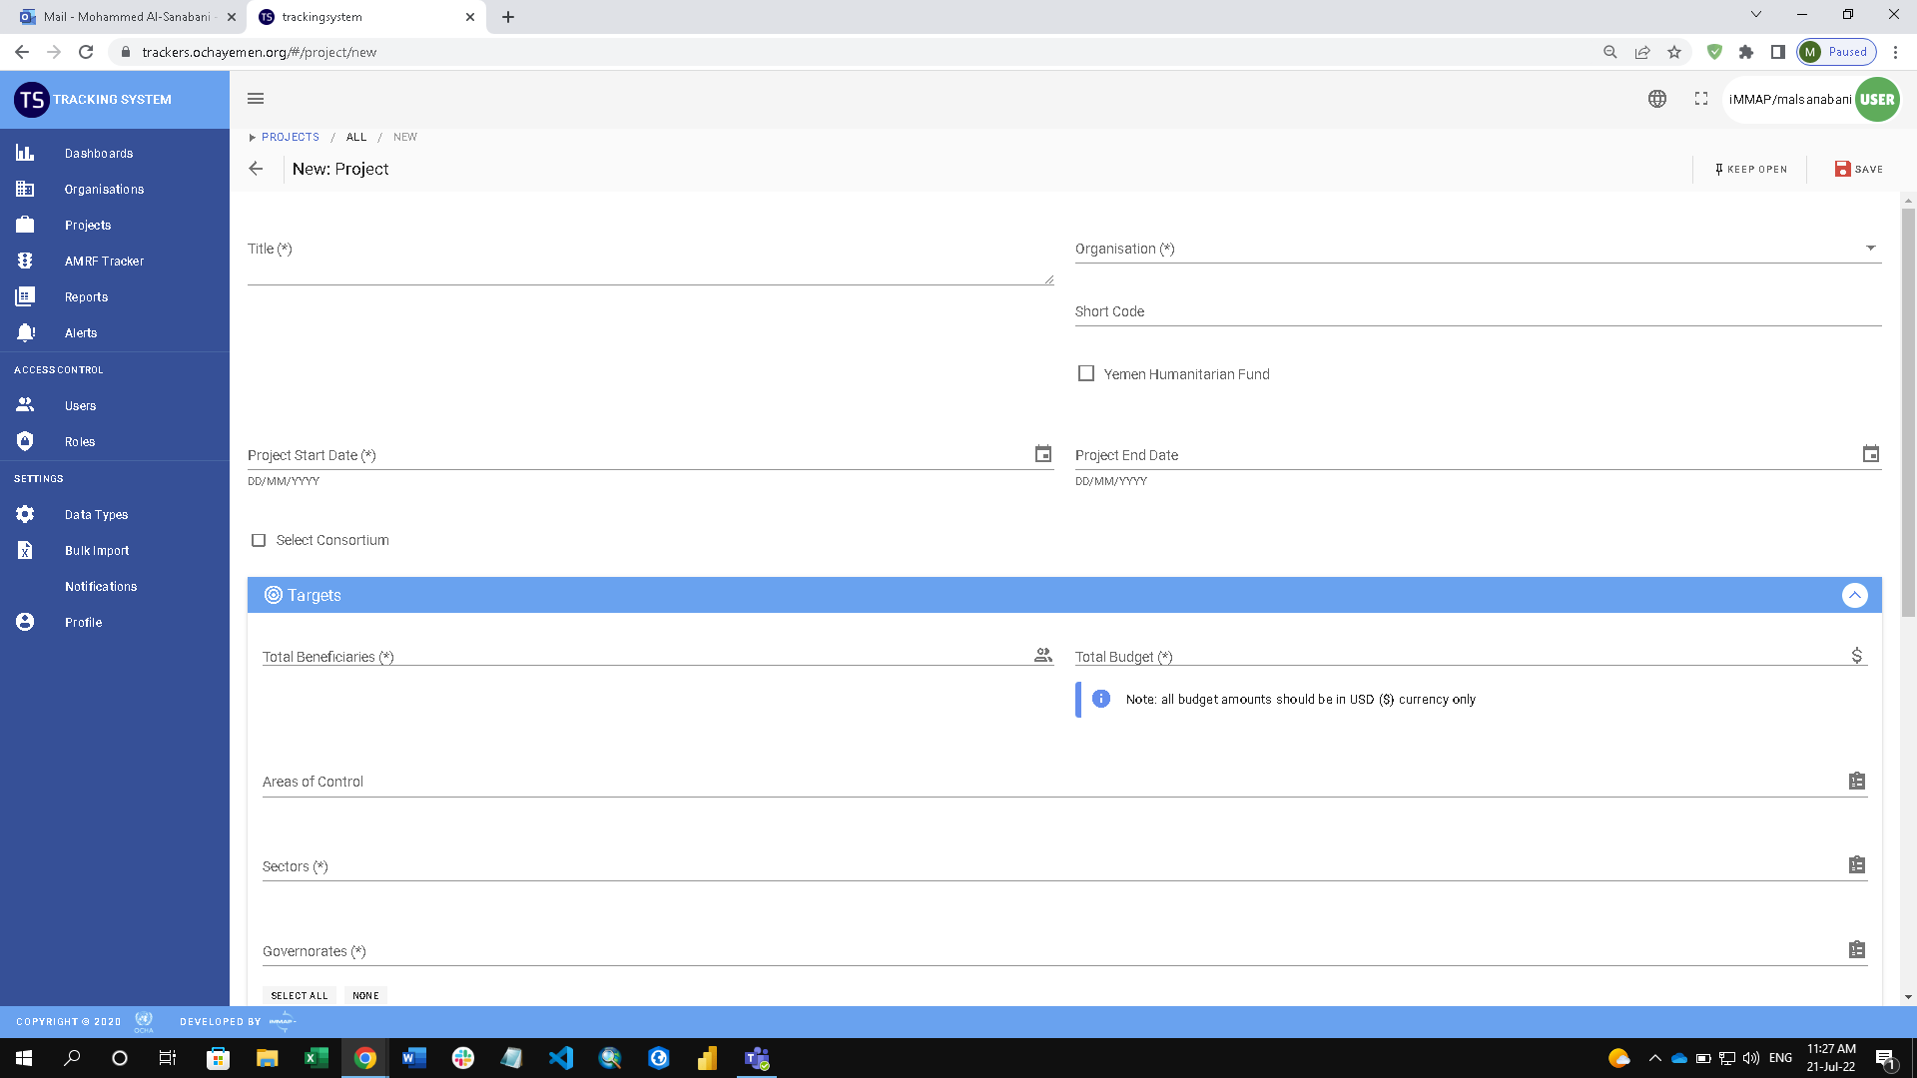

Slide 8
Reports
They are downloadable Excel format reports
Contains detailed or raw data sets, which can later be used for review, search, custom analysis, or custom dashboards.
Just like dashboards and other user interface views, users will have access to different set of reports based on their access level and permissions.

Slide 9
Analytic Dashboards
A set of interactive dashboards and information visuals with filters.
Just like reports and other user interface views, users will have access to different set of reports based on their access level and permissions.

Slide 10
Notifications
Automatic notifications will be sent to administrators when certain activities happen, such as:
New user registration
Creating or updating Sub-Agreements
Request for Sub-Agreement deletion
Comments, Events, and Alerts are another mechanism for internal communication.

Slide 11
Access Control & Administrative Tasks
Adding and managing organizations, users, access level, and permissions.
Adding and modifying data entry lists options, such donors, sectors, authority names, etc.)
Managing notification options.

Slide 12
AMRF Tracker
AMRF Tracker is an example of the platform modularity, where we can add more components and trackers, combined with their own set of reports and analytic dashboards.
AMRF Tracker is a dedicated component for tracking security incidents in a dynamic way that helps in reaching the quickest engagement and response.

Slide 13
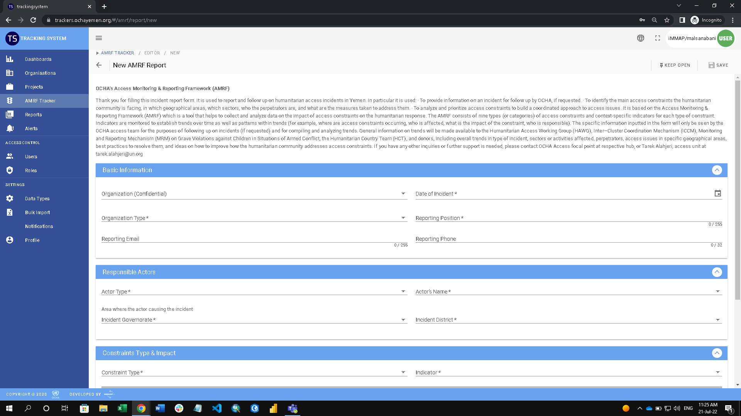

Slide 14
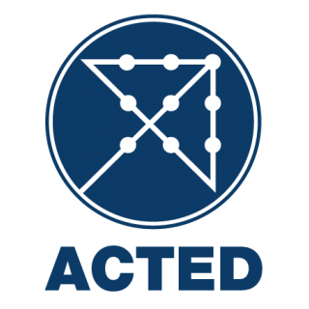
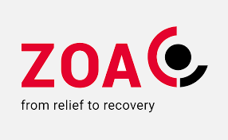
Since the launch of the “AMRF” tool, (152) incidents reported
56
INGO/NNGO
56
21
14
11
10
06
05
05
03
03
03
02
02
94
UN
37%
01
14%
IMC, RI, PHA, QC, AGFD, PU-AMI, FMF, AFDAD
09%
07%
07%
04%
03%
03%
01
02%
02%
02%
01%%
01%%
WHO

Slide 15
Trackers Security
The system has been developed with security priority in mind, we applied technological techniques and encryption in order to deliver a secured experience while using the system.
And on top of that, the system has been tested for vulnerabilities and penetration and endorsed by web specialized security firms with great score.

Slide 16
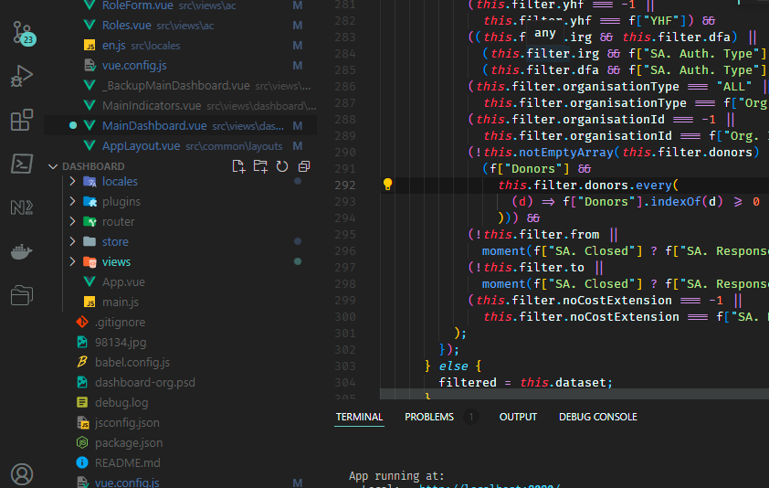
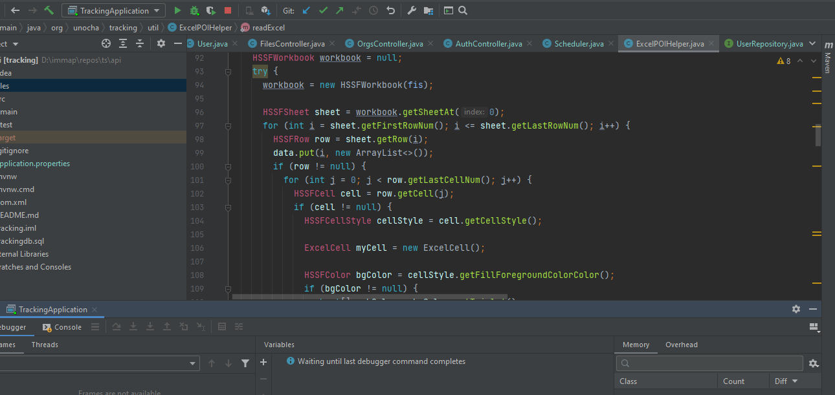
Modern Development Technologies
The system has been developed using a set of the best software development technologies, such as Java which is well know for building advanced and robust enterprise solutions.
For modern and highly interactive and component-based user interface development we used JavaScript/Vue framework, which is one of the top 3 frameworks for this type of development.
For databases PostgreSQL is also among the top in speed and security.
The Database Schema Design is also a great example of team collaboration and design, which took in consideration various aspects and solutions for data control and analysis.
The platform is hosted in AWS servers, with the highest security levels. AWS is considered the most trusted PAS (Platform as a service) available.

Slide 17
Questions

