Slide 1
FLOOD TRACKING TOOL ROWCA
19 July 2022

Slide 2
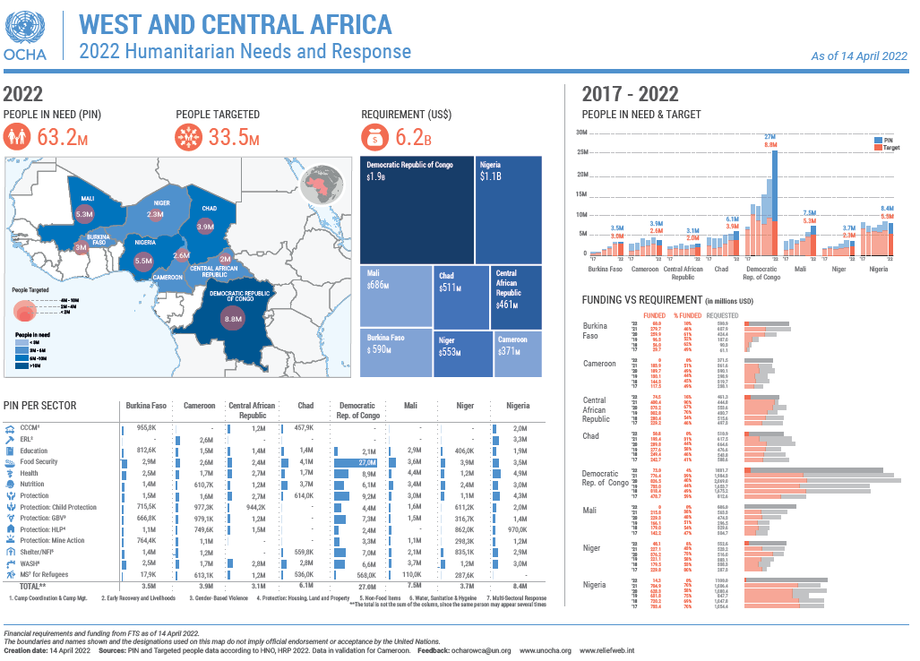

Slide 3
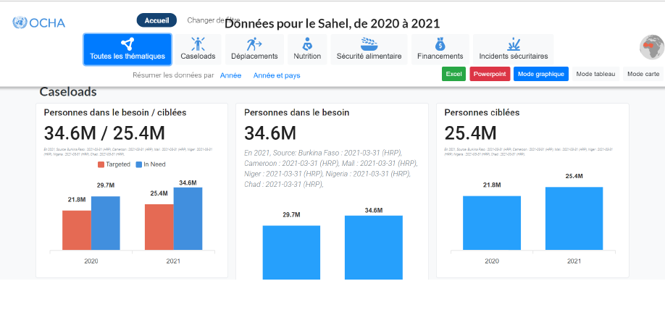

Slide 5
Outline
Flood tracking tool used in 2019
Objectives of the new monitoring tool
Methodology of the new monitoring tool
Flooding Snapshot 2020- 2021
Flooding Snapshot 2022 . New approach

Slide 6
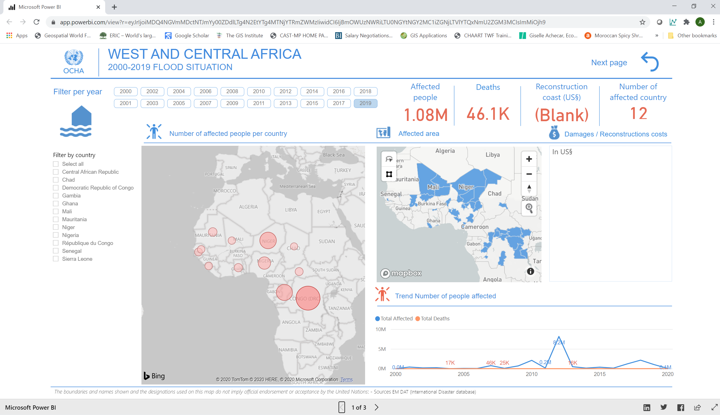
Flood tracking tool used in 2019
EM-Dat
The main data source does not provide real-time data and only monitors floods with a high impact.
Data are only available at the national level, which limits knowledge about the magnitude and impacts of flooding
Notes:
Critères EMDAT pour la saisie des données :
10 personnes ou plus rapportées tuées
100 personnes ou plus rapportées affectées
Appel à l'aide internationale
Une déclaration d'urgence

Slide 7
Objectives of the new monitoring tool
Monitor the flood situation in the region in (near) real time
To better estimate the magnitude and impact of floods
Compare the flood situation over time and between periods
Create a product that provides a regular overview (every two weeks) of the flood situation in the region
Analysis: Response funding vs Recurrency of flooding
Notes:
Monitor the flood situation in the region in real time
To better estimate the magnitude and impact of floods
Compare the flood situation over time and between periods
Create a product that provides a regular overview (every two weeks) of the flood situation in the region.

Slide 8
Methodology of the new monitoring tool
Data collection
2 focal points (1 IM –, 1 PCR –)
Main sources: OCHA Country Offices, Civil Protection Agency, IFRC, Reputable Media Sources (e.g. Floodlist)
Daily work during the rainy season
Data Collection
1

Slide 9
Data collection methodology (1/3)
How to collect data
Two focal points: Coordination and IM
Coordination:
Step 1: Collect data from non-OCHA countries
Step 2: Send the information to to verify and complete the data
Step 3: Processing and entering data into the collection matrix by IM
IMO:
Step 1: Collect data from OCHA countries
Step 2: Check the data with the MIs of the different countries
Step 3: Processing and entering data into the collection matrix

Slide 10
Data collection methodology (2/3)
2. Data sources
DoU of countries
Press clippings
Information shared by country focal points (emails)
Reports of the Directorate of Civil Protection (DPC)
HR Info
Reliefweb
Floodlist: http://floodlist.com/
ifrc GO.DATA PLATFORM

Slide 11
Data collection methodology (3/3)
3. Challenges
Find flood data
Find the reliable data
Find timely updated data
Find the most disaggregated data possible (by admin1 and admin2)
Find data by category (people affected, killed, injured, displaced, houses destroyed, crops destroyed)
Regularity of Data sharing

Slide 12
Methodology of the new monitoring tool
Data collection
2 points focaux (1 IM, 1 PCR)
Principales sources : Bureaux pays de OCHA, Agence de protection civile, FICR, Sources de médias réputés (e.g Floodlist)
Travail quotidien pendant la saison des pluies
Updating the preview
Collecte de
données
1
Data verification
1 focal point (1 IM)
Updated every two weeks
Shows the magnitude and impact of flooding for:
All year round
Since the last version. .
5
3 focal points (2 IM 1 PCR s)
To ensure that no flooding is missing
Triangulate to ensure the most up-to-date information on all events has been entered
Check for inconsistencies and report them
Vérification des
données
Mise à jour de
l'aperçu
2
Data analysis
4
Data processing
Traitement des
données
1 focal point (1 IM)
Aggregate data on the number of people affected, killed, injured, displaced and homes destroyed/damaged
Disaggregated by country and coverage period
Analyse de
données
1 focal point (1 IM)
Clean up data
Ensure that all necessary empty fields are filled in, e.g. calculating the number of people affected based on affected households
3

Slide 13
Flooding Snapshot 2020-2021

Slide 14
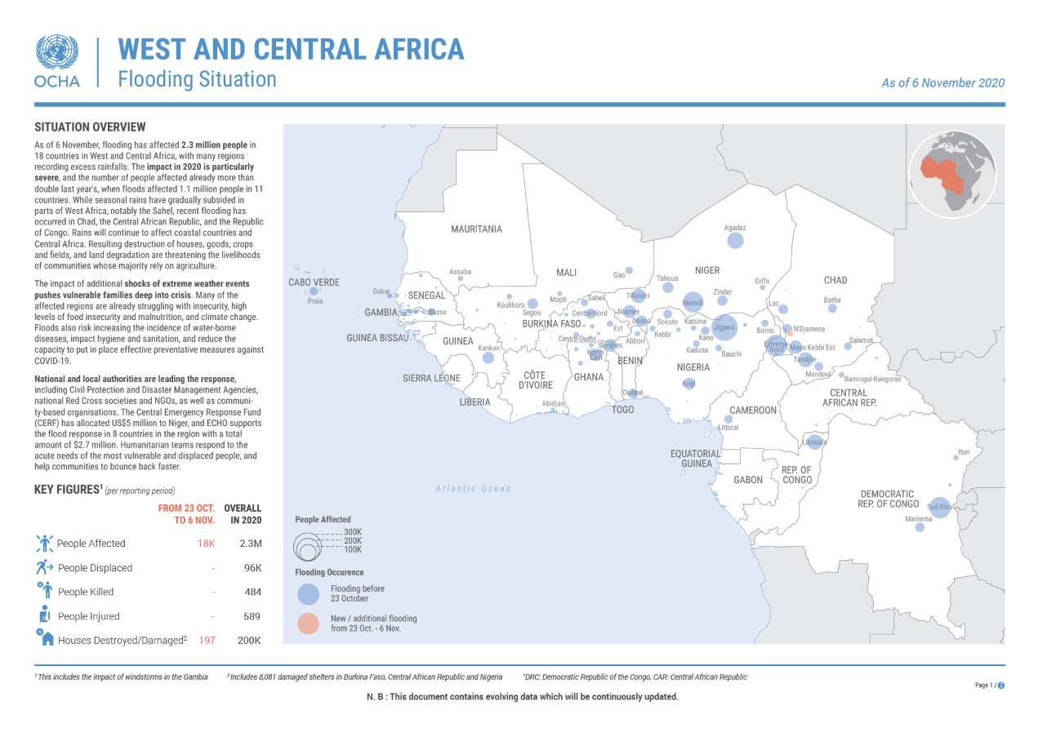

Slide 15
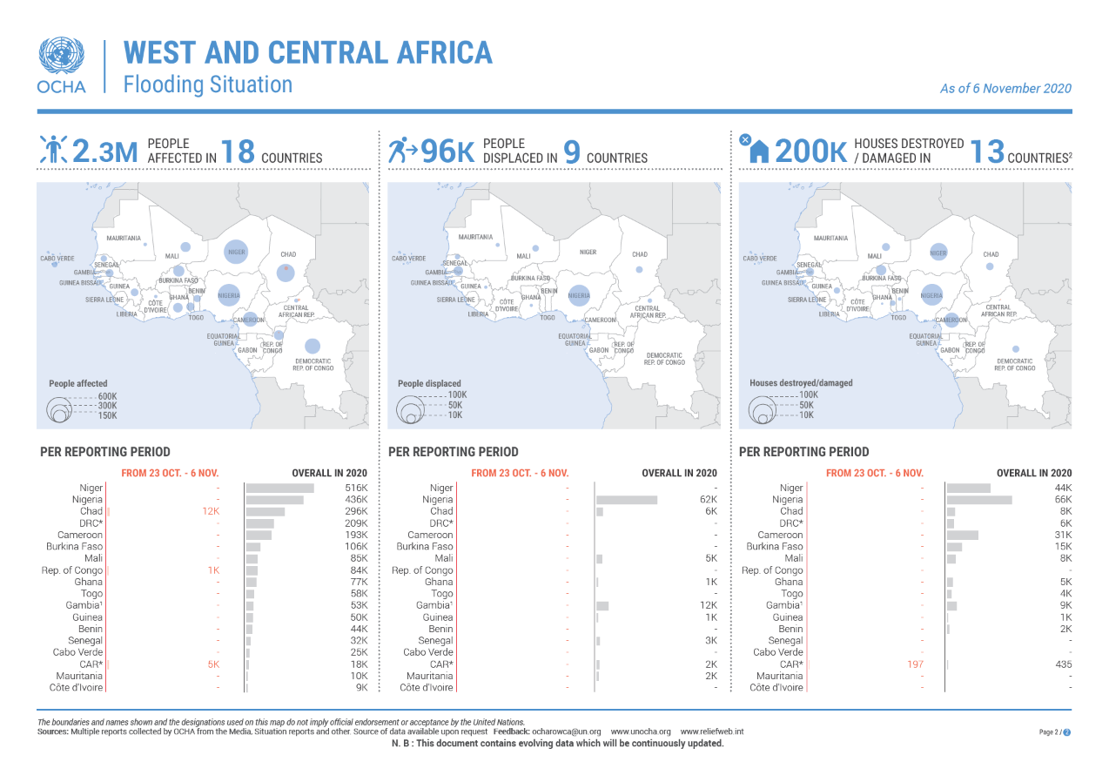

Slide 16
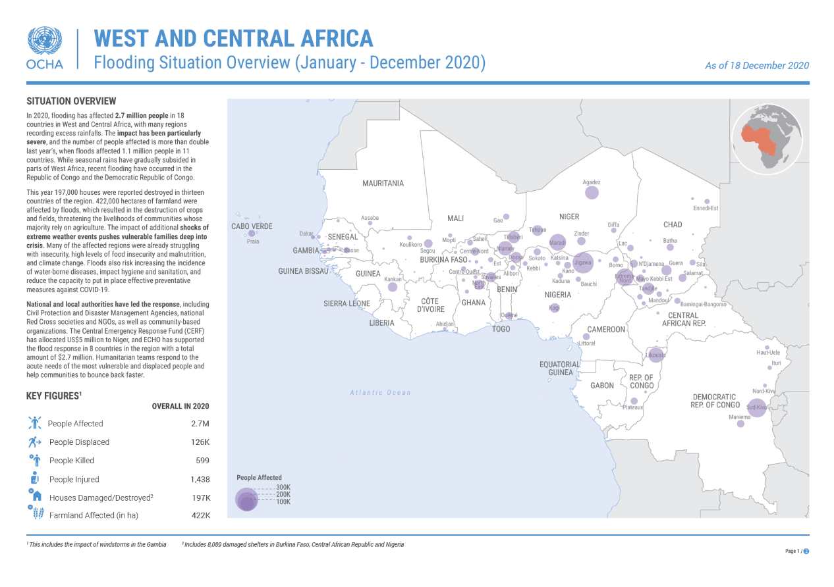

Slide 17
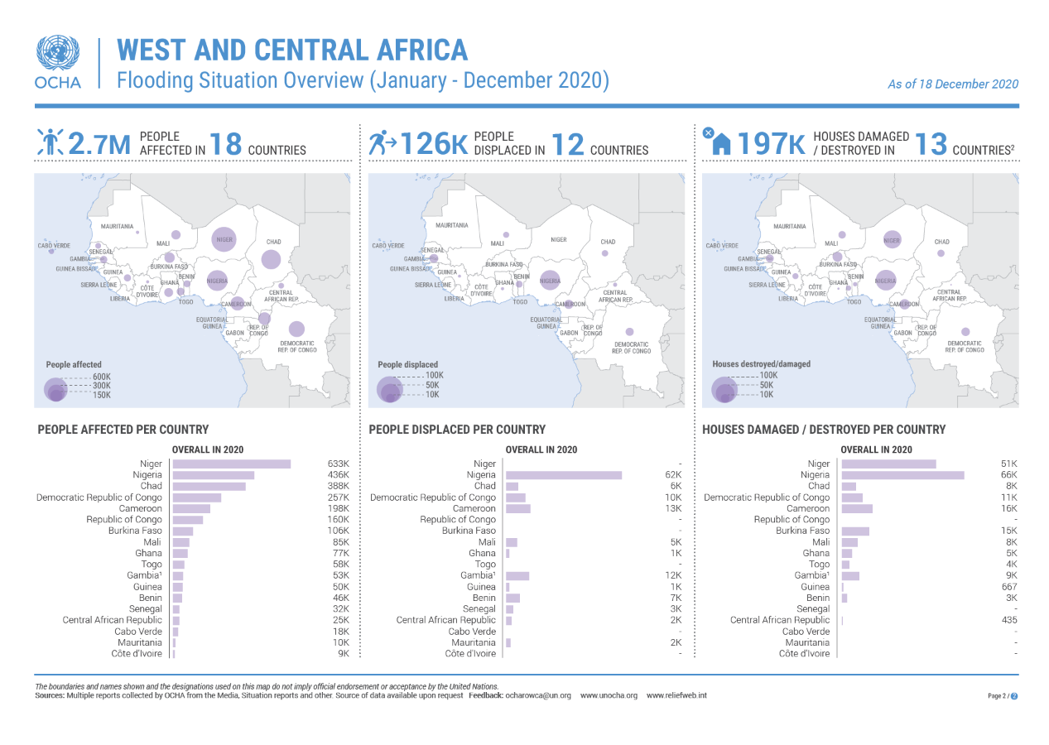

Slide 18
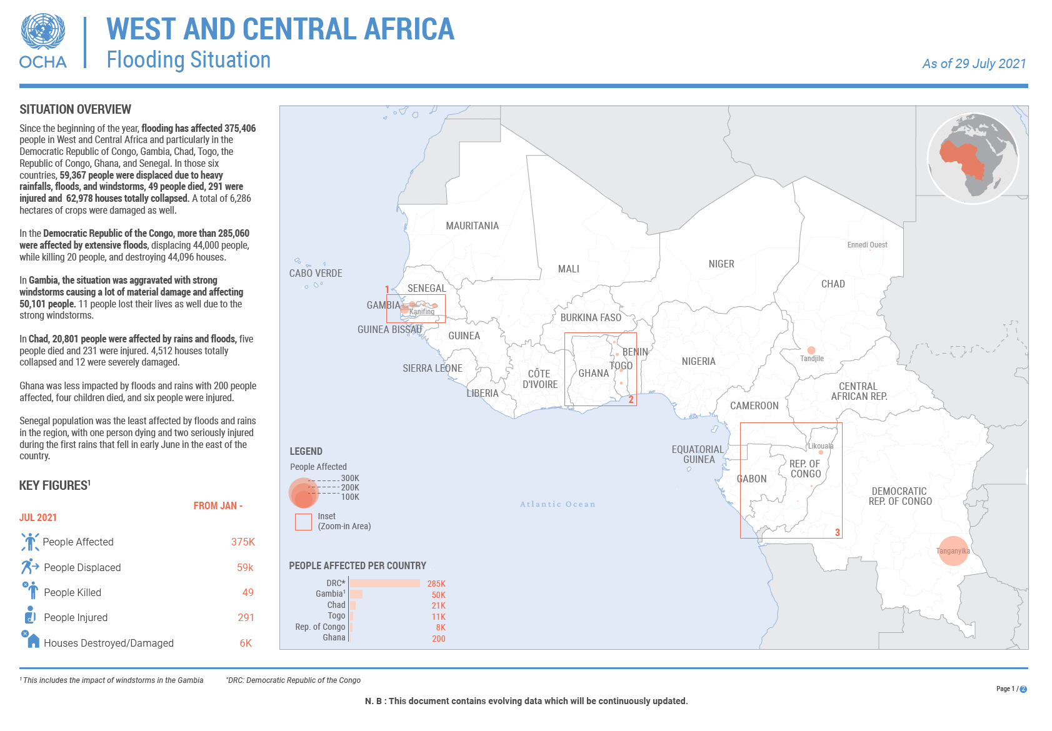

Slide 19
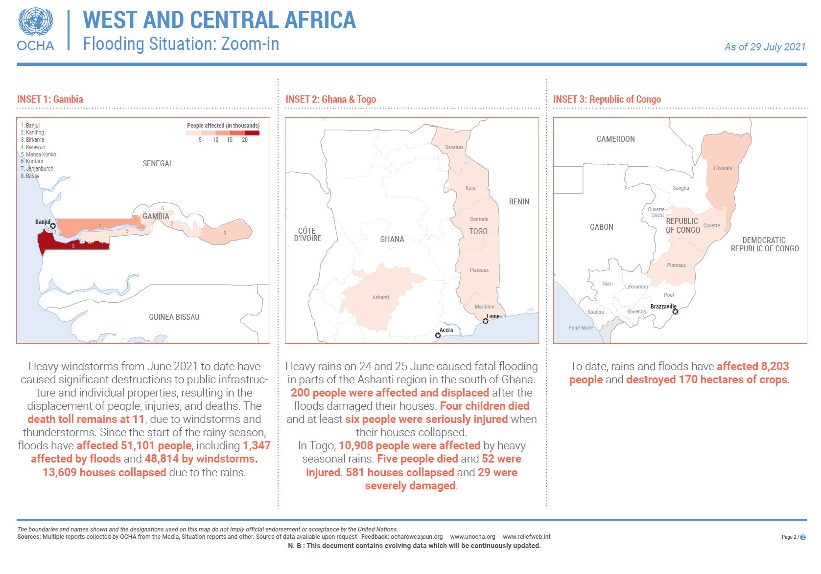

Slide 20
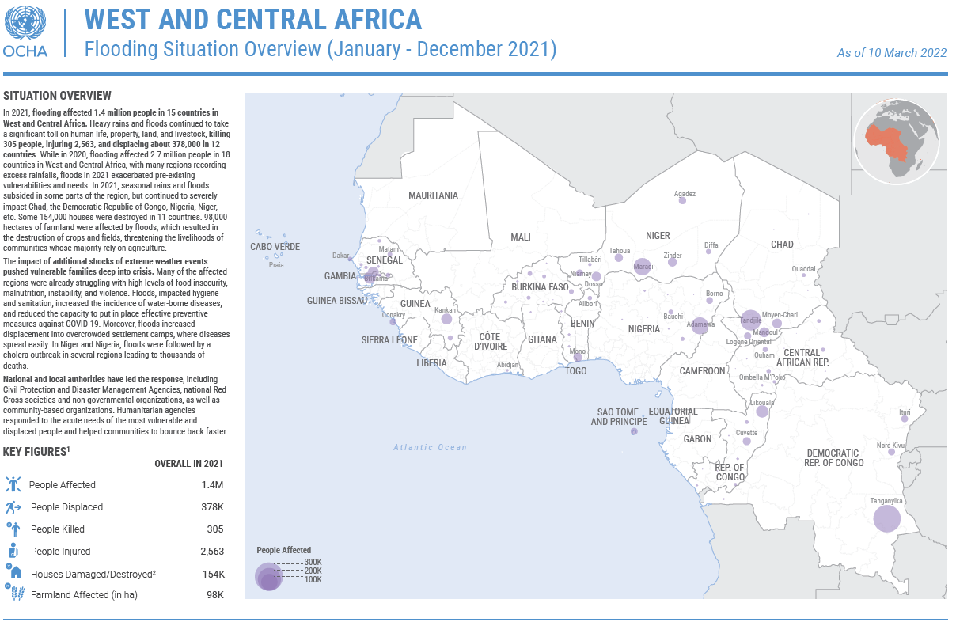

Slide 21
Flooding Snapshot 2022 . New approach

Slide 22
A. DATA/ INFORMATION COLLECTION
1. Data on impact of flooding will be collected by the flood focal points in the IM, PCR and PI units as follows:
The PI flood monitoring focal point shares information related to flooding as reported in the weekly and daily operational updates (DoU)
The IM flood monitoring focal point collects data for countries where we have OCHA Country Offices
PCR flood monitoring focal point collects data for non-OCHA countries and shares with IM flood monitoring focal point for verification
2. PCR flood monitoring focal point is responsible for collecting information on response and funding. When requesting data on the impact of flooding from OCHA Country offices, the IM flood monitoring focal point will also request response-related data.
3. Regional Humanitarian Financing Unit will also provide data on funding related to flooding, when available.

Slide 23
B. DESIGN
1. Snapshot to launch the flooding season
Publication date: First week of July (immediately after ACMAD launches their annual rainfall forecast)
Content:
2. Snapshot during the flooding season
Publication date: By the 10th day of each month between August and October 2022, and possibly November depending on the situation
Content:
3. Snapshot to close the flooding season
Publication date: During the month of January of the following year. It will be accompanied by a PowerPoint presentation with analysis.
Page 2: Map at admin 0 level and graphs on people affected, people displaced, and houses destroyed
Page 3: Zoom-in page. The areas to be captured on the Zoom-in page will be determined based on the following criteria:
Transborder flooding
Page 4: Focus on Preparedness and Advocacy, showcasing regional flood risk map and ACMAD weather forecast map covering the rainy season.
Page 1: Global Overview with a map at admin 1 level, key figures, and textual description of the situation.
Countries without an OCHA office or with less visible flooding because of the size of impact.
Page 1: Global Overview with a map at admin 1 level, key figures, and textual description of the situation. Narrative will also include information on funding received and response provided. They will also be a text box with an advocacy message.
Page 2: Map at admin 0 level and graphs on people affected, people displaced, and houses destroyed
Page 3: Zoom-in page.
Content:
Page 1: Global Overview with a map at admin 1 level, key figures, and textual description of the situation including analysis of hotspots and trends.
Page 2: Map at admin 0 level and graphs on people affected, people displaced, and houses destroyed
Page 3: Focus on Response and Advocacy. Showcase overall response carried out during the year based on information available. It will also include advocacy messages.

Slide 24
C. DISSEMINATION
The flooding snapshot will be disseminated via:
OCHA ROWCA Mailchimp
EPR mailing list
Regional Communication Group mailing list
It will also be distributed to all countries in the region, including those not affected by the flood during the coverage period.

Slide 25
Conclusions
Still a long way to go.
Data is collected manually and upon request
Validation takes time (info is not well structured)
Interest on flood monitoring by many institutions but none are (really) willing to work together
Automatic tools in development (i.e. PDC AI tool…)
Regional component as an added value ( cross border flood impact)

Slide 26
Merci

