Slide 1
Using for Contact Management
Thomas Elter, Ukraine
28 July 2022
Expert Workshop on Information Management Leadership: an IM Community of Practice Event (COPE), Istanbul, Türkiye, 25-29 July 2022

Slide 2
TABLE OF CONTENT
1
2
3
4
Purpose
Benefits
Statistics
Dashboard

Slide 3
1
PURPOSE

Slide 4
PURPOSE
01
02
03
04
OCHA
Collects and manages contact info on behalf of humanitarian community
Invitations
GCM, Hub GCM and NGO Briefings
Coordination
Through sharing contact info with Clusters
Periodically
On demand
Welcome email
Info sharing
On public contacts dashboard
(if consent was given)

Slide 5
2
BENEFITS

Slide 6
BENEFITS
Self-subscription
Users sign up and enter data themselves
Landing page
QR code
GCM/IMWG
New staff welcome email
Self-update
Users update and maintain their contact info themselves
Targeted comms
Campaigns based on subscription and data entry
Consent
For sharing contact info publicly or for coordination only

Slide 7
3
STATISTICS

Slide 8
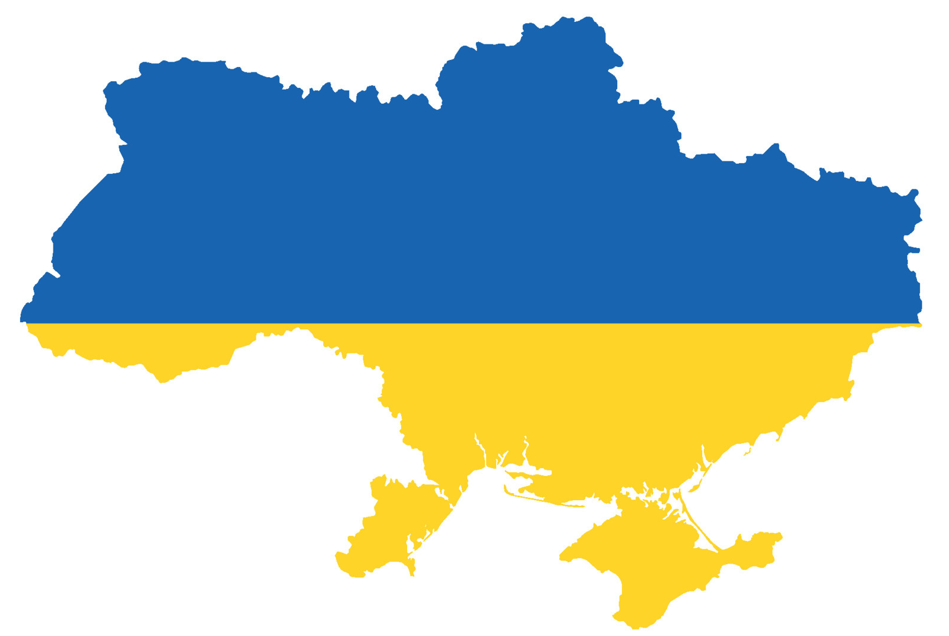
TOTAL AUDIENCE (28 July 2022)
6,949 contacts
5,011
General Distribution List
For receiving OCHA info products
1,938
Humanitarian Contact List
Used for coordination

Slide 9
CONSENT BREAKDOWN
40%
18%
42%
Public sharing
Contacts visible on public dashboard
Coordination only
Contacts being used “internally” within clusters
No indication
Mostly early subscribers, percentage decreasing

Slide 10
3
DASHBOARD

Slide 11
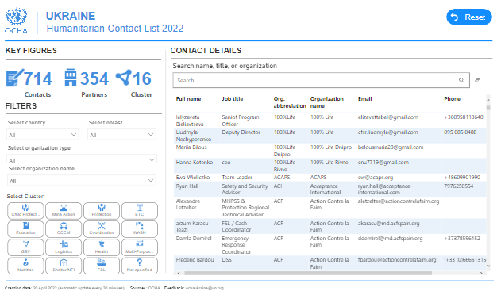
CONTACTS DASHBOARD

Slide 12
THANK YOU!

Slide 14
Contact Management using
Who is using PowerApps?
Use case: UKR UHF Partner Registration Form

Slide 15
PROCESS

Slide 16
SPECS
Self-submission
Users fill out Kobo form and provide contact data
Data consolidation
Automated push of data to SP List and Excel master file
Under development: flow checks if new entry or update
Email notification
Automated email to requester and UHF focal point
Campaigns
Targeted and automated outreach based on user data submission - triggered manually or periodically

Slide 17
THANK YOU!
FOR REAL!
QUESTIONS?

