Slide 1
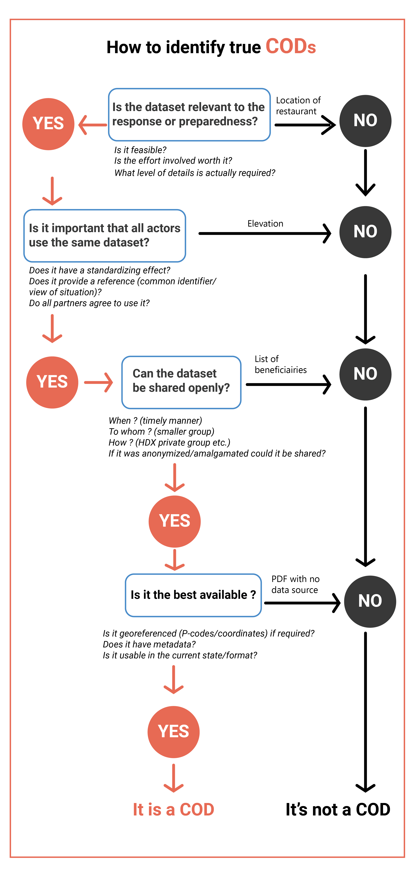
What is a COD?
The flow chart identifies the criteria of a COD. It can be used to help identify if a dataset is a COD.

