Slide 1

FINANCIAL TRACKING SYSTEM (FTS)
Guide for Whole of Syria partners on reporting contributions
March 2018

Slide 2

INTRODUCTION
What is the Financial Tracking System ?
Who reports to the FTS ?
How does the FTS work ?
What does the FTS do with the data ?
Why report contributions to the FTS ?
How to report contributions to the FTS ?

Slide 3
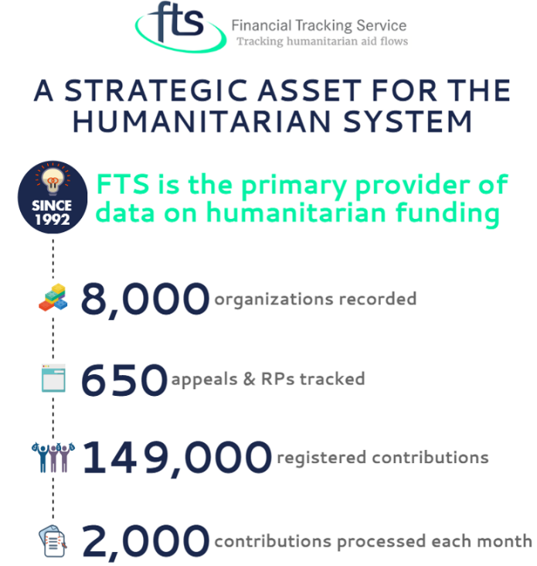
WHAT IS THE FINANCIAL TRACKING SYSTEM ?
A global, on-line, real-time overview of humanitarian funding needs and
international funding flows.
The Financial Tracking System (FTS) aims to present a complete picture of all international humanitarian funding flows.
It is managed by the UN Office for the Coordination of Humanitarian Affairs (OCHA).

Slide 4
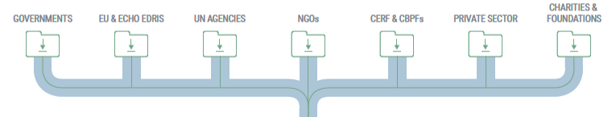
WHO REPORTS TO THE FTS ?
FTS counts on multiple sources of reporting: governments, the European Union, UN Agencies, NGOs, CERF and CBPFs, the private sector, charities and foundations.
All humanitarian actors should report their funding to FTS on a regular basis.
CERF and Country Based Pool Fund (CBPF) contributions do not need to be reported to FTS. FTS receives the data directly through the CERF Secretariat and OCHA systems.

Slide 5
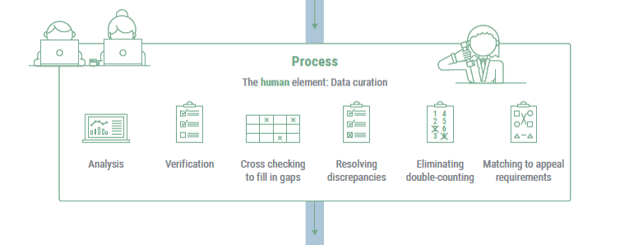
HOW DOES THE FTS WORK ?
The FTS dataset is fed by reports on funding flows and pledges provided by donors and recipient organizations.
FTS verifies and cross-check these reports using a consistent methodology, ensuring that data is fully comparable and presented as a seamless whole.

Slide 6
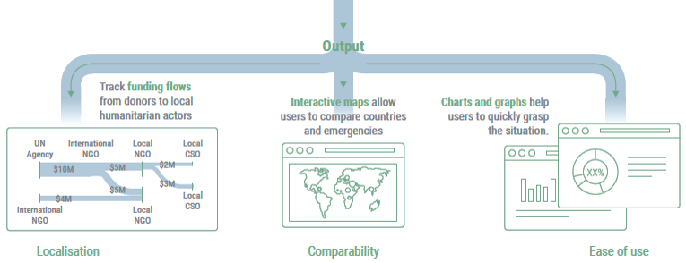
WHAT DOES THE FTS DO WITH THE DATA ?
FTS supports the transparency and accountability of the humanitarian system and facilitates resource mobilisation.
FTS informs real-time decision-making at both national and global levels across all humanitarian emergencies and actors.

Slide 7
WHY REPORT CONTRIBUTIONS TO THE FTS ?
FTS improves resource allocation decisions and advocacy by clearly indicating to what extent humanitarian funding are received, especially against the requirements of the HRP.
FTS allows donors to direct funds to where they are most needed by providing an overview of who is doing what to respond to crises and highlighting under-funded projects, organisations and sectors.
FTS supports the transparency and accountability of the humanitarian system : it informs real-time decision-making at both national and global levels across all humanitarian emergencies and actors, so that decisions won’t just be based on the amount of money received, but on how this relates to progress against our stated objectives, and ultimately to the impact on the needs of beneficiaries.

Slide 8
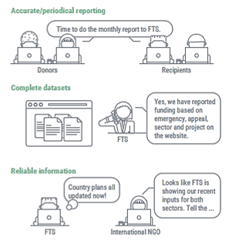
WHY REPORT CONTRIBUTIONS TO THE FTS ?
All partners commit to reporting to FTS when they include their projects on OPS.
For the Whole of Syria response, the Humanitarian Coordinator and Regional Humanitarian Coordinator have requested that periodic reviews of funding and activities be implemented.
Lack of reporting can lead to requests to lower funding requirements mid-year, giving the impression that targets are met with less funding received

Slide 9
WHY REPORT CONTRIBUTIONS TO THE FTS ?

Slide 10
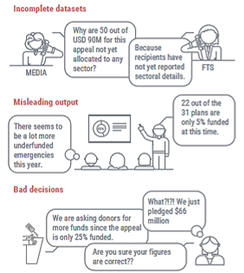
WHY REPORT CONTRIBUTIONS TO THE FTS ?
Being based on a voluntary reporting mechanism, the quality of the information provided by FTS can only ever be as good as the data it contains.
Full commitment of stakeholders to reporting contributions leads to effective support to people in need and increased humanitarian system credibility thanks to better decision making and more efficient allocation of funds.

Slide 11

HOW TO REPORT CONTRIBUTIONS TO THE FTS ?
Excel template

Slide 12
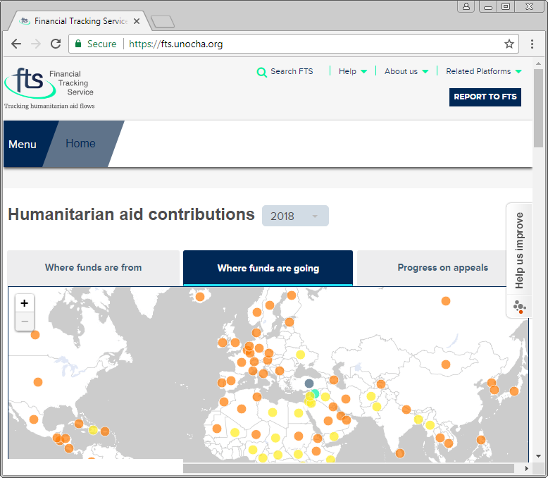
EXCEL TEMPLATE | STEP-BY-STEP INSTRUCTIONS
Enter the following URL in your web browser: https://fts.unocha.org
Click on the “REPORT TO FTS” button.

Slide 13
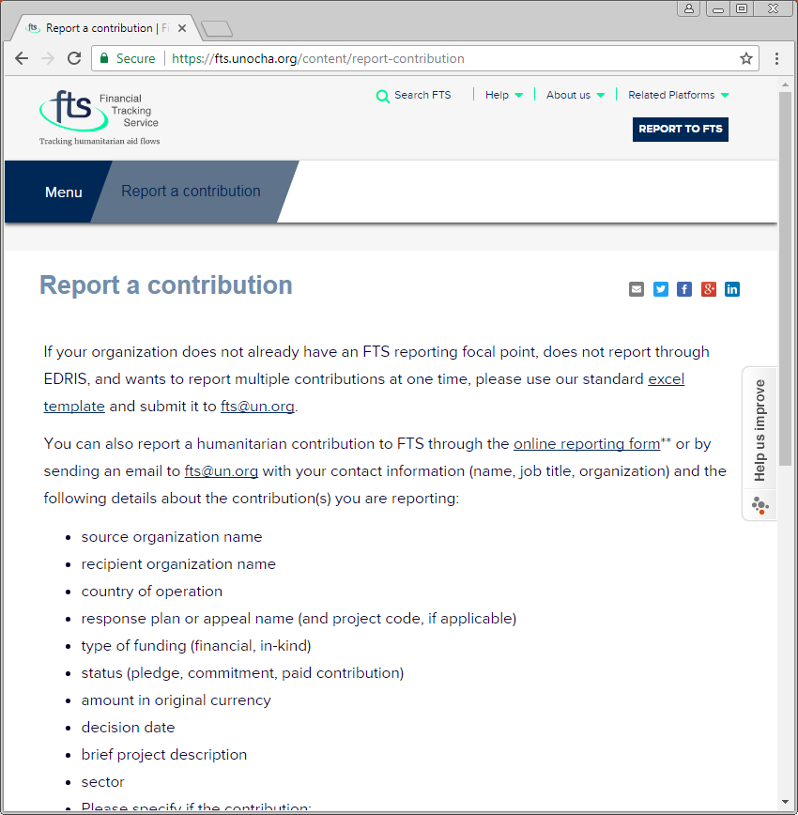
FTS Website
Partners that want to report multiple contributions at one time can download the standard Excel template by clicking on “excel template”.
Next, open the Excel file “international_humanitarian_assistance-reporting_template.xls” that was downloaded to your computer.

Slide 14
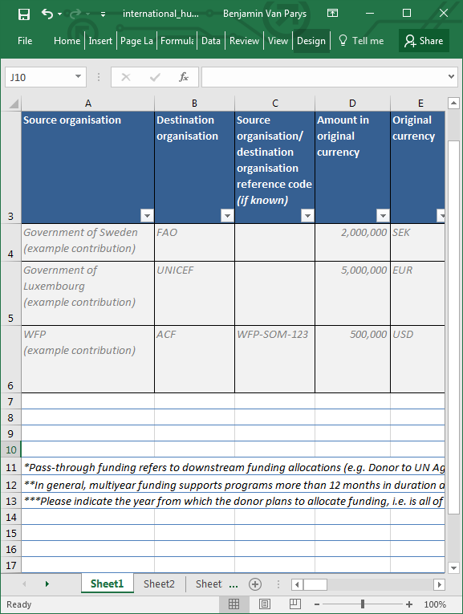
Donor and Recipient Information
SOURCE ORGANIZATION *
Enter the original source of the funds (e.g. Government donor, fund, private sector organization)
DESTINATION ORGANIZATION *
Enter the organisation that is receiving the funds to implement the project (e.g. international NGO, national NGO, UN agency)
SOURCE ORGANIZATION/DESTINATION ORGANISATION REFERENCE CODE (IF KNOWN)
Enter the project code given by the source or destination organisation.

Slide 15
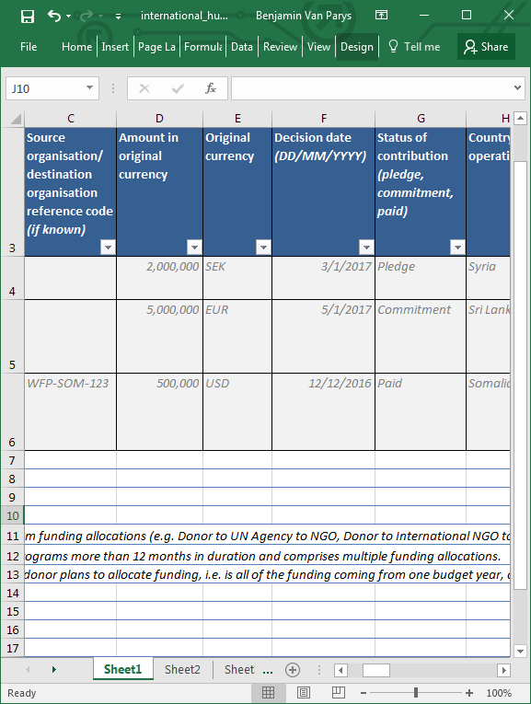
Funding Details
AMOUNT IN ORIGINAL CURRENCY *
Enter the amount of the contribution to the project in the currency entered in the next column.
ORIGINAL CURRENCY *
Enter the currency of the contribution to the project (e.g. EUR, USD).
DECISION DATE (DD/MM/YYYY) *
Enter the date on which the source organisation decided to contribute to the project.
STATUS OF CONTRIBUTION *
Enter the status of the contribution: commitment (the contribution has been confirmed), paid (the contribution has been received by the destination organisation), or pledge (the contribution has been promised).

Slide 16
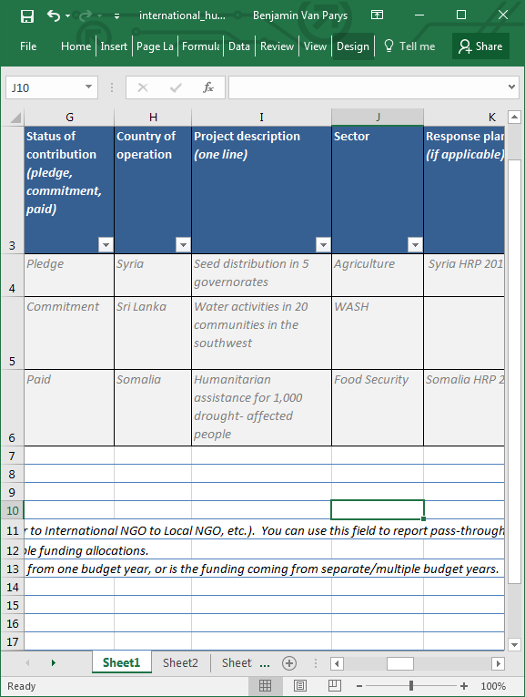
Project Details
COUNTRY OF OPERATION
Enter the country where the project is implemented (e.g. Syria). If the funding is for multiple countries and the money by country breakdown is known, please submit separate contribution forms for each contribution.
PROJECT DESCRIPTION *
Describe briefly in one line the project that is being implemented with the contribution.

Slide 17
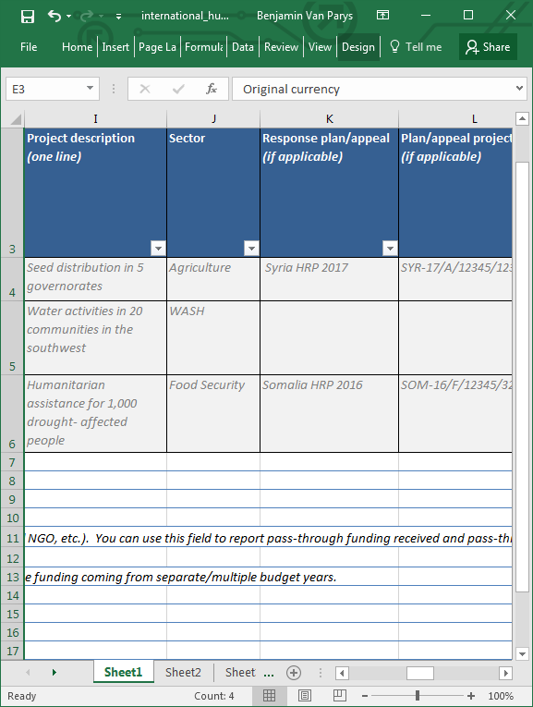
Project Details
SECTOR *
Enter the sector the project falls under in the HRP. It can be one of the following:
  CCCM
  Coordination and Support Services
  Early Recovery and Livelihods
  Education
  Food Security & Agriculture
  Health
  Nutrition
  Protection
  Shelter/Non-food Items
  Water, Sanitation, and Hygiene
  Other
This information is crucial for projects submitted under the Whole of Syria Humanitarian Response Plan. Please do not select “Other” unless no aid sector listed corresponds to your activity or project.

Slide 18
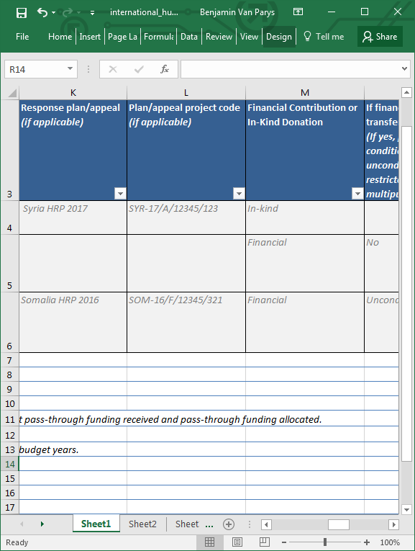
Project Details
RESPONSE PLAN/APPEAL
Enter the name of the name of inter-agency humanitarian response plan (HRP)/appeal that the project falls under (e.g. Whole of Syria HRP 2018).
PLAN/APPEAL PROJECT CODE
Enter the project code provided by the Online Project System (OPS).
This information is crucial for projects submitted under the Whole of Syria Humanitarian Response Plan.
FINANCIAL CONTRIBUTION OR IN-KIND DONATION *
Enter if the contribution was a financial contribution (money) or an in-kind donation (food, non-food items, equipment, etc.)

Slide 19
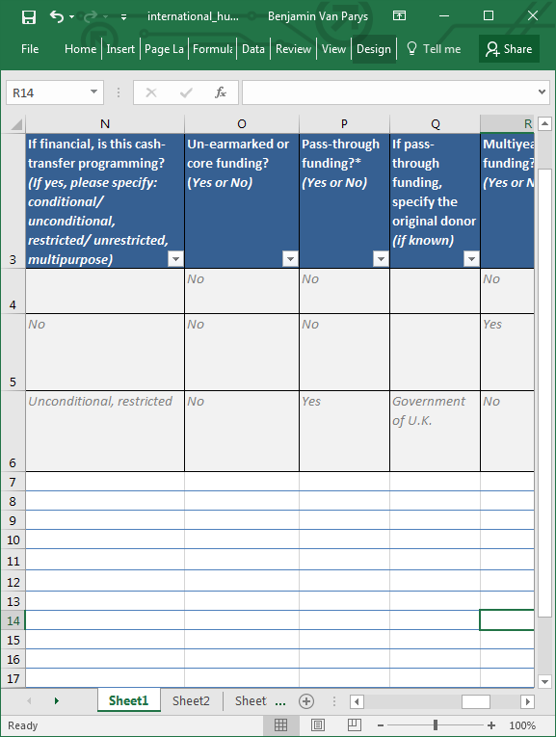
Project Details
IF FINANCIAL, IS THIS CASH-TRANSFER PROGRAMMING ?
If the contribution is financial, specify if it is conditional or unconditional, restricted or unrestricted, or multipurpose.
DEFINITIONS
Conditional transfers require beneficiaries to undertake a specific action/activity (e.g. attending school, building a shelter, attending nutrition screenings, undertaking work, trainings, etc.) in order to receive assistance; i.e. a condition must be fulfilled before the transfer is received. Cash for Work/Cash for Assets/Cash for Training are all forms of conditional transfer.
Unconditional transfers are provided to beneficiaries without the recipient having to do anything in return in order to receive the assistance.
Restricted transfers require the beneficiary to use the assistance provided to access specific, pre-determined goods or services. Vouchers are by default restricted transfers as the range of goods and services and/or the retailers or service providers from which they are accessed are pre-determined.
Unrestricted transfers can be used entirely as the recipient chooses; i.e. there are no restrictions on how the transfer is spent.
Multipurpose cash transfers are transfers (either regular or one-off) corresponding to the amount of money households need to cover, fully or partially, a set of basic and/or recovery needs. Multipurpose cash transfers are by definition unrestricted.
Source: Cash Learning Partnership

Slide 20
Project Details
UN-EARMARKED OR CORE-FUNDING ?
Select “Yes” from the drop-down list if the contribution is a un-earmarked funding allocation (core-funding). Select “Don’t know” if you are unsure.
PASS-THROUGH FUNDING ?
Pass-through funding refers to downstream funding allocations (e.g. Donor to UN Agency to NGO, Donor to International NGO to Local NGO, etc.). You can use this field to report pass-through funding received and pass-through funding allocated. Enter “Don’t Know” if you are not sure.
IF PASS-THROUGH FUNDING, SPECIFY THE ORIGINAL DONOR
If reporting pass-through funding, specify the original donor of the contribution.

Slide 21
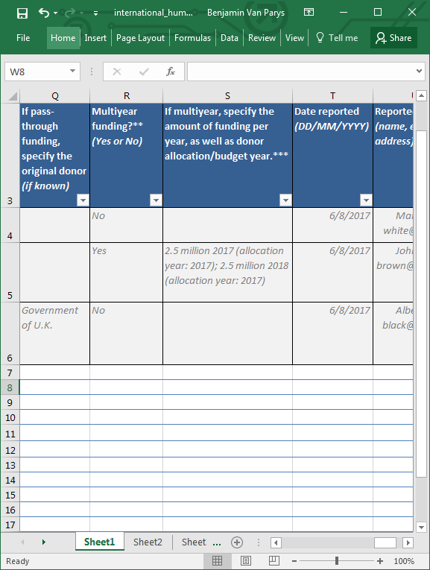
Additional Funding Information
MULTIYEAR FUNDING ?
Enter “Yes” if it is a multiyear funding that supports a project more than 12 months in duration and comprises multiple funding allocations. Is all of the funding coming from one budget year, or is the funding coming from separate/multiple budget years ?
IF MULTIYEAR, SPECIFY THE AMOUNT OF FUNDING PER YEAR, AS WELL AS DONOR ALLOCATION/BUDGET YEAR
If it is a multiyear funding that supports a project more than 12 months in duration and comprises multiple funding allocations, enter the years the donor plans to allocate funding from and enter the amount for each year.
DATE REPORTED (DD/MM/YYYY)
Enter the date on which the source organisation pledged/committed/paid the contribution to the destination organisation.

Slide 22
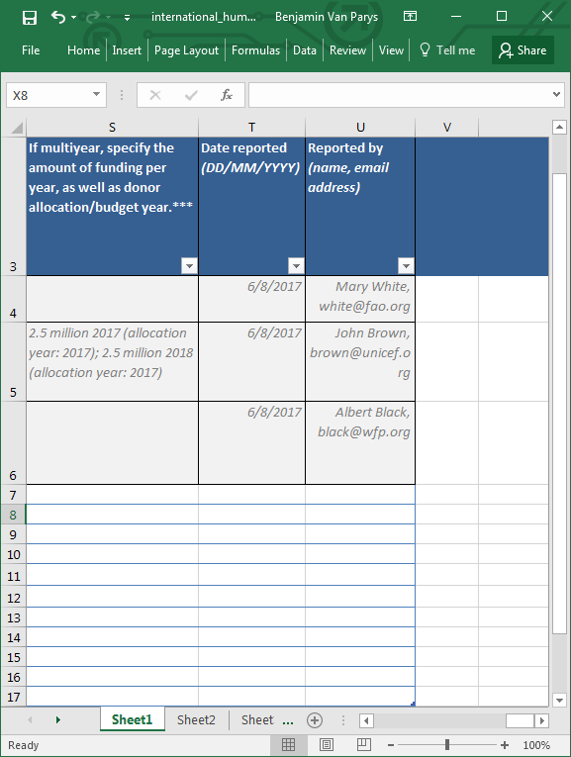
Contact Details
(for FTS internal use only)
REPORTED BY
Enter your full name and email address. This information is for internal use by FTS only, and will not be published.

Slide 23
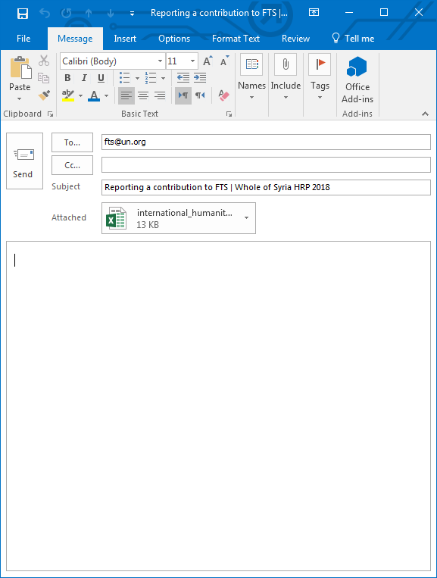
Submit the information
To submit the Excel sheet to FTS, please send by email to fts@un.org.
Please update regularly the information submitted to FTS.

Slide 24
OCHA FOCAL POINTS FOR FTS
Please contact OCHA focal points from the relevant hub by email if you require support to report contributions to FTS:
  Syria Hub
    Rima Ali: ali37@un.org
    Mona Aldib: aldib@un.org
  Turkey Hub
    Tamara Hallaq: hallaq@un.org
    Rawad El Zir: elzir@un.org
  Jordan Hub
    Zein al-Tayyeb: tayyeb@un.org

Slide 25
THANK YOU
The FTS team is fully open to help and support stakeholders to ensure a smooth reporting process.
Please contact FTS by email if you have any questions: fts@un.org

