Slide 1
Service de Suivi Financier (FTS)

Slide 2
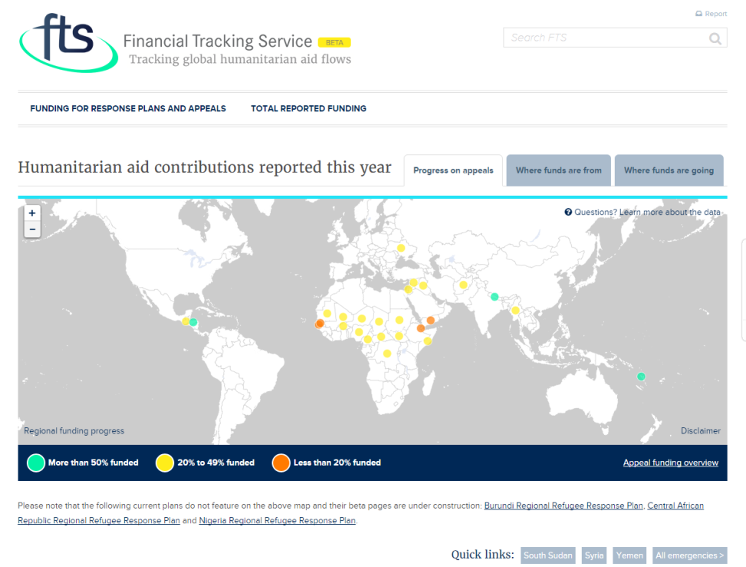
Pourquoi FTS est unique?
Il fournit des données comparables à l'échelle mondiale sur le financement humanitaire
Il met a jour en continue les contributions humanitaires
Il vérifie et regroupe les données provenant de diverses sources (donateurs, agences des Nations Unies, ONG, Croix - Rouge, secteur privé)
Il suit l’évolution du financement des plans de réponse inter-agence coordonnés
Notes:
FTS provides the humanitarian community with a data aggregation and curation service for funding in response to humanitarian emergencies – and with a unique, open data platform for visibility and transparency.
FTS is updated every day, continuously capturing and publishing new funding flows, amendments and any additional information reported by data providers, facilitating real-time decision-making
Data is verified according to standards, cross checked, aggregated to ensure accuracy and avoid double counting.
It is the only database that monitor progress to the interagency plans as mandated by GA resolution

Slide 3
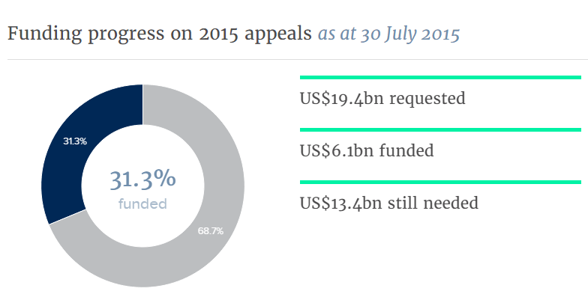
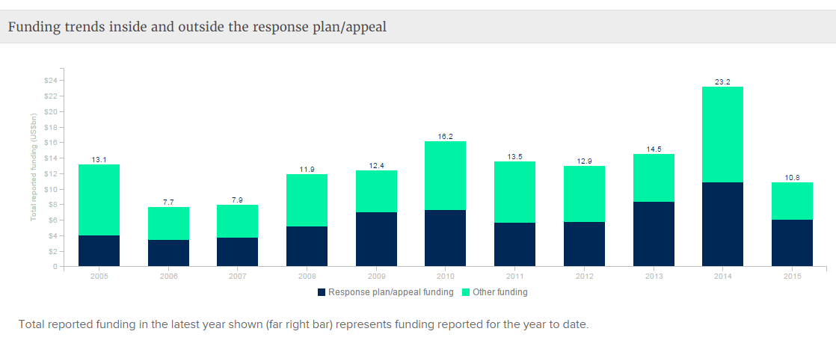
Qu’est-ce que FTS permet de faire?
Obtenir un aperçu instantané des derniers chiffres sur le financement humanitaire international.
Soutenir le plaidoyer et les efforts de mobilisation des ressources
Faciliter la prise de décisions dans le cadre de l'affectation des ressources
Analyser les tendances du financement
Fournir des données libres et des téléchargements.
Notes:
It facilitates resource allocations decision: Underfunded sectors or emergencies, agencies.
It helps in monitoring where and how humanitarian funding is used
It monitors appeal progress,
It assists with advocacy and resource mobilization efforts by highlighting gaps
It support both strategic and operational decision-making at the highest levels (resource allocations to underfunded crisis etc)
It helps in analyzing funding trends – by donor, sector, emergency or recipient agency.

Slide 4
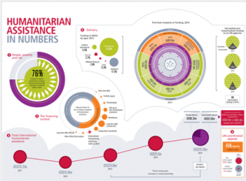
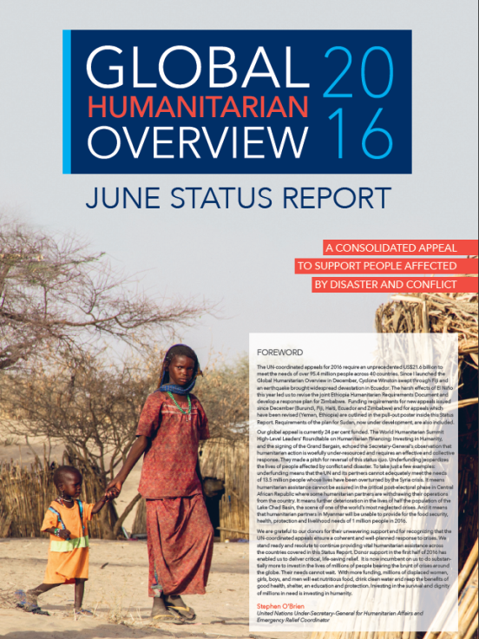
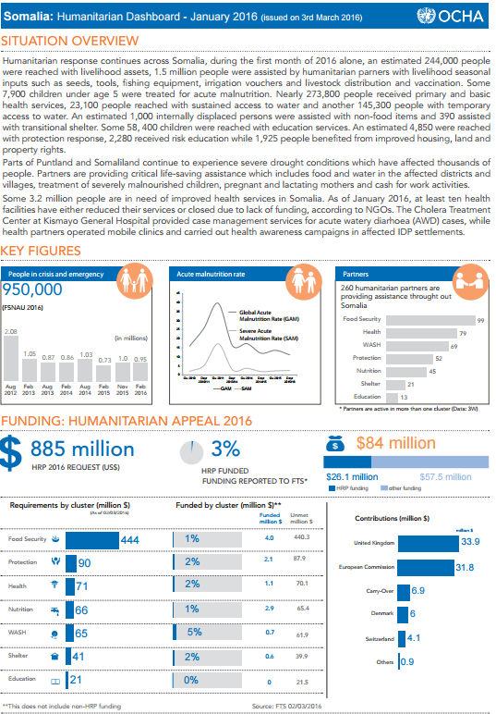
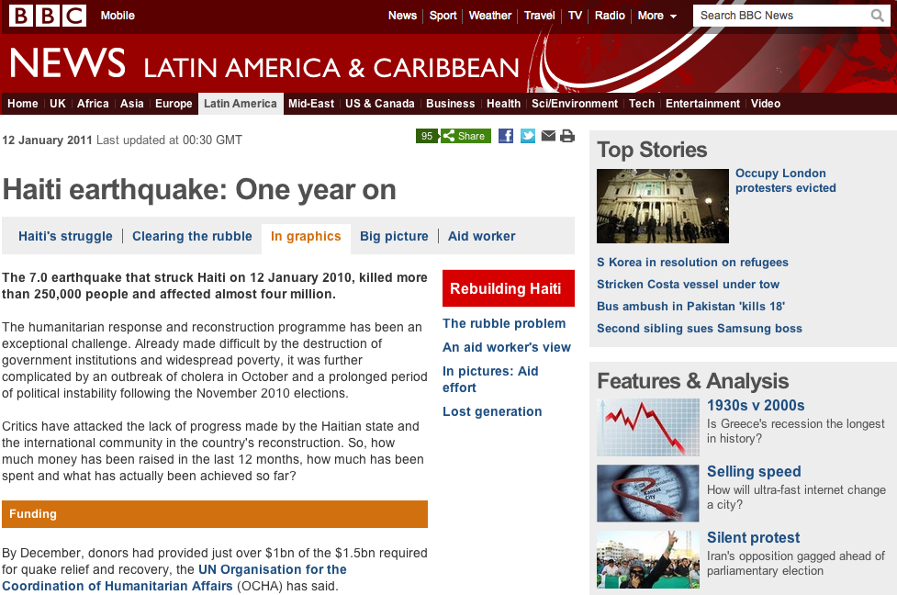
Qui utilise les chiffres de FTS?
Notes:
OCHA HQs for internal and external communication (Global Humanitarian Overview, Dashboard etc)
Humanitarian Coordinators and Humanitarian Country Teams
Operational agencies and host country governments
Government and institutional donors
Media
Researchers, academics and think tanks

Slide 5
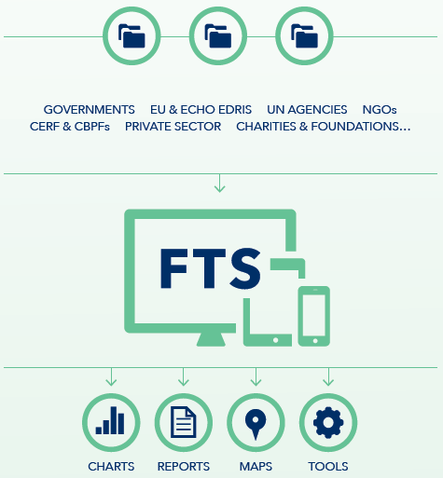
Qui rapporte sur FTS?
Il s’agit d’un mécanisme de rapportage volontaire: il est aussi bon que les données qu'il reçoit.
Avoir différentes sources permet une meilleure vérification, la granularité des données et éviter les lacunes d'information.
Les principaux donateurs rapportent par le biais des points focaux désignés officiellement dans les missions/capitales. Les membres de l'UE et ECHO rapportent à travers EDRIS.
Les agences de l'ONU rapportent principalement de leur siège, sauf PNUD,FAO, OIM
Les ONG rapportent soit de leur siège ou du terrain.
Notes:
Funding can be reported to FTS by a donor, by the recipient organizations or by both.
Not everybody is reporting and therefore , sources complement or substitute for each other.
FTS processes between 1,500 and 2,000 new contributions each month, each records can be amended three or four times as more data is received to complement the initial information. E.g. a donor reports unearmarked contribution which will in turn be reported by it the receiving organization without necessarily allocating it to specific activity or sector.
Information can be received in different format, by email, EDRIS automatic system with ECHO, on line form, fax, automated feed.
No matter the level of automatisation , all data is manually reviewed, verified, triangulated before being posted on line.
WHO, UNFPA , WFP, UNHCR, UNICEF, IOM have centralized reporting structures. Official reports can only come from their HQs. FTS is therefore not allowed to publish any figure reported from their country offices without each agency HQ verification and consent.
FAO and UNDP have decentralized reporting structures, therefore their country representatives should report to FTS.

