Slide 1
The Financial Tracking Service

Slide 2
Why we need FTS
Providing a unique service for the humanitarian community since 1992
Provides globally comparable data
Continuously updated to support coordination and decision-making
Curates data, verifying its accuracy, triangulating and cross-checking
Tracks how funding is allocated and used, particularly for inter-agency response plans
Notes:
FTS started 27 years ago, as a follow up to the resolution 46/182 which created the humanitarian coordination framework we still use today.
FTS registers any humanitarian funding directed to UN, NGOs, the Red Cross movements from government donors or private entities, or funding provided bilaterally to the affected governments. FTS does not cover resilience/development and longer term funding unless it is part of an interagency humanitarian response plan. It also does not cover internal spending of the government for humanitarian purposes.
FTS is a unique service, too easy for us to take for granted given its age. However, our colleagues on the development side have never had an equivalent information source to support their work.
There are four key elements that make FTS so unique.
1) it provides globally comparable data. It’s a central clearing house of information that allows us to ensure that we use the same standards and methodologies when processing the data from many different sources. This means that we don’t end up comparing apples and oranges, and can use its data to make informed decisions not just within, but across humanitarian crises.
2) it is continuously updated. There are several platforms or services which provide an after-the-fact account of what happened – including the OECD-DAC database on ODA. However, to be useful for coordination and decision-making, we need information in as close to real time as possible.
3) FTS is not just a platform or a database, but a service. In order to create the best possible ‘bigger picture’ of global funding flows, we piece together data from many different sources, each of which report in a different format and with varying degrees of accuracy, quality and timeliness. The information is processed by a team of data experts who verify, triangulate and cross-check all the reports before anything is published.
4) FTS doesn’t just report on funding flows, but focuses on how these flows are allocated and used – which organizations, projects and sectors are supported, particularly (but not only) within the framework of Humanitarian Response Plans.

Slide 3
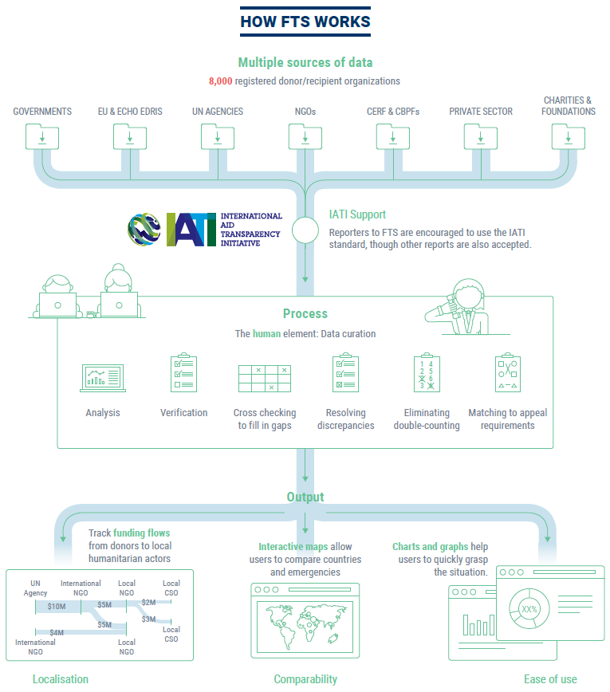
Who reports to FTS?
It is a voluntary reporting mechanism: it is as good as the data it gets
Different sources allows better verification, data granularity and avoid reporting gaps .
Major donors reports through officially designated focal points in missions/capitals.
EU members and ECHO report through EDRIS.
UN agencies mainly reports from HQs
NGOs reports either from HQ or field.
Notes:
Funding can be reported to FTS by a donor, by the recipient organization or by both.
Being a voluntary mechanism, not everybody is reporting and therefore, sources complement or substitute for each other.
FTS processes between 1,500 and 2,000 new contributions each month, each record can be amended multiple times as more data is received to complement the initial information. E.g. a donor reports an unearmarked contribution, which will in turn be reported by the receiving organization with specific project details or sectoral breakdowns.
Information can be received in different formats: by email, EDRIS automatic system from ECHO and EU member states, via an online reporting form.
The use of IATI standard to fulfill the reporting obligation is part of a pilot projects with a small number of participants.
No matter the level of automatisation, all data is manually reviewed, verified, and triangulated before being posted online.
Major donors report through an officially designated focal point in mission/capitals.
UN Agencies: WHO, UNFPA, WFP, UNHCR, UNICEF, have centralized reporting structures. Official reports can only come from their HQs. FTS is therefore not allowed to publish any figure reported from their country offices without the agency HQ verification and consent.
FAO and UNDP and IOM have decentralized reporting structures, therefore their country representatives should report to FTS.
NGOs report from HQ or field.
Press releases might be accepted on exceptional circumstances (usually in natural disasters), only if issued by the donor or by the recipient, provided that they contain data required by FTS for verification and posting.
Donors should encourage recipients organization to also report on a regular basis to FTS in order to improve details related to the use of the funding.

Slide 4
The FTS Flow Model
The database reflects the full complexity of humanitarian funding
Response plan
The basic tracked element is a ‘flow’, representing the movement of resources from a source to a destination
Sources and destinations can be organisations, funds, countries, plans, activities, clusters, projects, etc.
Donors
UN Agency
UN country office
Int’l NGOs
Carryover
Un-ear-
marked
Allocation
Pass-
through
Management cost
Local NGOs
Pooled fund
Donors
Contributions
Allocations
Management cost
Notes:
A massive transformation to the database in 2017 took place to make it fit for the future. The upgrade was necessary to better cope with the evolving data needs and tracking requirements, in particular those emerged from WHS and Grand Bargain.
FTS initially upgraded the way it looked, with more interactive pages, more graphs, ready to use material that can be customized by non IM experts. Fundamentally 3 levels, 1) key figures with visuals, 2) easier access to data through the data tab allowing some minimum customization and search, and 3) full data search.
The new database is based on a ‘flow model’. Basically, every piece of data is treated as a financial flow from a source to destination. The destination can be anything – an organization, country, sector, plan, project, or any combination of them. This means that FTS can better reflect partial or incomplete information – vital for a continuously updated service. It also means that FTS can link flows together, which is essential to be able to trace flows through successive implementing partners until the final recipient.
Beforehand, FTS only tracked the top-level flows, which means that it could simply add everything together to get the big picture. Now, tracking pass-through funding means that there additional layers of complexity to be carefully considered to avoid double counting. The model helps doing this by showing which flows are incoming, internal or outgoing for any particular organization or plan.

Slide 5
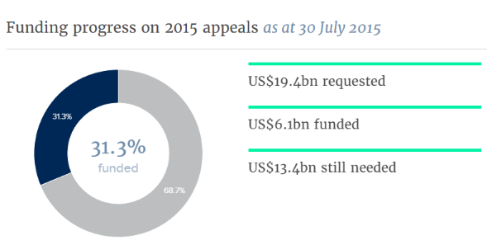
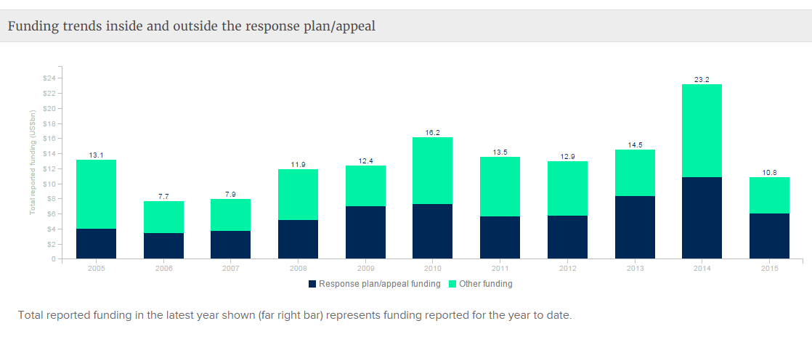
What does FTS allow you to do?
Get a snapshot in time of the latest figures on international humanitarian funding.
Assist with advocacy and resource mobilization efforts
Facilitate resource allocations decision
Analyze funding trends
Provide open data and downloads.
Notes:
It helps in monitoring where and how humanitarian funding is used
It assists with advocacy and resource mobilization efforts by highlighting funding gaps , especially against the requirements of an HRP
It facilitates resource allocation decisions. It allows donors to direct funding to where it is most needed, providing an overview of who is doing what to respond to crises and highlighting under funded sectors or projects.
It helps in analyzing funding trends – by donor, sector, emergency, or recipient agency
FTS supports the transparency and accountability of the humanitarian system : it informs real-time decision-making at both national and global levels across all humanitarian emergencies and actors.

Slide 6
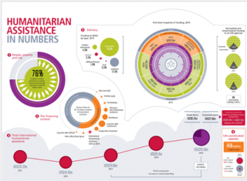
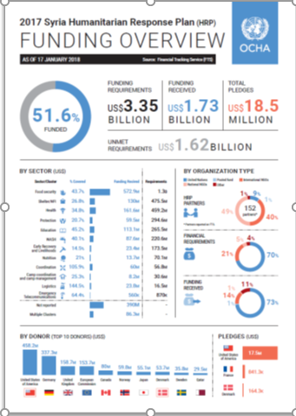
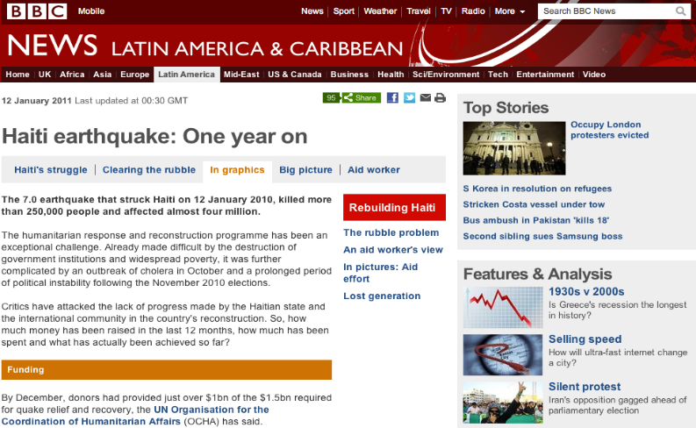
Who uses FTS data
Notes:
FTS data is used for various type of internal and external analysis and products.
It feeds key OCHA public products, like funding overviews, the global humanitarian overview report, but it is also used by external partners, the media, research institutes and the general public.

Slide 7
Where to find out more, and to report your contributions
→ Visit fts.unocha.org
→ Email fts@un.org

