Slide 1
Country Specific Common Operational Dataset (COD-CS)
December 2021

Slide 2
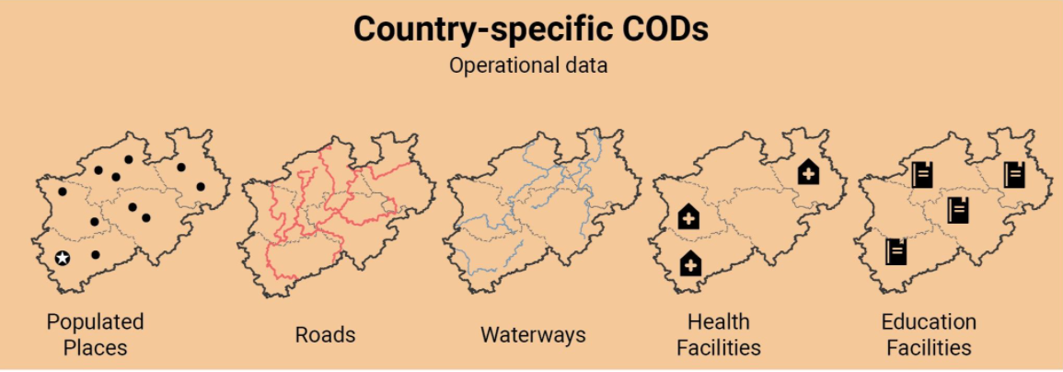
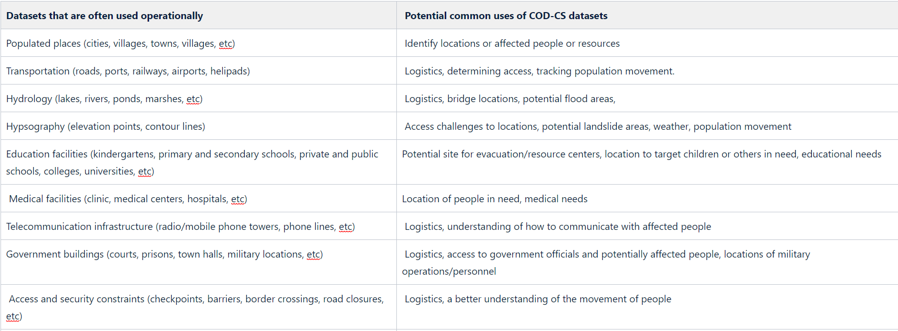
Examples of COD-CS

Slide 3
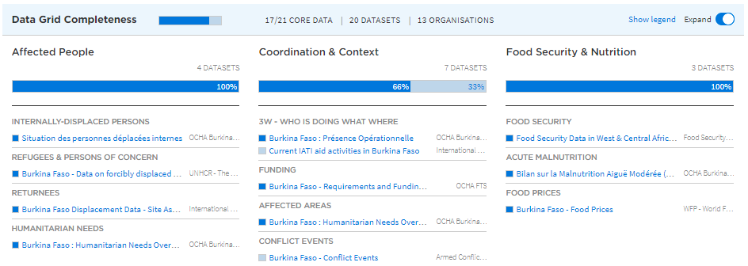
HDX Data Grid vs COD-CS
The Data Grid has same data category for all countries
COD-CS varies depending on risk and hazard profile of a country
The Grid doesn’t include topographical data such as DEM, river, etc.

Slide 4
Process
Requires the active participation of field IMOs and IMWG in country
Make use of existing relationships with Gov’t and agencies, processing of data should be shared
Start by reviewing (if there is any) what is tagged as COD on HDX (other than COD-AB & COD-PS)
If needed, FIS can provide support in the review
Notes:
FIS’s role is to encourage field IMOs to use existing relationships for this process
Data cleaning and processing shouldn’t be the work of OCHA in the case of COD-CS, other actors can share the responsibility
WFP/Logistics cluster can take the responsibility of cleaning, processing, updating road, airports, data if these data are identified as COD-CS

Slide 5
Steps to identify COD-CS
Examine country's risks and hazards (or current emergency)
Identify and prioritize dataset needed for response
Add dataset to the COD data plan
Evaluate dataset (in case multiple data)
Develop data agreement
Start COD-CS cycle

Slide 6
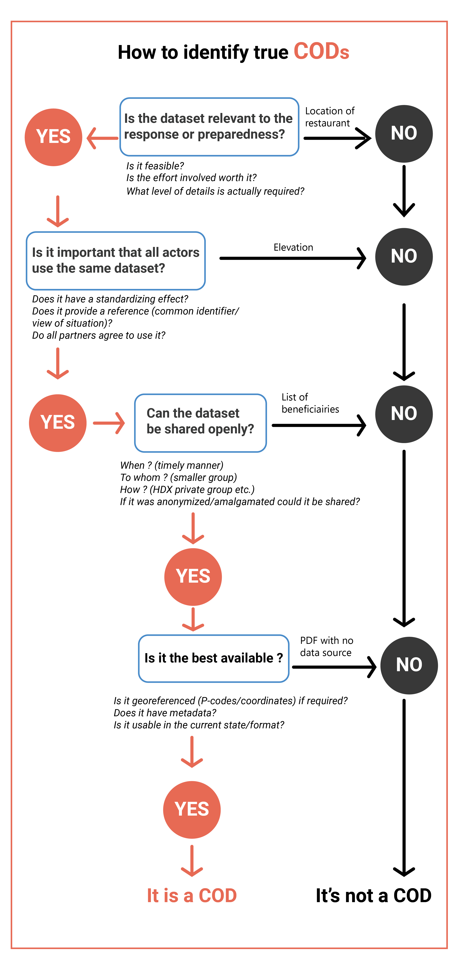
What is COD?

Slide 7
Types of COD-CS
CODs for Natural Disasters
  Potential datasets; pre-crisis and post-events related to natural disasters
CODs for Complex Emergencies
  Potential datasets crisis specific
  Not all datasets are CODs!!

Slide 8
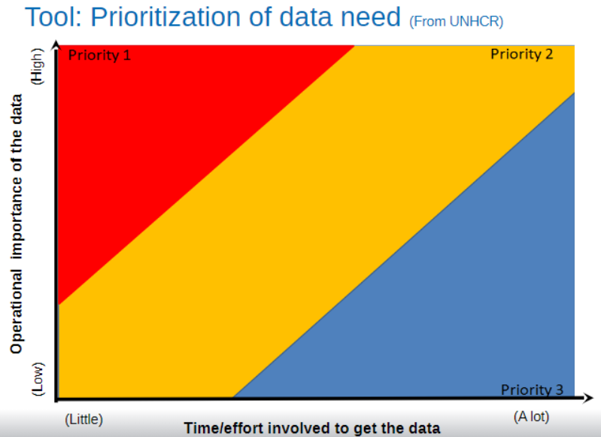
Prioritization tool of data need (From UNHCR)

Slide 9
Suggested Standards of COD-CS
Consider adding P-codes to your data (consider the return on investment)
HXLate your data to improve interoperability
Data items should be clear or explained in metadata
Metadata should be clear

Slide 10
Follow up (Field IMOs)
Follow the COD cycle and do yearly revision
Review and revise the list of COD-CS
Ensure only datasets agreed by IMWG are tagged as ‘COD’ on HDX
Provide feedback to FIS on the COD-CS guidance/standards

