Slide 1
RPM: Monitoring data entry process A step-by-step guide for Cluster Leads

Slide 2
This step-by-step guide covers:
1 - Logging in
2 - Interpreting displayed planning data
3 - Adding results data per indicator
4 - Adding results data in bulk
5 - Verifying your data using the Viewer
6 - Verifying your data using Excel

Slide 3
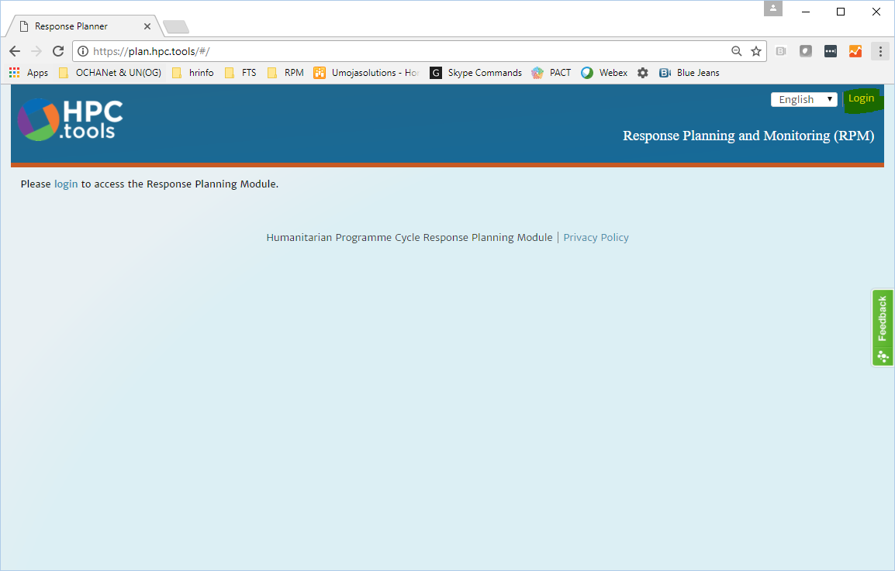
1 - Logging in
1.1 - Navigate to plan.hpc.tools and click Login in the top-right corner.
- We recommend using the latest version of Chrome or Firefox.

Slide 4
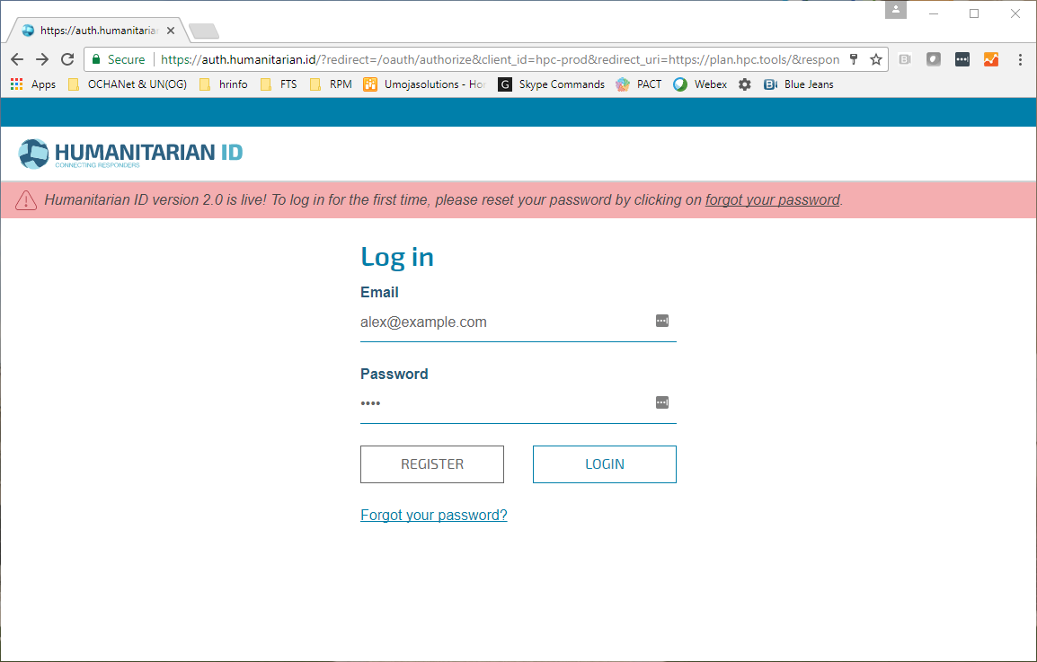
1 - Logging in
1.2 - Enter your H.ID credentials:
If you do not have an H.ID, please create a profile at humanitarian.id.
If you are logging in for the first time, H.ID will ask you to authorize RPM. Please do so.

Slide 5
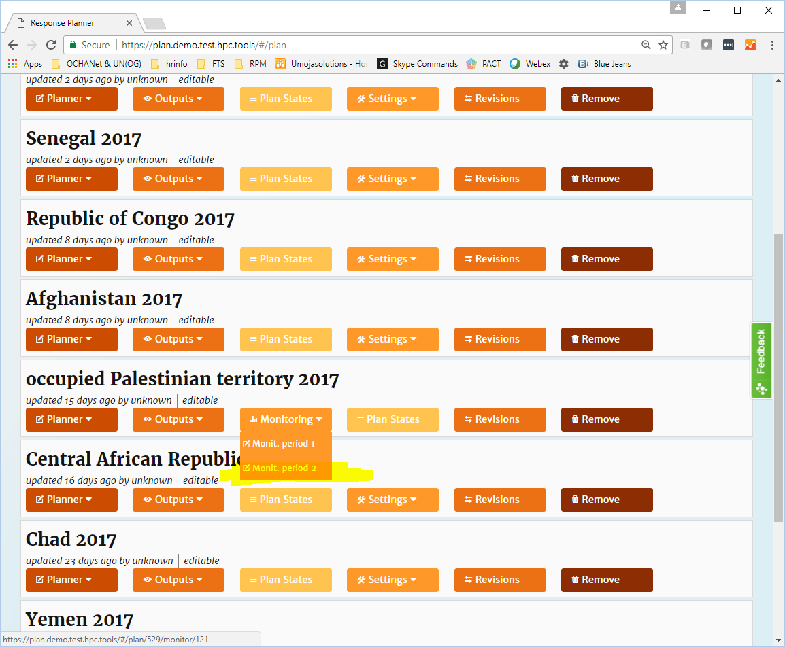
1 - Logging in
1.3 - Buttons are displayed for your plan. Click Monitoring, choose the period..

Slide 6
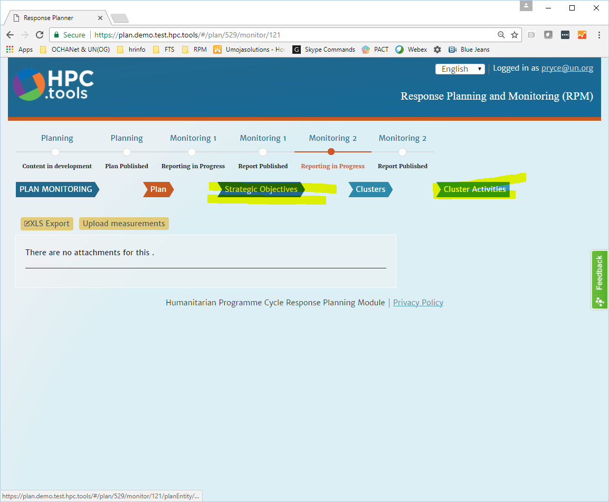
2 - Interpreting displayed planning data
2.1 – The plan hierarchy levels are displayed. Choose the level you wish to view, e.g. Cluster Objectives or Cluster Activities.

Slide 7
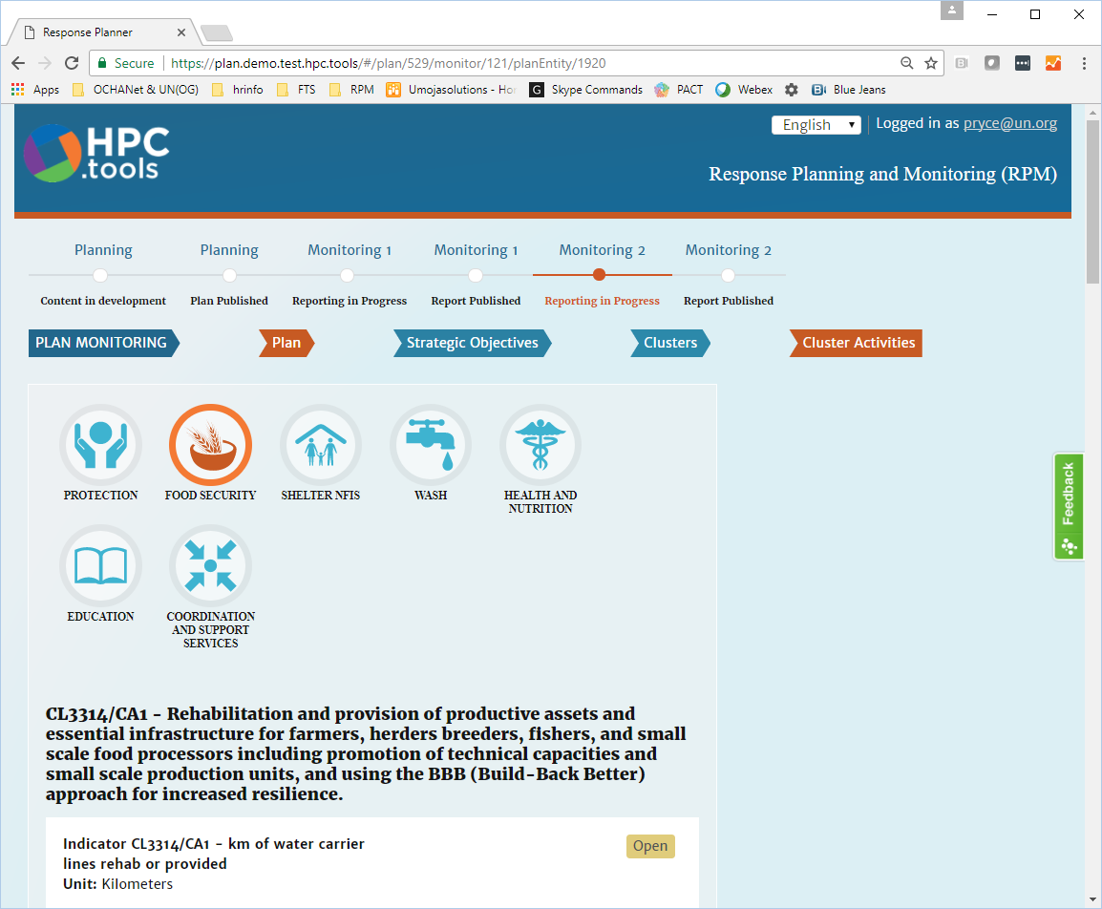
2 - Interpreting displayed planning data
2.2 - Select your cluster using the icons provided.

Slide 8
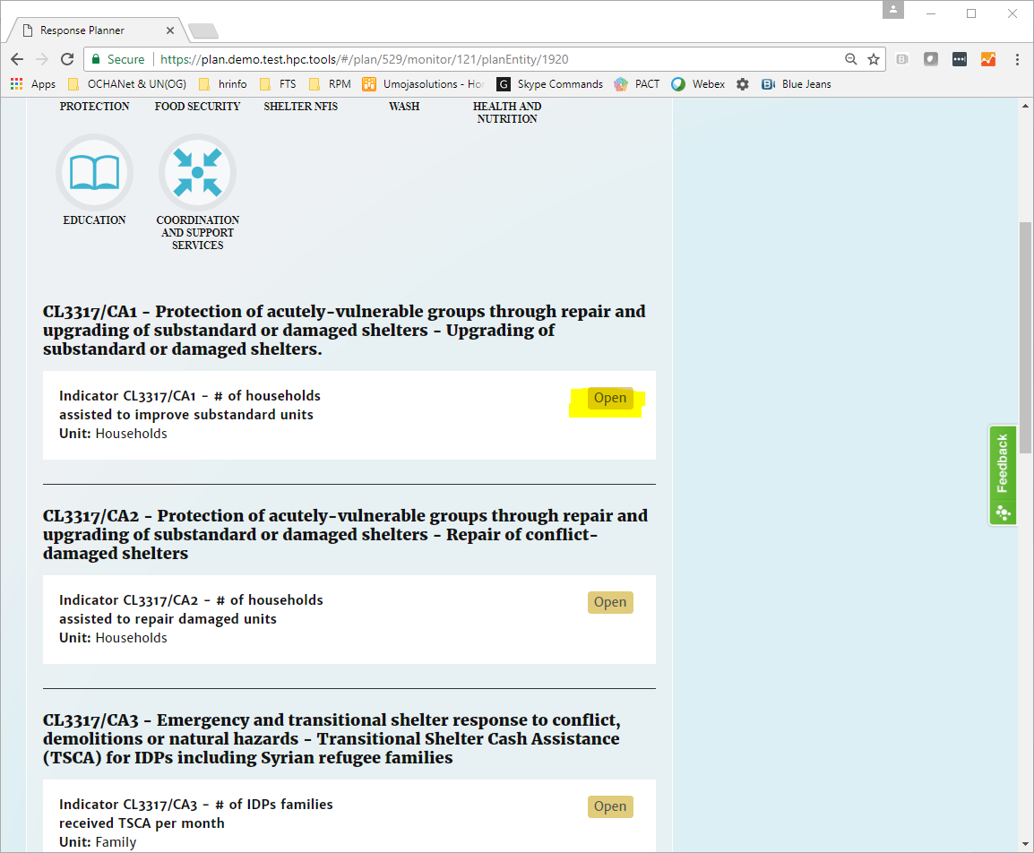
2 - Interpreting displayed planning data
2.3 - The elements for the selected hierarchy level and cluster are listed, e.g. all Shelter Cluster Activities, with indicators for each. Click Open on an indicator to view its data.

Slide 9
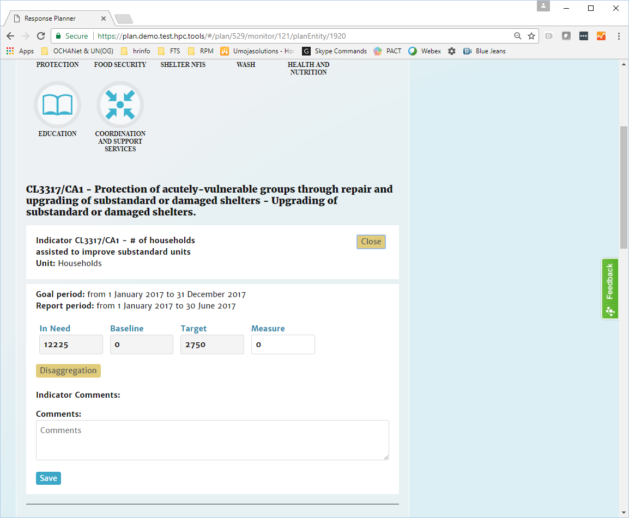
2 - Interpreting displayed planning data
2.4 - The tool displays the target figures defined during planning, usually In need, Baseline and Target, as well as the previous period’s published result data, if any exists.

Slide 10
3 – Adding results data per indicator
3.1 – Select the indicator for which you wish to add data (see 2.1 – 2.4):

Slide 11
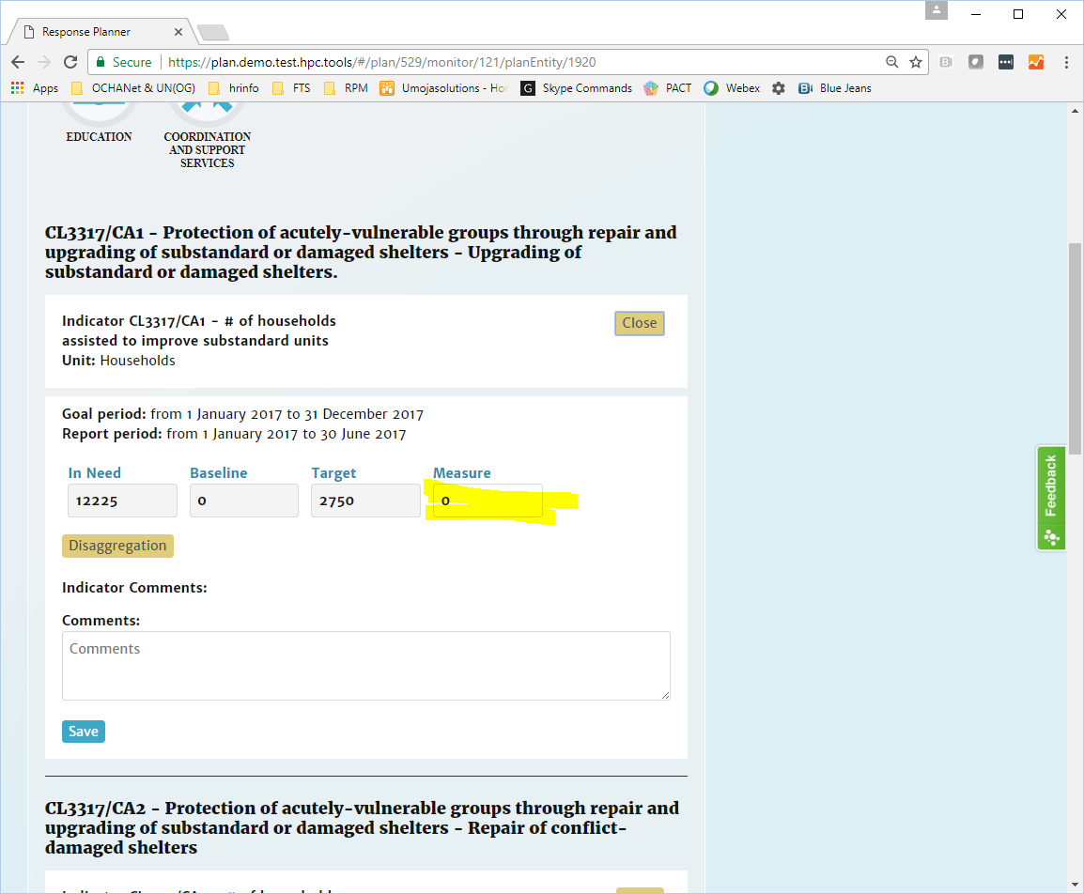
3 – Adding results data per indicator
3.2 - To enter a single result for the indicator, simply add it to the Measure field displayed alongside the planning figures and any previous result.

Slide 12
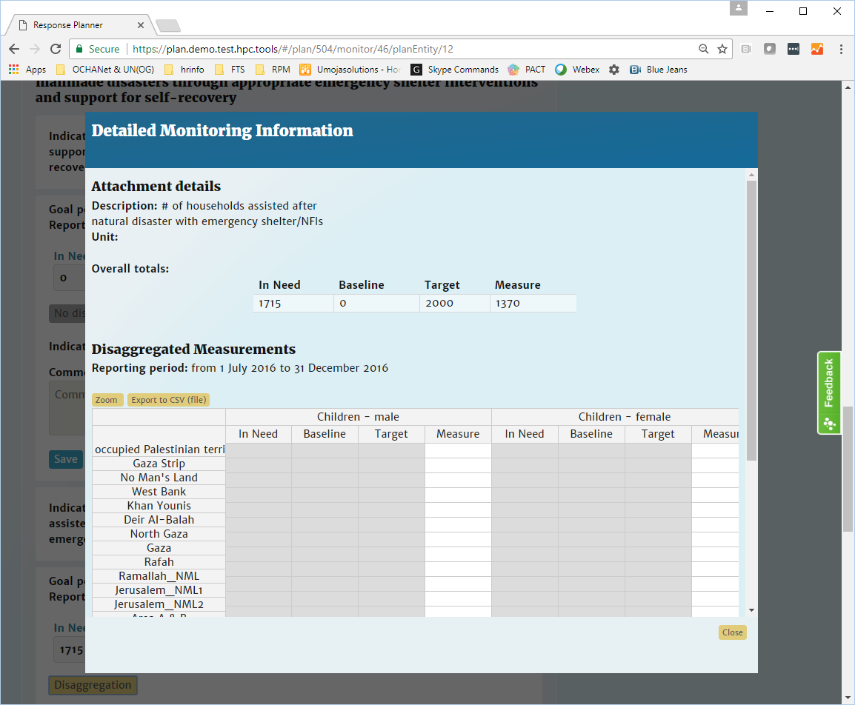
3 – Adding results data per indicator
3.3 – To enter disaggregated results, click Disaggregation and complete the form.

Slide 13
3 – Adding results data per indicator
3.4 – Entering disaggregated data, continued:
- No calculations are made at this time. Make sure to enter any relevant subtotals and totals along with granular data.
- You can enter multiple values at once by selecting the range of destination cells and simply pasting the range to it. Please ensure that the arrangement of rows in the source matches that in the form on-screen.
- To maximize the form view, click Zoom.
- Save your data and close Disaggregation by clicking Save and continue.

Slide 14
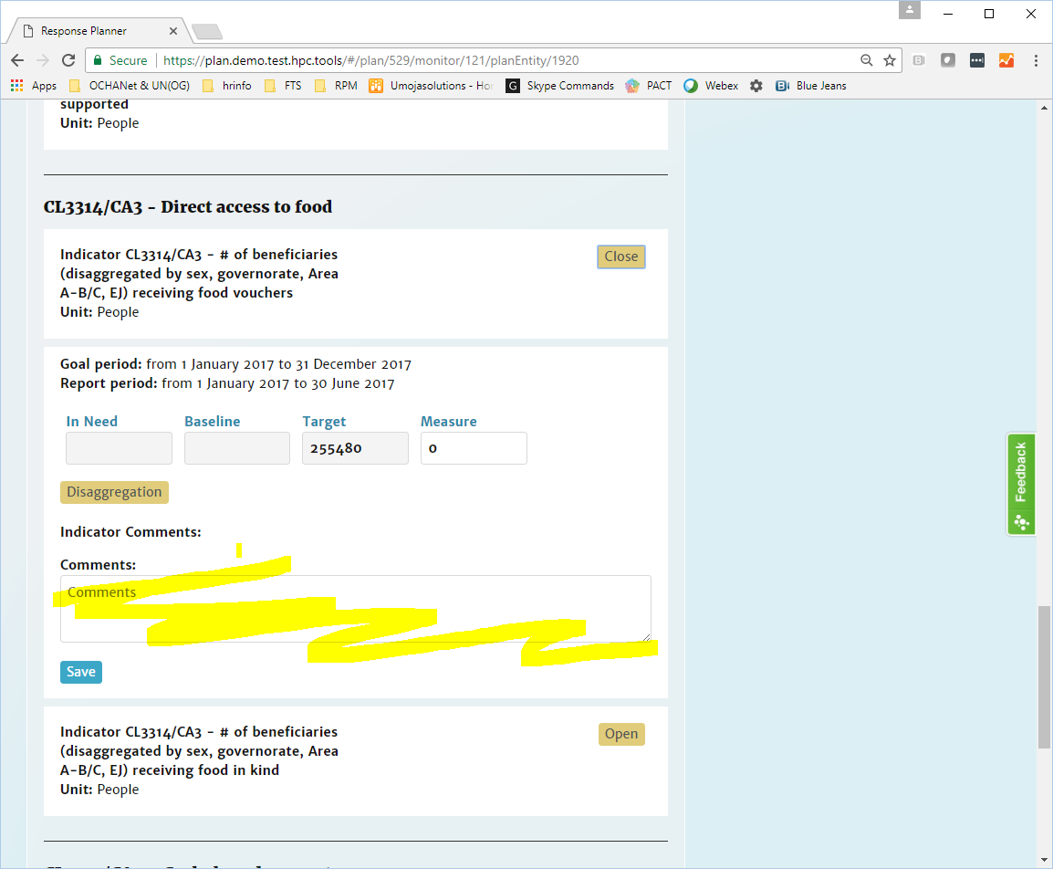
3 – Adding results data per indicator
3.5 – Enter any comments in the field provided and click Save.

Slide 15
4 - Adding results data in bulk
4.1 - From the Monitoring menu, select the period you wish to add data for.

Slide 16
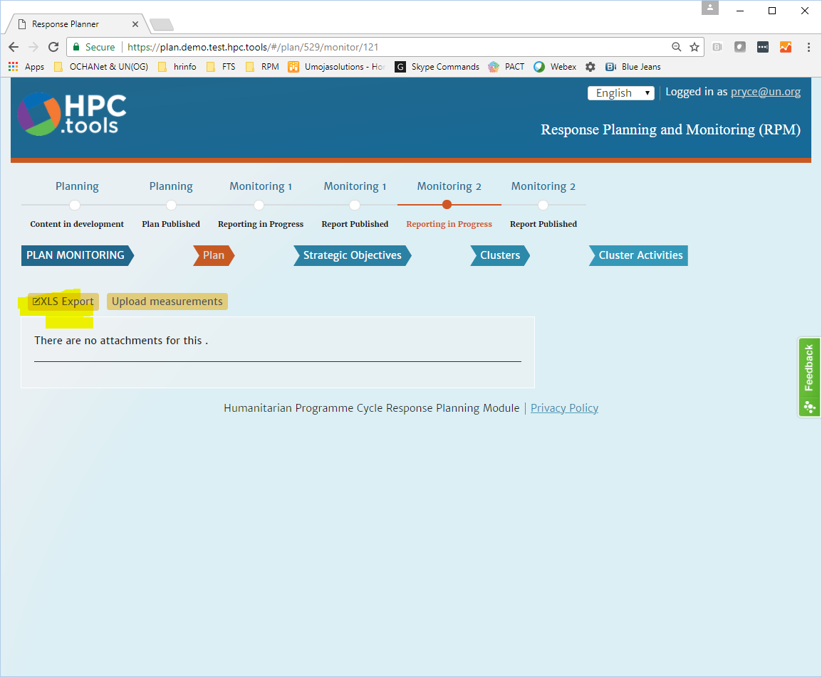
4 - Adding results data in bulk
4.2 – Click XLS Export to download the reporting template.

Slide 17
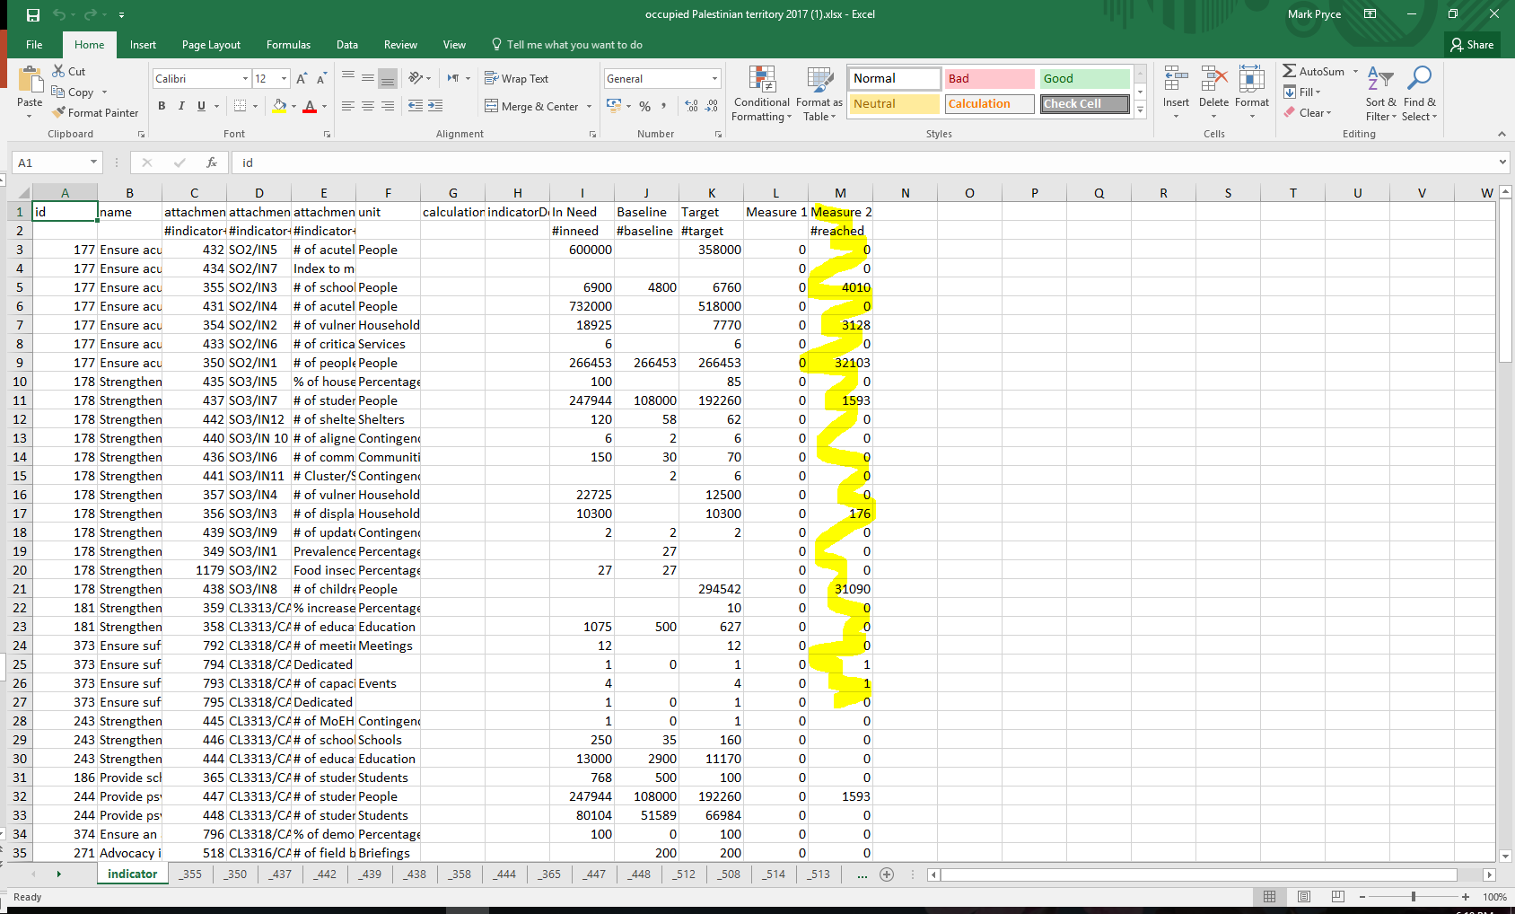
4 - Adding results data in bulk
4.3 – For your indicators, complete the measurements column in the xls file.
NB. You have write access to your cluster and read access to all others. Any data added against indicators outside the cluster(s) for which you have write-access will be rejected.

Slide 18
4 - Adding results data in bulk
4.3 – continued.
- Aggregate results per indicator can be added in the single column in the tab labelled indicator, as instructed above.
- For disaggregated data the file includes further tabs, one for each indicator. To find your indicators, scroll right through the tabs until you find the Custom IDs for your indicators.
- These tabs are organized with rows per location and columns for each category.
- Add your data and save.

Slide 19
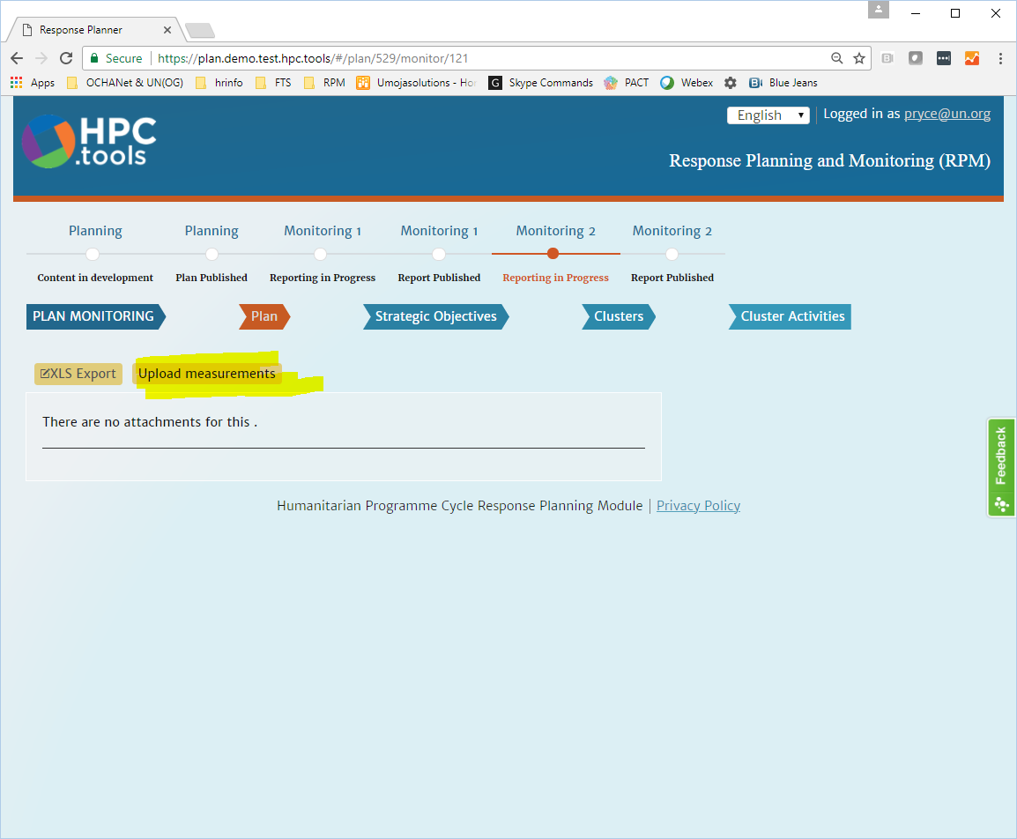
4 - Adding results data in bulk
4.4 – Back on RPM, click Upload measurements.

Slide 20
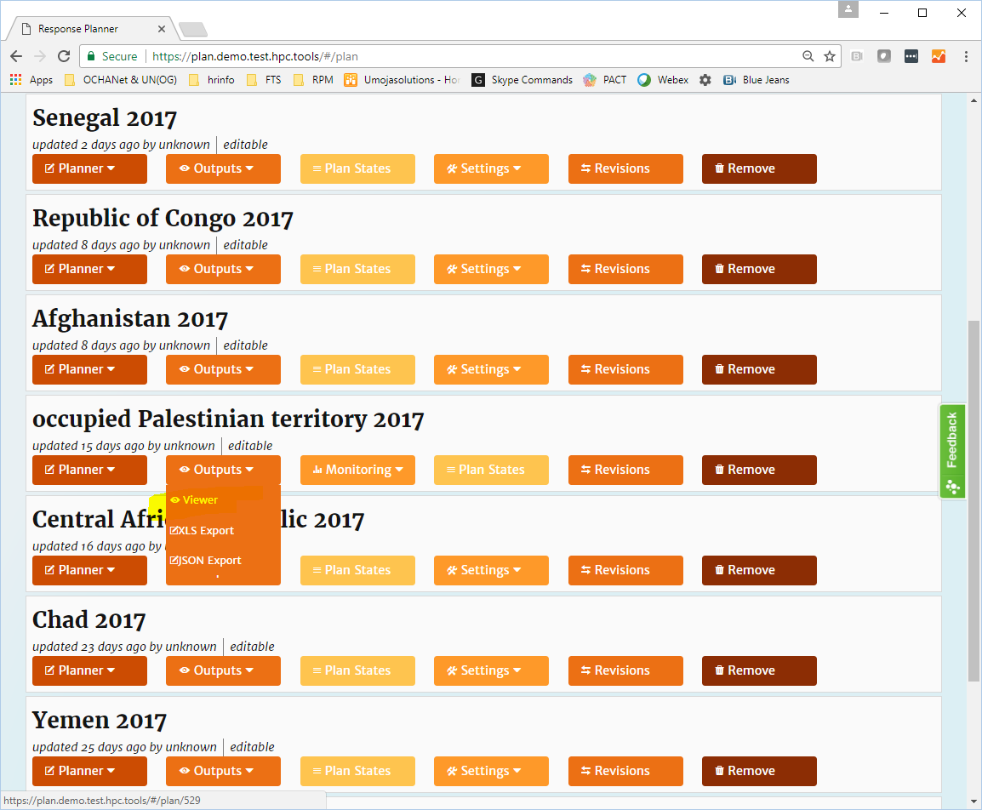
5 - Verifying your data using the Viewer
5.1 - From the Outputs menu, choose Viewer.

Slide 21
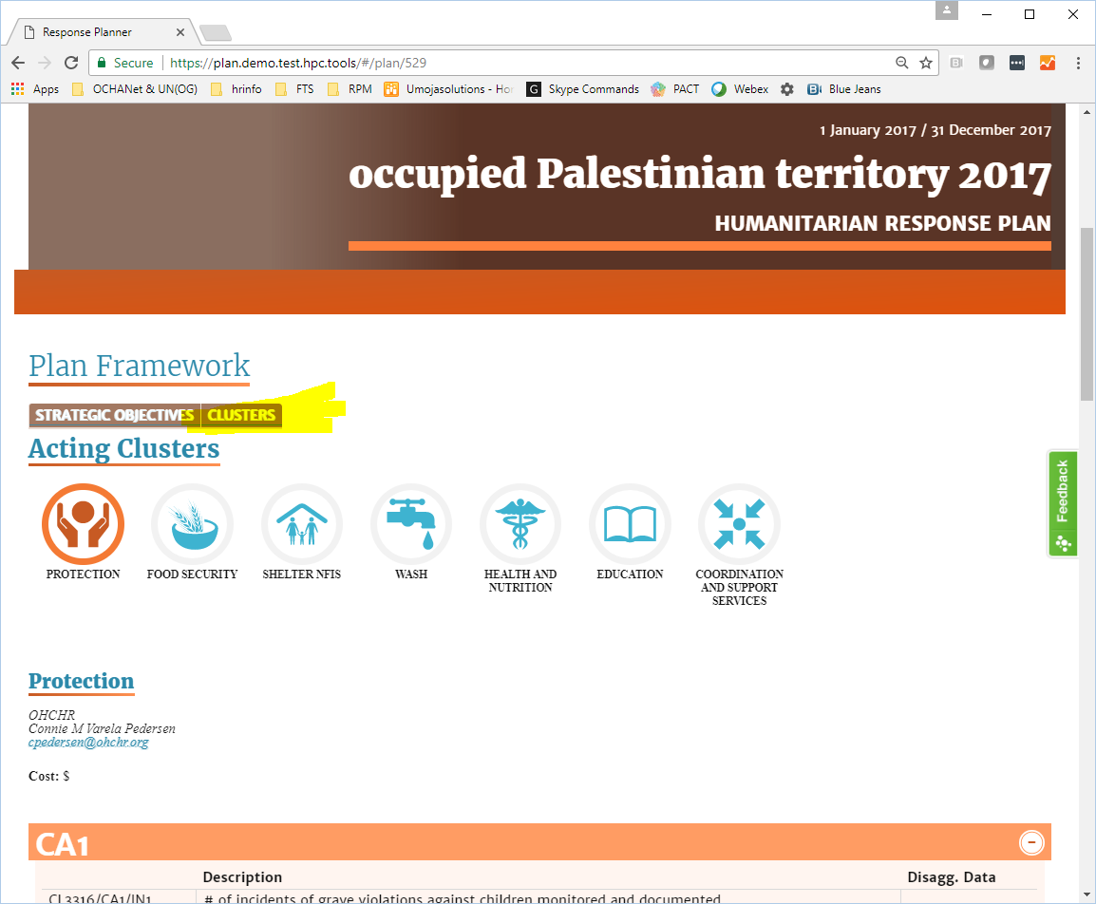
5 - Verifying your data using the Viewer
5.2 – Navigate to your cluster using the on-screen navigation.

Slide 22
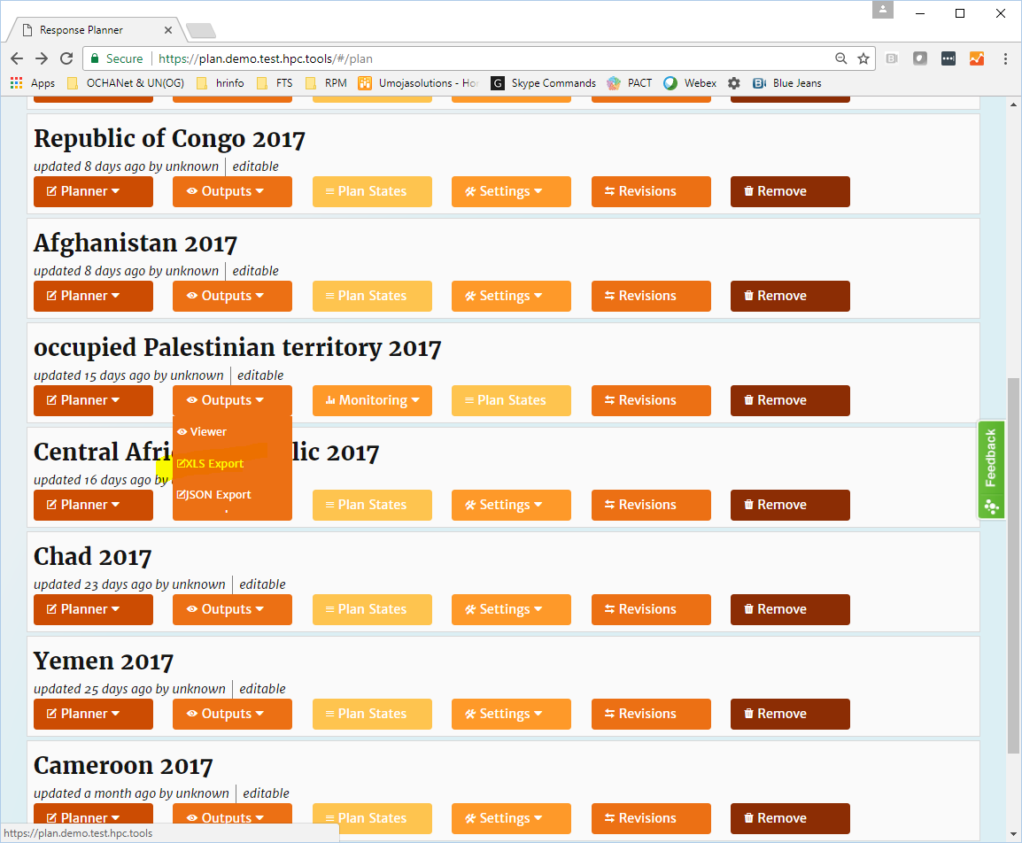
6 - Verifying your data using Excel
6.1 – In the Outputs menu, select XLS Export and browse the file.
- JSON downloads and API access are also available.

Slide 23
Any questions?
Feel free to email the HPC-IS team at OCHA HQ:
Mark Pryce - pryce (at) un (dot) org
Anwar Mahfoudh - mahfoudh (at) un (dot) org

