Slide 1
COUNTRY NAME
Sub-title
As of DD Month YYYY
The boundaries and names shown and the designations used on this map do not imply ofﬁcial endorsement or acceptance by the United Nations.
Creation date: DD Mmm YYYY Sources: XXXX, XXXX, XXXX. Feedback: xxxx@un.org www.unocha.org www.reliefweb.int

Slide 2
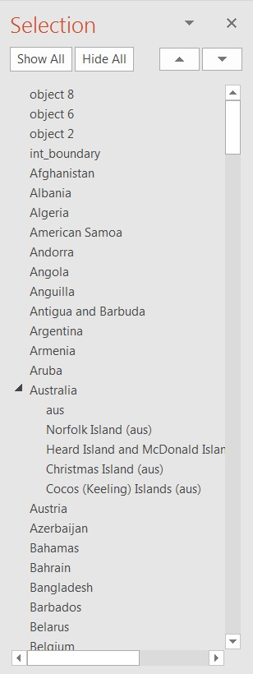
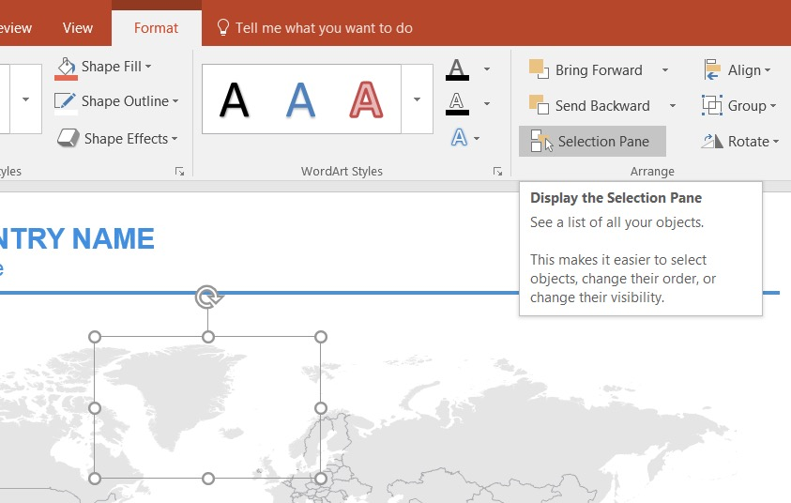
Guideline: Step by step
Activate the Selection Pane by selecting a object on the map > Format tab > Selection Pane. A side bar will appear.
2
3
1

Slide 3
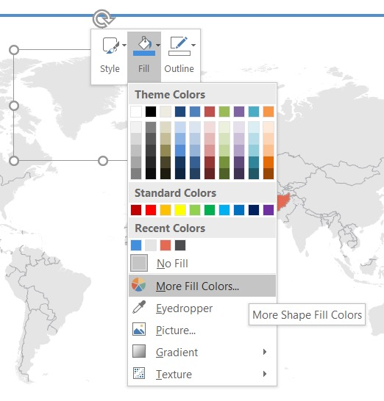
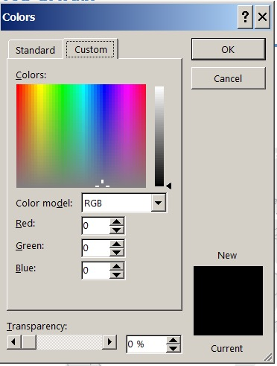
Guideline: Step by step
Select the country you want to highlight in the Selection Pane. The shape will be highlighted on the map.
Right-Click on the shape and go to Fill option.
Change the Fill of the shape with the color you want. For better control use the More Fill Colors option so you can set the RGB values.

