Slide 1
Tool: Prioritization of data needs (From UNHCR)
This is a tool developed by UNHCR to help prioritize information needs to be collected in assessments but it can also be used to prioritize data needs
Instructions
In your IMWG or with partners
Project this graph on a wall or flip chart (without the colour bands showing)
Identify datasets (include criteria identified under *, **, ***) – best if these are written on Sticky notes
Groups discuss their operational importance and amount of time and resources required to acquire the dataset
Place the sticky note in the appropriate spot on the graph (no colour bands showing)
The PPT is animated so you can click your mouse and the colour bands will appear and dataset are then grouped by priority, leading to an easier way of planning and collecting datasets (if you keep the colours off it can make the conversation more practical than political).
The group can then discuss data sources/ways to acquire the data/any changes that may be required
* To which administrative level required
**Data Volume: Unit of measurement affects data volume , e.g. normally HH level vs community level, vs admin level
***Other criteria that should be discussed
The quality of the data
If it is more useful later in the response
What value does the data offer
Does the data already exist somewhere and can some organization (out side of the response) help process it if required

Slide 2
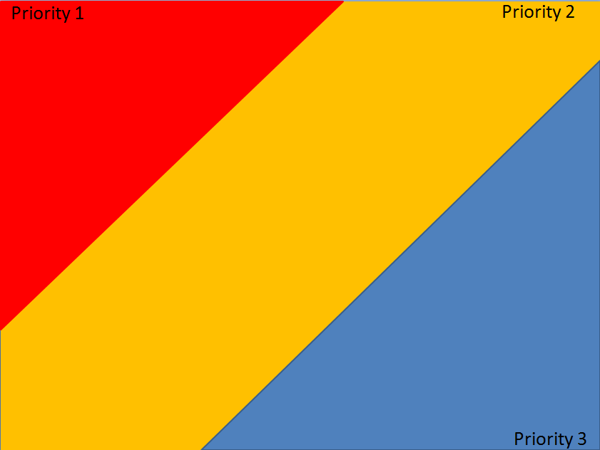
Tool: Prioritization of data need (From UNHCR)
(High)
Operational importance of the data
(Low)
(Little)
(A lot)
Time/effort involved to get the data

